Slide 1
Initiatives towards TBO in Japan
Shoji YOSHIDA
Director General
Air Navigation Services Department
Japan Civil Aviation Bureau

Slide 2
CARATS
In Japan, initiatives toward TBO are being promoted within the framework of CARATS.
Collaborative Actions for Renovation of Air Traffic Systems (CARATS) is long-term action plan to renovate Air Traffic Systems in Japan.
Led by the Japan Civil Aviation Bureau (JCAB) and in cooperation with industry, academia, and government, a long-term vision is being formulated to respond to increasing air traffic and user needs, and to contribute to economic growth and global warming countermeasures.
Industry
Academia
Government
Airline, Aviation-related manufacturers
Research institutes, Universities
JCAB, Related government authorities

Slide 3
CARATS categories for TBO
CARATS measures are broadly classified into eight categories.
Each category is linked to the ICAO ASBU, but not one-to-one.
Each category is interrelated and contains the measures which are essential to achieving TBO.
Classification |  | Related ICAO ASBU
SUR | Surveillance | ASUR, SURF
COM | Communication | COMI, COMS
NAV | Navigation | APTA, FRTO, NAVS
MET | Meteorological | AMET, SWIM
DCB | Demand and Capacity Balancing | ACDM, FRTO, NOPS
APO | Airport Operations | ACDM, APTA, CSEP, RSEQ, SURF, WAKE
INF | Information Management | DAIM, FICE, SWIM
TBO | Trajectory Based Operations | APTA, CSEP, FICE, FRTO, OPFL, RSEQ, TBO

Slide 4
CARATS measures towards TBO (1 / 3)
- 2023
- 2030
2031 -
ADS-B
Wide Area Multilateration (WAM)
Surveillance
Downlink Aircraft Parameters (DAPs)
Improve Tracking Accuracy by DAPs
Weather Data from DAPs
Expand Domestic CPDLC Message Set
CPDLC in Domestic Airspace
ATN/IPS & ATS B2 (D-TAXI/D-RVR/ HZWX/EPP)
Communication
RNP2
RNAV5/RNP2
A-RNP (TOAC)
Navigation
LP/LPV
RNP to ILS
GBAS CAT II/III
Conversion of WX Information to Operation/Capacity
High Temporal/Spatial Resolution Forecast
Full MET-ATM Integration
Meteorological

Slide 5
CARATS measures towards TBO (2 / 3)
- 2023
- 2030
2031 -
En-route Airspace Separation by Altitude (Eastern Japan)
En-route Airspace Separation by Altitude (Western Japan)
Complexity Management
Demand
and
Capacity
Balancing
Dynamic Sector Boundary
Multi-Sector Planning
Dynamic Airspace Configuration
Cross Border CTO
Calculated Time Over (CTO)
Time Based Management
AMAN/PMS
Integration of AMAN and DMAN
Airport
Operations
DMAN/SMAN
Time Based Wake Separation Minima

Slide 6
CARATS measures towards TBO (3 / 3)
- 2023
- 2030
2031 -
Regional IP Network
Global SWIM Air/Ground SWIM
Ground/Ground SWIM
Information
Management
FF-ICE/Release 1
FF-ICE/Release 2
Direct Routings (DCTs)
DARP in En-route Airspace
Free Route Airspace (FRA)
CDO
CDO by CPDLC (ATS-B2)
CDO by CPDLC (FANS 1/A)
Trajectory
Based
Operations
En-route Metering
Interval Management
Pre-departure Trajectory Negotiation
Post-departure Trajectory Negotiation

Slide 7
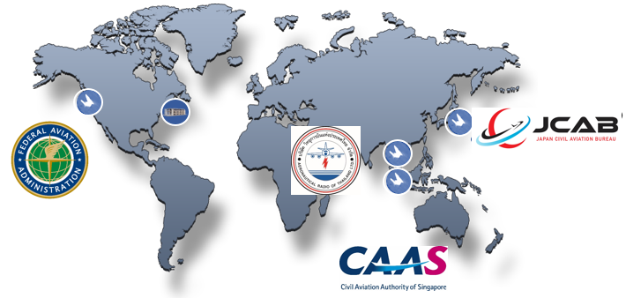
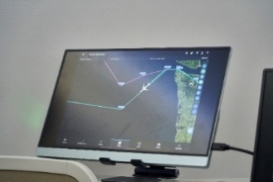
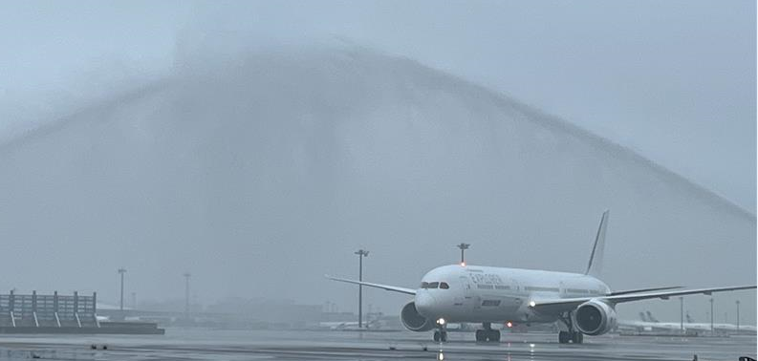
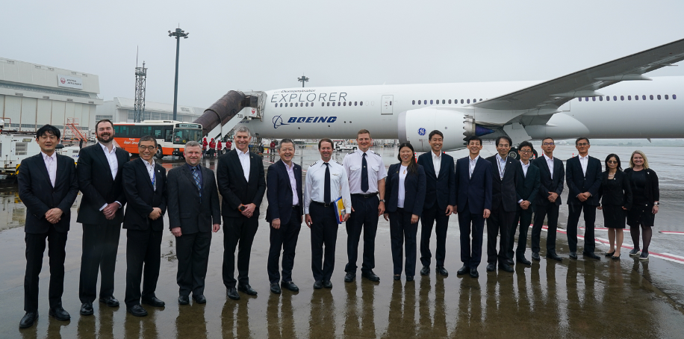
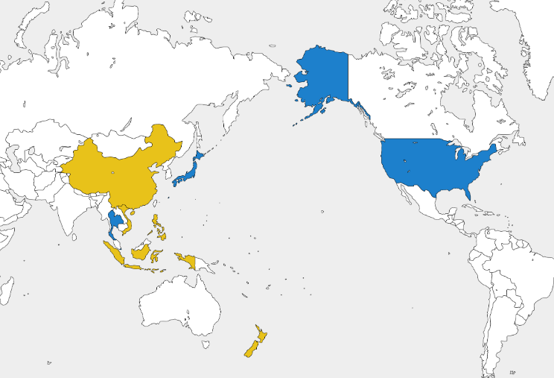
TBO Validation Activities
○ In June 2023, in collaboration with the aviation authorities of the United States, Singapore and Thailand, and Boeing company, we conducted the world's first test flight using an actual aircraft to verify the practical utility of Trajectory Based Operations.
Ceremony at Narita Airport
ecoDemonstrator
Boeing 787
Signing Ceremony at
Air Navigation World 2023
○ From 2024, “APAC TBO Pathfinder Project” started.
○ China, New Zealand, the Philippines, Indonesia and Vietnam have been newly added to the group, and within the next four years, the 9 participating countries plan to jointly conduct test flights using actual aircraft to specifically verify the operational use case and benefit of TBO.
Continue to participate from MR TBO Demo
Newly joining Pathfinder Project

Slide 8
Thank you

