Slide 1
GLOBAL TBO SYMPOSIUM
Taking TBO global
Bryan Jolly
EASA – Senior ATM/ANS Expert Innovation/SESAR
June 2024

Slide 2
Trajectory Based Operations
What is TBO ?
FF-ICE
Improves flight planning and trajectory prediction
ADS-C/EPP
Improves trajectory management
CPDLC
Facilitates issuing of complex clearances
Data sharing
Facilitates upto date information availability

Slide 3
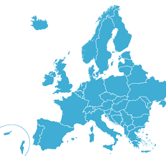
Implementation
Regulated entity
Air Operator
Others Req.
ATM/ANS provider
Airspace
Airport Operator
ATM/ANS System
Airworthiness
Regulatory consideration
Effected parties
Airspace users
ATM Service Providers
Airports
Access Impact on safety, interoperability security and sustainability)

Slide 4
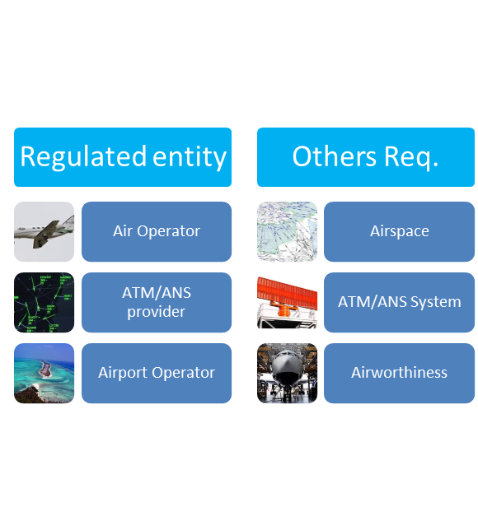
Global Harmonisation - Implementation
What do we need to
More efficient airspace operations
Correct implementation objectives
Known requirements

Slide 5
Global Harmonisation
What are the Keys to success ?
Compatible solutions and Procedures
Aligned
Global Air Navigation Plan,
EU ATM Master Plan,
Regional Implementation plans
Concept
Air/Ground Sync
Harmonisation regulatory requirements
Internationally agreed Standards/Norms
Standardisation
Regulations

Slide 6
Thank you for your attention!

