Slide 1
Iris Satcom contribution to TBO:
Europe and Worldwide
ESA Iris Team
4-6/06//2024

Slide 2
Four main enablers for TBO
ATS B2
AVIONICS
1
AIR-GROUND
DATALINK
2
FF-ICE
4
3
ATS B2 SERVICES
TBO requires enabling trajectory negotiation anywhere, anytime...so, it is a global challenge!

Slide 3
… but today the global situation looks like this…
FANS1/A in USA
1) ACARS based datalink
Europe: ATN B1 and limited ATS-B2 (limited FANS 1/A)
1) ATN datalink service not yet widely used
2) VDLm2 technology approaching saturation
TODAY, DATALINK SERVICES ARE NOT
INTEROPERABLE
AND NOT globally deployed
No ATM datalink
Asia and Middle East
No ATM datalink widely used in South America
No ATM datalink
Africa
FANS1/A in Oceanic & Remote
….and…IPS is in the pipeline….

Slide 4
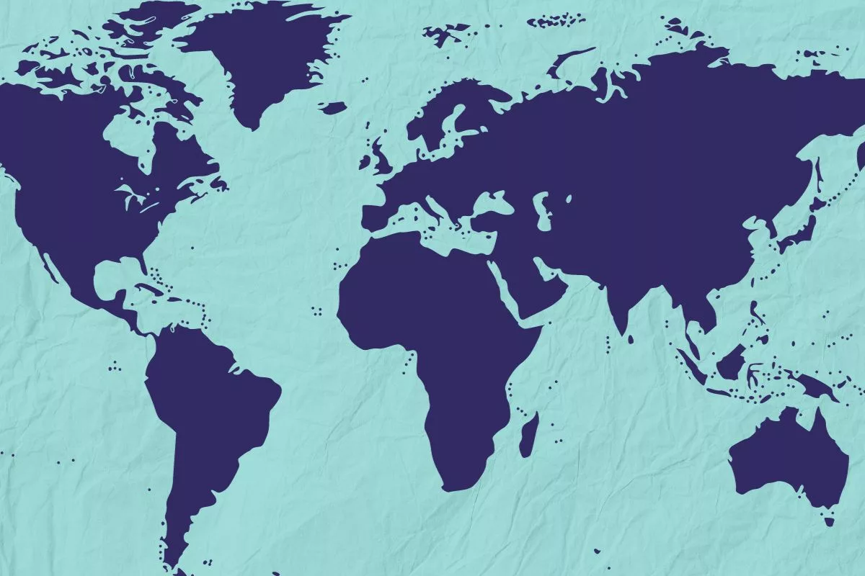
Iris' contribution to TBO: In Europe and Worldwide
• Complements terrestrial data-link
• Immediate coverage in Europe. Iris has already a global coverage
• Satcom datalink compliant to ATS B2 performance standards
• Avionics: Cobham and Honeywell. EPP in Europe as from 2028.
ATN-IPS SARPS on track at ICAO
IPS flight trials in EU by 2024 and USA by 2025 (TBC), including ATN-IPS/OSI interoperability
Contacts ongoing with Airbus, Boeing, and several civil aviation organisations and airlines in far East, Middle East and Americas for Iris flight trials
PERFORMANCE
COVERAGE
CONTINUITY OF SERVICE
AVIONICS
IPS
BEYOND EUROPE

Slide 5
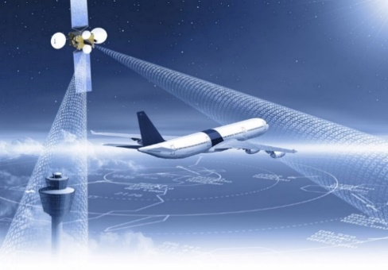
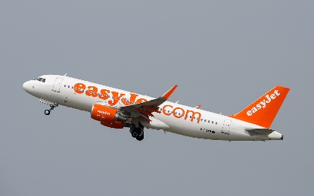
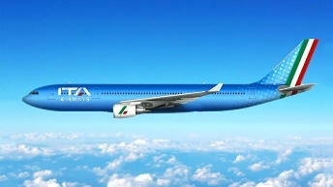
Iris latest achievements
ESSP CERTIFIED BY EASA AS IRIS SERVICE PROVIDER
KICK-OFF OF IRIS COMMERCIAL FLIGHTS
Iris commercial flights have been kicked off in Europe with easyJet on Airbus 320 aircrafts.
Most ANSPs participating in the commercial flights – other ANSPs in the pipeline.
NEW AIRLINES TO JOIN IRIS COMMERCIAL FLIGHTS
ITA Airways and other airlines to join
July 2023
IWA SIGNATURE & NSA APPROVAL
IRIS COMMERCIAL FLIGHTS
IRIS COMMERCIAL FLIGHTS
2025
Jan
2024
Mid
2024

Slide 6
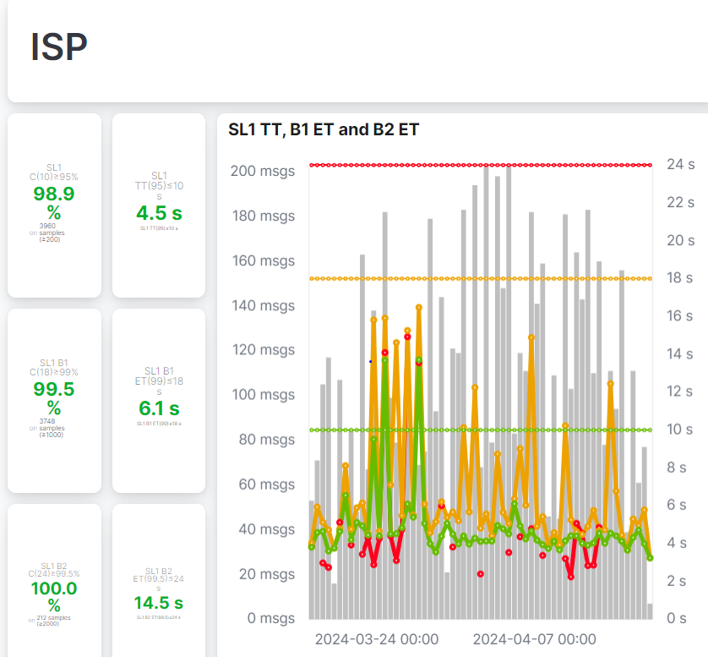
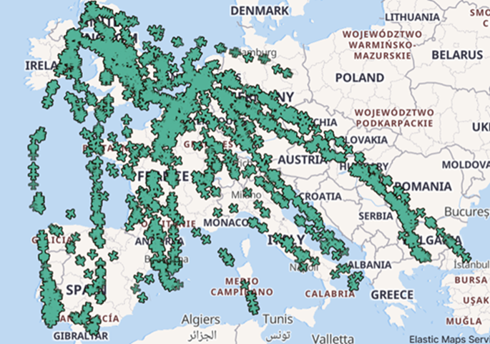
Current performances, available online
https://satcom-dls-support.essp-sas.eu/iris/service-performance
More than 1,000 flights so far

Slide 7
Thank You
For more info:
Davide.Tomassini@esa.int

