Slide 1

ANDREAS BOSCHEN,
EXECUTIVE DIRECTOR, SESAR JOINT UNDERTAKING
EUROPEAN TBO ROADMAP
6 JUNE 2024

Slide 2






WE ARE ALL TBO
NETWORK TBO
ATC TBO
REGIONAL TBO

Slide 3

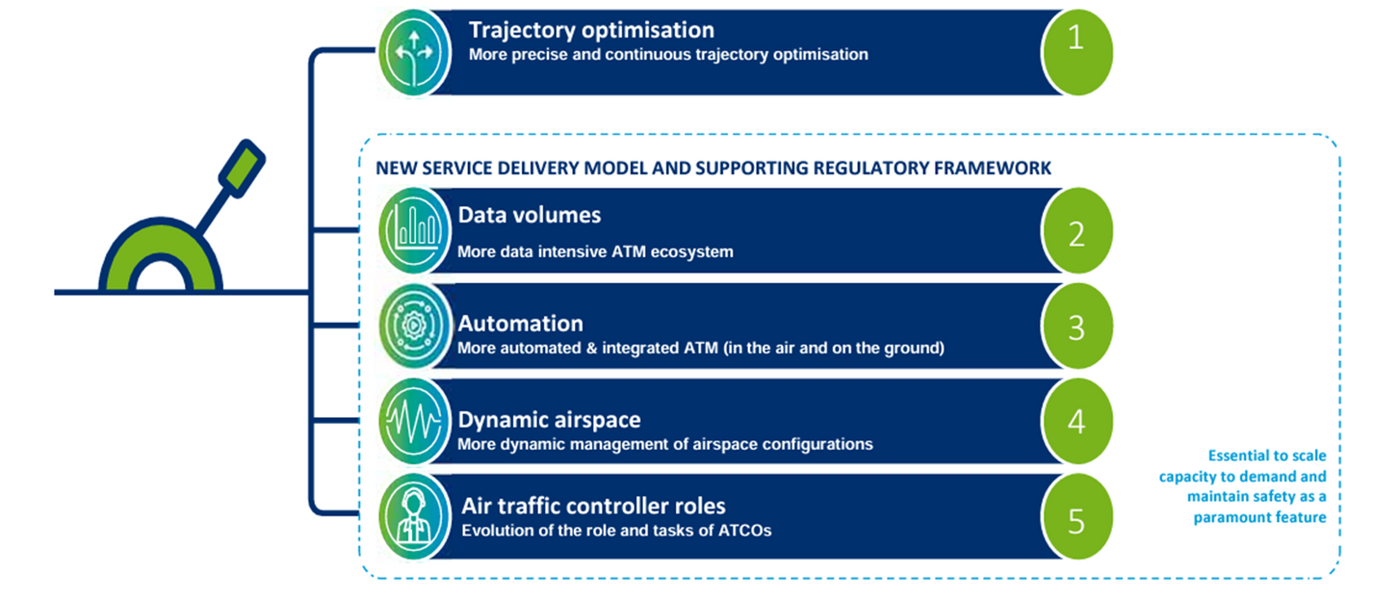


EUROPEAN ATM MASTER PLAN 2024
Our vision: Establish Europe as the most efficient and environmentally friendly sky to fly in the world with safety as a paramount feature.
European ATM Master Plan update ongoing
TBO is one of the five key transformation levers
Detailed 2025-2040 TBO roadmap under development as part of the future European ATM Master Plan addressing all TBO threads

Slide 4






TBO DEPLOYMENT 2025-2035
Transformation to TBO is a strategic deployment objective in the ATM Master Plan 2024:
EPP into ATC tools (beyond the EU mandate) (ATC TBO)
First step multi-element clearances via CPDLC with autoload, including cross border (ATC TBO)
All elements will be TRL6 by 2026
(most are already TRL6 today)
Dynamic RAD phase 1 (Network TBO)
Enhanced consideration of user priorities: arrival ATFM & pro-active flight delay criticality concept
FF-ICE/R1 beyond the EU mandate (planning service, constraint management)
Seamless ATC-ATC coordination for cross-border clearances

Slide 5



FIRST STEPS: DEPLOYMENT IN PROGRESS
NETWORK TBO
ATC TBO
REGIONAL TBO
  EPP/initial trajectory information sharing
  Already operational in 1 ACC (Maastricht)
  EU NM/ANSP uptake period 2024-2027
  EU Mandate: all new aircraft must be equipped from 2028
  Intra-European trajectory synchronisation for enhanced ground-ground messages
  Supporting NM/airport connectivity
  EU Mandate: ASD-C used to improve NM trajectory (in addition to radar data) by 2028
  Initial FF-ICE Deployment
  SWIM standard published by EUROCONTROL and used in operations
  EU Mandate: Airspace User uptake period 2024-2025

Slide 6

TBO RESEARCH AND DEVELOPMENT PRIORITIES 2025-2035
  ATS B2 development, including extension to lower airspace and the airport surface (ATC TBO)
  Development of FF-ICE, including pre-departure enhancement (e.g. ATFM integration) and post departure FF-ICE/R2 (Network TBO)
  Network trajectory synchronisation in the execution phase (Regional TBO)
  Connected aircraft, integrated FMS, EFB and FOC functionalities for trajectory optimisation (ATC TBO)
  Dynamic RAD development, towards a RAD by exception environment (Network TBO)

Slide 7



TRANSITION TOWARDS MULTILINK
DIGITALISATION
DATA TRAFFIC
  MULTILINK = performance + resilience
  Principle of backwards compatibility
  Move to IPS
  Coexistence of different A/G communication technologies:
Transition towards high-performance A/G connectivity through multilink is a strategic deployment objective in the ATM Master Plan 2024
  VDLM2
  SATCOM
  LDACS
  Hyperconnected (use of commercial networks)
  VHF voice (ground and satellite-based)

Slide 8


TBO IN THE 2040 VISION
Continuous trajectory optimisation in planning and execution
  G-G and A-G sharing of trajectory data
  Human-machine teaming:
High automation in planning and execution
Reduction of dispatch, flight-deck, ATFM and ATC
workload
  From airspace management to the management of individual flights -> reduced environmental impact
  Routine ATC clearances are automated

Slide 9
NEXT STEPS FOR THE EUROPEAN ATM MASTER PLAN
July 2024 Final draft of ATM Master Plan (including TBO roadmap)
for formal consultation with stakeholders
December 2024 Adoption of the Master Plan by the
SESAR Joint Undertaking Governing Board
In the meantime, still open for discussion and improvements

Slide 10
THANK YOU FOR YOUR ATTENTION

