Slide 1
Global TBO Symposium
LH Group Progress on TBO Implementation
Brussels, 5th June
FRA AO/FF-A
Enis Aksu

Slide 2
The Trajectory Based Operations (TBO) Concept is the core ATM pillar to support the reduction of CO2-emissions
TBO
Capacity
Efficiency
Sustainability
Safety
TBO as the strategic and tactical management of aircraft trajectories in four dimensions (3D space + time)
Used by all concerned actors (AU, ANSP, NM)
Through all phases of flight (planning, pre-departure, departure, en route, arrival and post-arrival)
Capacity
Efficiency
Sustainability
Safety
Relevant Prerequisites for the LH Group OPS
ATS B2 (ADS-C EPP + CPDLC) On-board communication technology
FF-ICE (Flight Planning and OPS Control Software) Flight & Flow Information for a Collaborative Environment
Early investment by LHG
Early implementation at LHA

Slide 3
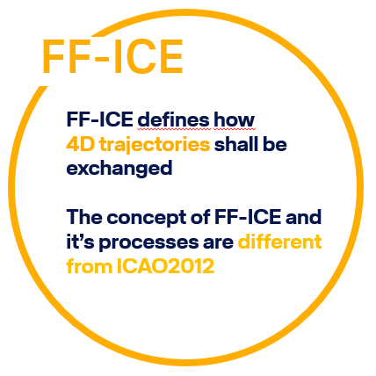
FF-ICE: Status of Implementation and Expectations
What about ANSP
implementation ?
Solutions AO/CFSP <> NM required
To be worked on / To be clarified : Standard and grey zones!
Mixed Mode ICAO 2012 and FF-ICE/eFPL filing – requirements outside inside ECAC ?
Transfer of Airline FF-ICE/eFPL Trajectory in NM agreed Trajectory - visualization of differences ?
Digitalization of FF-ICE/eFPL trajectory makes Nav data detailing-gaps visible – requirement for unambiguous/unique data publication (not yet available) ?
Handling AO <> NM for flightplan refiling in NM ops tools CHMI / NMUI – function support not yet aligned ?
These necessary clarifications should support the implementation in a way, so the speed of execution could be increased or at least kept
Project start
DLH, AF,
LH Systems
Test start
LH Systems >
NM
First
operational
DLH flightplan
Actl. Operation
DLH 50 – 100 daily flights
Complete DLH operation scheduled for 2025
2022
2019

Slide 4
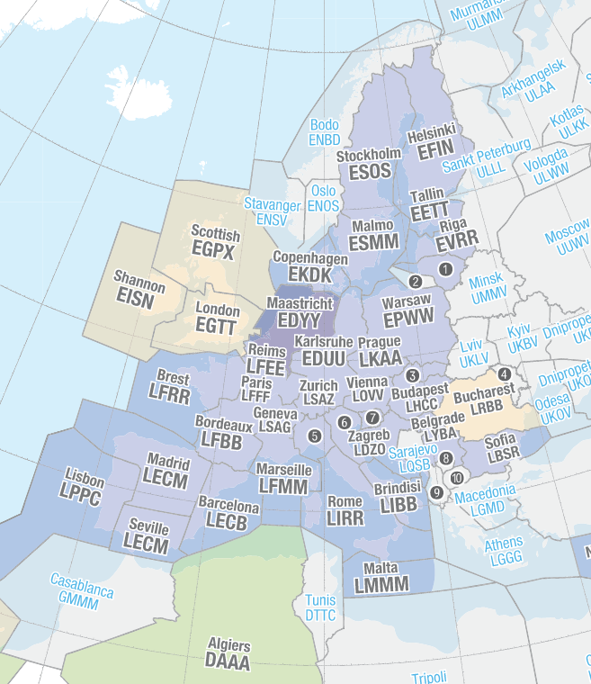
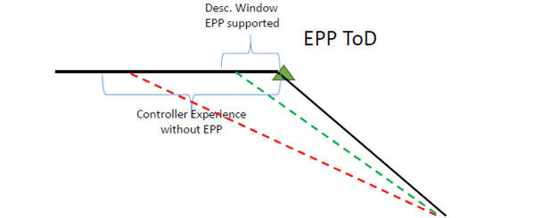
Sustainability effects for LH-Flights through MUAC enabled by ATS B2 (ADS-C EPP and CPDLC V2)
ATS B2 (ADS-C EPP and CPDLC V2) has been operational at Maastricht Upper Area Control (MUAC) since 30 May 2022
3 Use Cases were analyzed according to traffic flows through MUAC and their potential benefits
1. Later Start of Descent
2. Earlier direct routings
3. Better en-route delay-absorption
ToC
On Radar heading for separation
LONDON TMA
XMAN/ AMAN
Climbing to FL370
Conflicting traffic in FL360
Earlier direct with EPP Information
Examples for typical fuel savings each flight
Vertical view
Horizontal view
14 kg
4 kg
4 kg
Lufthansa Group has decided to begin equipping aircraft with forward-fit FANS C installations starting in 2024, ahead of the mandate's enforcement

Slide 5
Initial flight trial confirmed that predicted benefits by “later start of descent” have been successfully realized – SN2257/SN2258 on 31st May 2024
EKCH - Copenhagen
delaying start of descent by 3 Minutes
resulted in 22 kg fuel saving
EBBR - Brussels

Slide 6
Higher efficiencies can only be realised if procedures and operating concepts are adjusted and brought to life
New Technology (Mature for Deployment)
Positive Businesscase
Change Management
Define harmonization & synchronisation
Invest in GND/AIR
Benefits enabled
Training & Communication
Benefits locally
Harmonized deployment
Benefits sufficient
Ops concept
Benefits defined
Define operational use cases

Slide 7
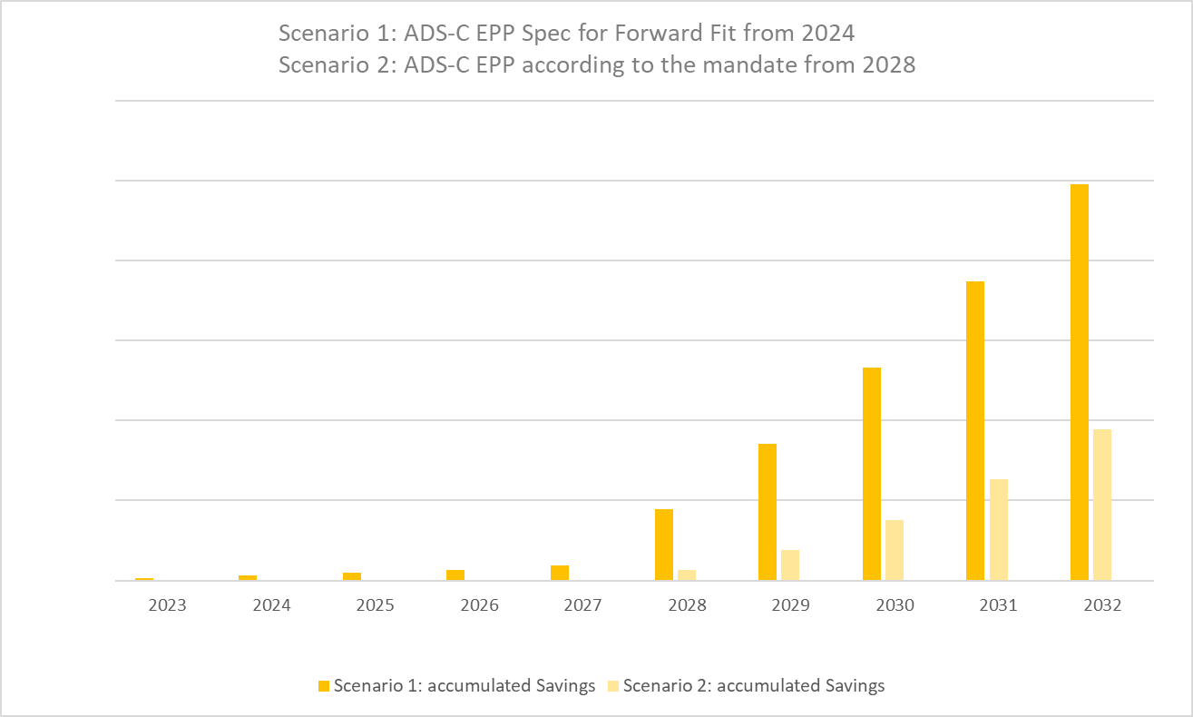
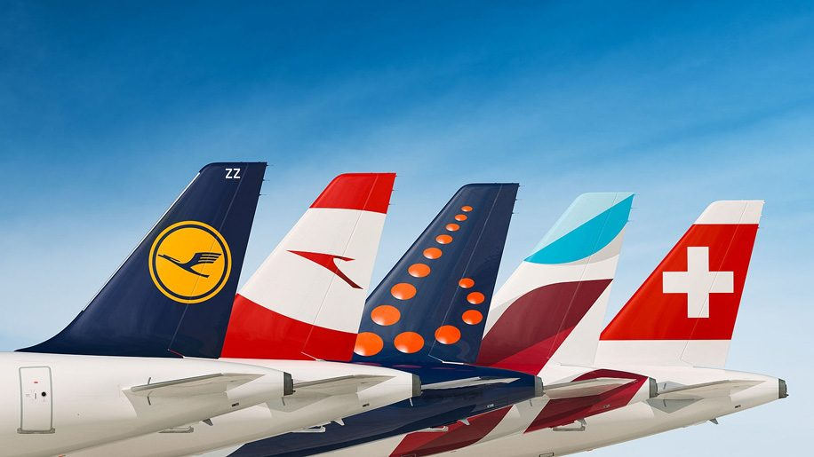
The Effect of Early Deployment of ADS-C EPP on the CO2 Savings
Illustration to visualize
relations based on
estimated savings
Benefits with Maastricht until 2027
Benefits with EU ANSPs for all Airlines from 2028 (Mandate)
65 A320neo/A321neo aircraft newly delivered from 2024 onwards will be equipped with ADS-C EPP
65
0
Mandate is in effect

Slide 8
Early implementation brings the greatest success for TBO
We are seeking to motivate partners to acquire more benefits. We are ready to enhance new use cases with other ANSPs. Only together can we realize all the benefits
Full ATS Baseline 2 is not mandated by CP1, but application beyond ADS-C EPP are core technologies to leverage full benefits of TBO (e.g. CPDLC V2)
We are facing a critical bottleneck in data bandwidth. Ensuring a data bandwidth (onboard and ground) far beyond today's level (Concept of Multi-Link)
DLH Group demand compliance with the timelines for deployment
The industry needs common guidelines on the handling of FF-ICE along the identified use cases without compromising the implementation speed

Slide 9
Thank you for your attention

