Slide 1

Multi-Regional TBO Demonstration
Amornrat Jirattigalachote, PhD
Strategic Planning Manager (Engineering)
Policy and Strategy Management Bureau, AEROTHAI
Global TBO Symposium – June 2024

Slide 2




Objectives
To validate and demonstrate TBO concept
To explore the impacts of TBO within the context of modernization initiatives
To support the development of information exchange standards and related ICAO materials

Slide 3
Journey
Phase 2B Live-Flight Demo
Demonstrating capabilities
  Air/Ground system connectivity
  Use of modern aircraft with existing equipage
  Use of flexible auxiliary device
  4 route segments
  Seattle – Tokyo
  Tokyo – overfly Bangkok FIR – Singapore
  Singapore – Bangkok
  Bangkok – Seattle
Phase 2A Lab Demo
Developing technical capabilities
Establishing system connectivity
2014 - 2019
2020
2021
2023
2020
2021
2022
2023
Phase 1 Guided Discussion & Tabletop Exercise
Planning and developing activities
Establishing (baseline) technical capabilities
Establishing industry and international partnership
MR TBO Live-Flight Video
https://www.youtube.com/watch?v=T-5OdubNloQ&t=3s

Slide 4
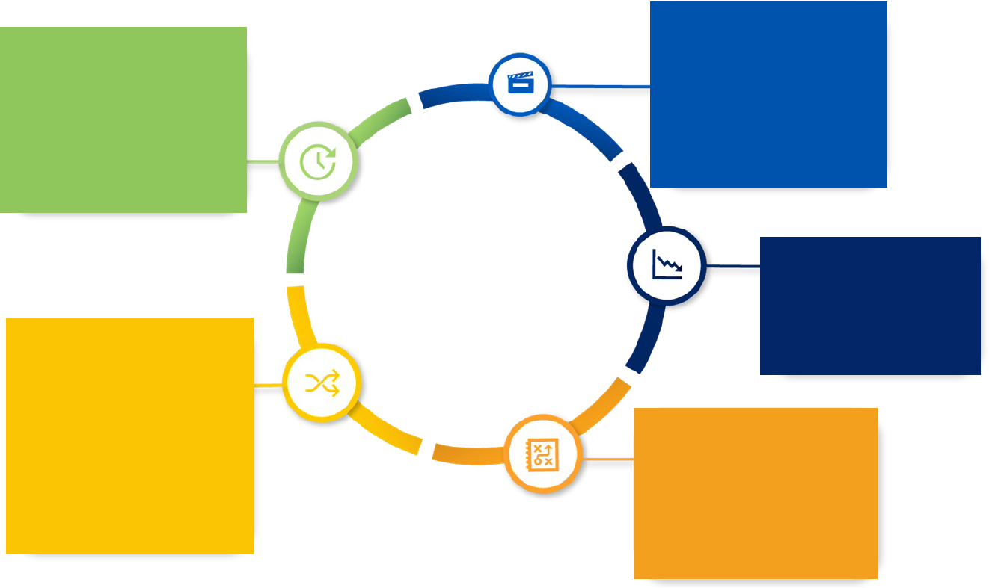

Operational Value
Alignment of
Strategic Plan &
Tactical Actions
Enhanced
Predictability
Decreased Uncertainty
Operational
Value
Increased,
Reliable Flexibility
Improved
Strategic Planning

Slide 5




Demonstrated Capability
Pre-departure trajectory
planning, negotiation, and filing
Sharing of constraint information
e.g. ATFM measure, MET, airspace usage
Post-departure trajectory
negotiation and revision
TBO clearance
Trajectory parameter exchange
Sharing of a/c-derived trajectory
eASP-eASP & eASP-eAU coordination
SWIM
FF-ICE/R1 services
(Initial) FF-ICE/R2 services
Connected Aircraft
CPDLC
Cybersecurity

Slide 6
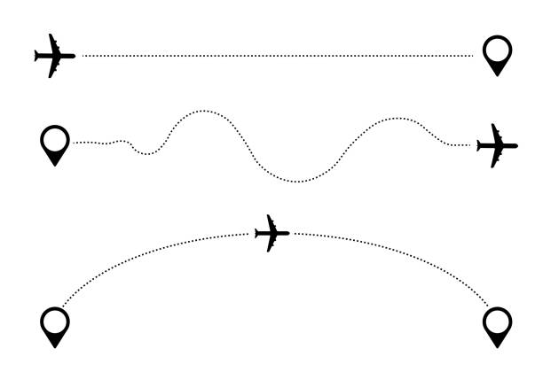
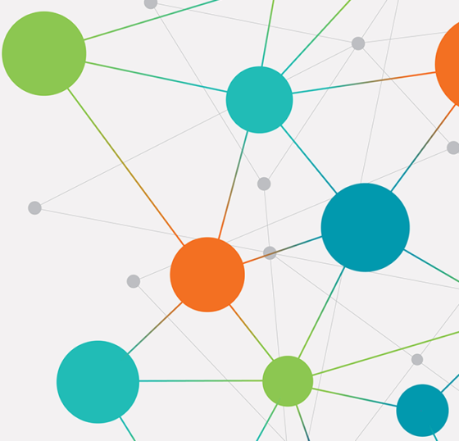
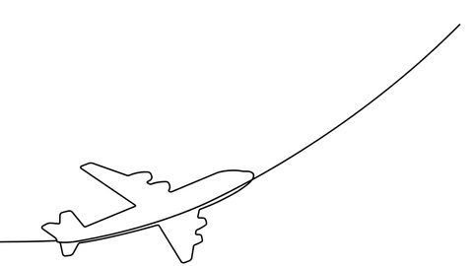
Key Lessons Learned
TBO: Sharing, Maintaining, and Using Trajectory
as a Common Reference across Stakeholders
  The globally standardized information exchange models are foundational to the success of TBO
  The continued evolution of the Connected Aircraft is required
  to enable the sharing of more information among stakeholders, allowing the active participation of flight crews in CDM

Slide 7
Thank You
amornrat.ji@aerothai.co.th

