Slide 1
TRAJECTORY BASED OPERATIONS MILITARY PERSPECTIVES (CHALLENGES AND BENEFITS)
TBO SIMPOSIUM
Igor KUREN
Civil-Military ATM coordination senior expert
06 June 2024

Slide 2
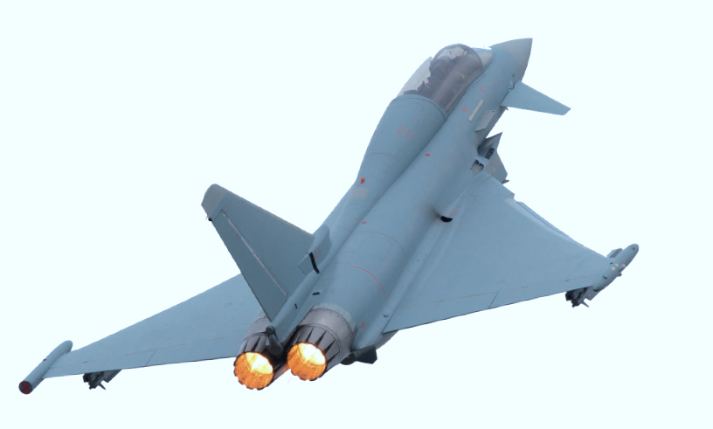
Military in TBO

Slide 3
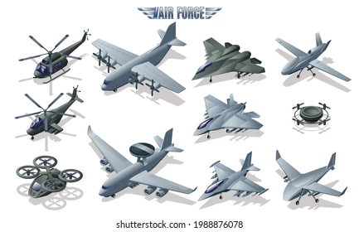
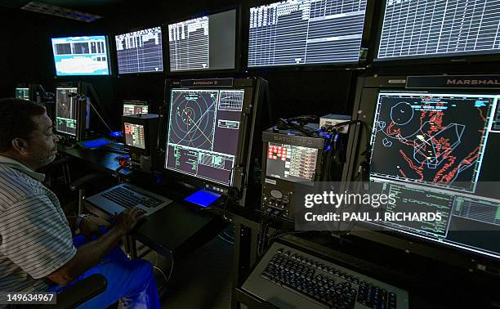
Who are Military in the European ATM system
Aircraft Operator
ANS provider

Slide 4
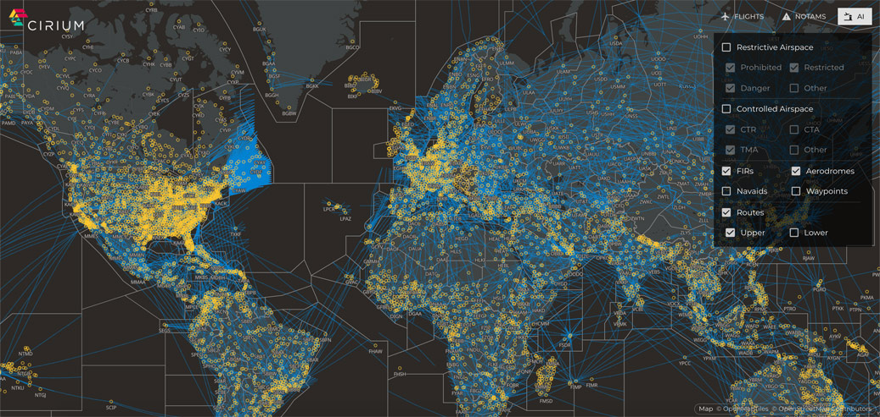
Who are Military in European ATM system
AIS Data provider
Weather Data provider

Slide 5
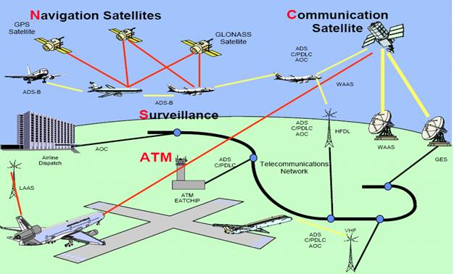
Who are Military in the European ATM system
CNS/ATM provider

Slide 6
Future ATM system
TRAJECTORY CENTRIC
SAFETY
CAPACITY
ENVIRONMENT
COST EFFECTIVENESS
FLIGHT EFFICIENCY
MISSION EFECTIVENESS

Slide 7
Trajectory Based Operations
ICAO
TBO
ATM Environment
4D Trajectory
collaboratively developed, shared
and managed
Serve as a common reference for Decision Making across all stakeholders

Slide 8
TBO in the context of ICAO GLOBAL ATM CONCEPT
TBO Consists of a range of ATM functions
which operate across the ATM system components such as
Demand and Capacity Balancing DCB
Conflict Management
Airspace Organisation and Management AOM
Traffic Synchronization TS
Service Delivery Management ATM-SDM
Airspace User Operations
Airport Operations

Slide 9
Trajectory Based Operations in the context of SESAR
The effective dynamic adjustment of airspace characteristics to meet predicted demand
Aiming to keep any distortions to the Business/Mission Trajectories to the absolute minimum
ENABLES
TBO
Providing sufficient flexibility for optimization purposes.

Slide 10
Trajectory Based Operations
Represents ATM operations based on optimised accurate and constantly updated trajectory that represents business and mission intensions.
ATM operations enable:
A fully collaborative environment where each flight trajectory is shared, maintained, and used by all the concerned actors during all phases of flight
More dynamic management of restrictions according to traffic evolution and real needs
Extended Airspace User capabilities to provide preferences and priorities
The timely and seamless exchange of flight trajectory information from take-off to landing
Enables seamless coordination based on enhanced interoperability
Enhanced trajectory downlink capabilities supported by CPDLC and ADS-C
Improves accuracy of the network manager traffic prediction from medium-term planning phase to execution
Better situational awareness
Dynamic CDM from planning to execution phase

Slide 11
Concepts that apply in TBO
DAC
TBO
BT
MT
FF-ICE/
eFPL
FO/IOP
iOAT FPL
AFUA
VPA/DMA
D
DCB

Slide 12
4D Trajectory
The 4D trajectory is a set of
consecutive segments
linking published waypoints
and/or pseudo waypoints
computed by air or ground tools
(FOC/WOC system, aircraft systems,
ground trajectory predictor)
to build the lateral transitions
and the vertical profiles
X
.
each point is defined by:
a latitude,
a longitude,
a flight level/altitude and
a time
Y
Z
Cruise
Climb
Descent
Departure
Approach
Taxi-Out
Take-Off
Roll
Landing
Roll
De-brief
Flight
Planning
Taxi-In

Slide 13
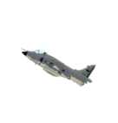
TBO Business Trajectory VS Mission Trajectory
Driven by business needs
Driven by National Defence and security policies and international commitments
Flies in accordance with ICAO rules
Flies in accordance with National rules and /or ICAO rules when required
Equipped with ATM cooperative on-board
avionics and sensors
Shares flight related data through FF-ICE
Shares ATM related flight data only through iOAT FPL mechanism
Shares accurate flight performance data
Equipped with ATM non cooperative on-board avionics and sensors
Provides air to ground trajectory data exchange via CPDLS and ADS-C
Flies MMS trajectory according to the mission objectives
Flies FMS trajectory according to airline policy (Cost Index)
Provides limited downlinked capabilities for ATM purpose
Flies the most efficient route to ensure mission effectiveness
Flies the most cost-efficient route

Slide 14
TBO Business Trajectory VS Mission Trajectory
Depends on:
Passengers' availability
Airports throughput
Airspace availability (FRA)
ANS provisions
ATC capacity
Weather
Relies on:
Efficient collaborative planning
Seamless ANS provisions
Most up-to-date Aeronautical and METEO data
SWIM technical profiles
Depends on:
Aircraft availability
Mission type
Airspace availability (RSA type)
ANS provisions + Tactical control
Geographical scope of the mission
Weather
Relies on:
Efficient collaborative planning
Mission support services (DPC, AAR)
Most up-to-date Aeronautical and METEO data
SWIM interface

Slide 15
Challenges for Military in TBO
Operational
Provision of the harmonised and ICAO compliant aeronautical information across ATM domains to ensure consistency in the European Aeronautical Data base.
Implementation of new airspace design principles and advanced management of airspace
Participation in collaborative planning
Participation in CDM in planning and execution phase
Compliance with TBO requirements for trajectory management
Adherence to trajectory lifecycle through trajectory development sharing and execution
Adherence to ground agreed trajectory in execution phase
Participation in constraint management

Slide 16
Challenges for Military in TBO
Information sharing
Sharing of trajectory accurate ATM related data in planning and execution phase through interoperable systems and interfaces
Development of the system support functionalities facilitating trajectory development sharing and management
Implementation of FF-ICE for military operating as GAT

Slide 17
Challenges for Military in TBO
Technical
Compliance with a set of ATM/CNS requirements such as:
Air-ground voice channel spacing,
Controller-pilot data link communications and trajectory management,
Advanced navigation, comprising Performance Based Navigation applications and functionalities,
Mode S and ADS-B surveillance,
Airborne collision avoidance system and airport connectivity.
Connection of military systems with SWIM technical infrastructure
Automation of human processes related to CNS/ATM data exchange
Close collaboration with ground and airborne industry

Slide 18
TBO Benefits and Opportunities for Military
ICAO compliant and harmonised aeronautical data base for civil and military use in Europe
Increased flexibility in planning and execution phases by sharing military ATM demand in the form of trajectory
Enhanced civil-military ATM collaboration/cooperation/coordination in planning and execution phases
Flexible access on demand to available airspace resource through trajectory exchanges
Request of the most efficient flight levels leading to fuel saving for military flight operations
Improved use of available airspace resource through advanced airspace management
Improved military mission effectiveness and ATM network performance
Military in CDM process for optimisation purpose and manifesting their priority
New airspace design principles facilitating military flight operations through flexible and dynamic configuration and allocation of volume of airspace needed for military training
Use of ICAO compliant harmonised iOAT FPL mechanism enables:
Centralised processing and distribution of MT data
Semantic interoperability
Consistency of Mission Trajectory data across ATM actors concerned
Increased awareness on military ATM demand leading to improved capacity
Improved cross-border/cross FIR/UIR military flight operations
Increased civil-military and military-military interoperability

Slide 19
TBO Opportunities for Military
Opportunity to retrofit aircraft equipment or develop new system functionalities facilitating military integration into TBO environment
Opportunities to define and implement dual use technical solutions hence enabling the reutilisation of available military capabilities and reducing technical constraints
Development of interoperable solutions facilitating military integration into civil CNS/ATM infrastructure
Opportunities to influence development of technical standards to consider military specific requirements
Opportunity to eliminate procurement and certification mismatches
Opportunity to enhance AD flight monitoring capabilities through the ground exchange trajectory information with ATCU (EPP extended projected profile) to close the gap between ground and flight trajectories.

Slide 20
Conclusions
TBO is a new challenge for interoperability and civil/military ATM co-ordination
From trajectory perspectives it is not a new way to fulfil military mission objectives, but a new way to:
Deliver military ATM demand through ATM services
Describe trajectory with flight data that is richer than today’s flight plan
Integrate military IFR flights into the ATM network operations
Share trajectory information in the planning and execution phases
Collaborate with ATM network through trajectory lifecycle
Provide mission support services

