Slide 1
NM Implementation of FFICE
Augustin GHEORGHE
NMD/ACD/PCI

Slide 2








SHARING
MAINTAINING
ICAO concept
FF-ICE
TBO foundation
Flight & Flow Information for a Collaborative Environment
SWIM
services
Standard format
Replaces
FPL2012
USING
Increased information sharing
Digitalised and structured

Slide 3
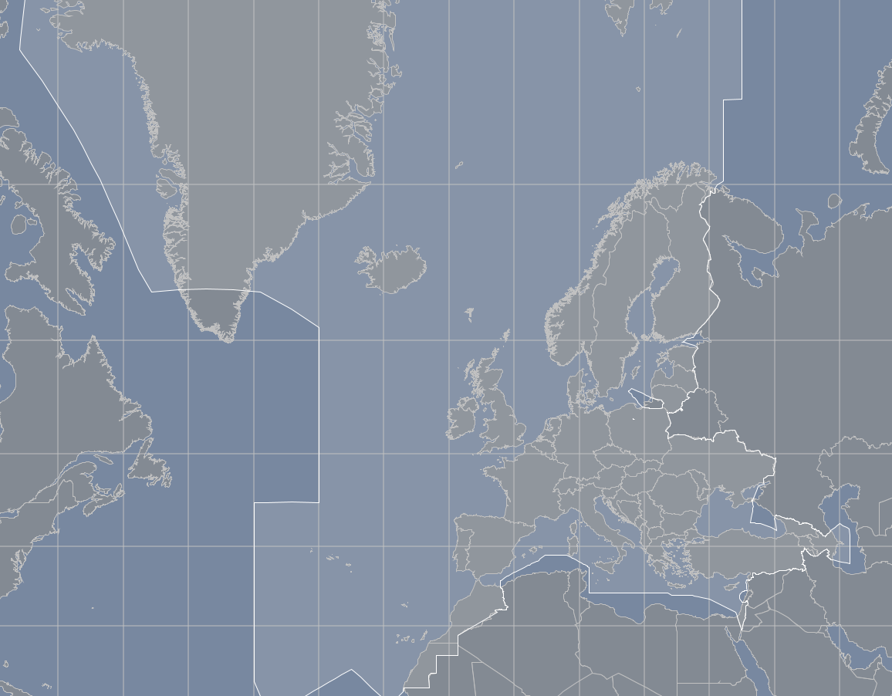
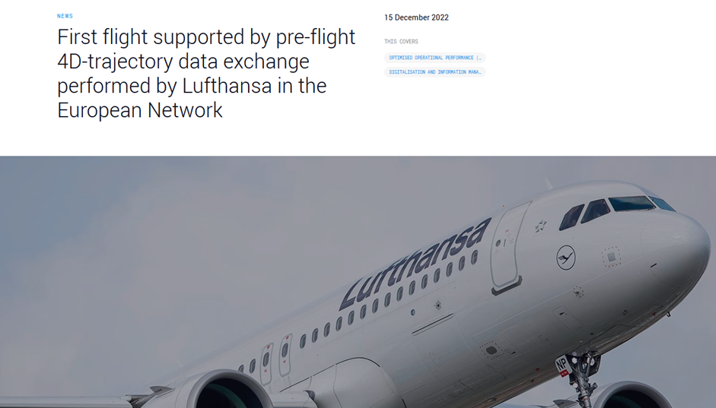
European Network Manager Implementation
Operational cut-over
NM AREA
Notification
Publication
Dedicated Task Force – FPFDE TF
Implementation Strategy
Re-evaluation feedback
Flight Data Request
NM Strategic Project - FPFDE
Initial Filing & Trial
Evaluation Feedback
2015
2016
2017
2018
2019
2020
2021
2022

Slide 4
FF-ICE Services
Planning Service
Filing Service
Related Messages:
Related Messages:
Preliminary Flight Plan Message
Filed Flight Plan Message
Flight Plan Update Message
Flight Plan Update Message
Flight Cancellation Message
Flight Cancellation Message
Submission Response Message
Submission Response Message
Planning Status Message
Filing Status Message
Trial Service
Flight Data Request Service
Related Messages:
Related Messages:
Trial Request Message
Flight Data Request Message
Submission Response Message
Submission Response Message
Trial Response Message
Flight Data Response Message
Publication Service
Notification Service
Related Messages:
Related Messages:
No specific messages defined. Information on flights
Flight Departure Message
that match a set of criteria are transmitted to
Flight Arrival Message
registered subscribers in response to certain events or
Submission Response Message
conditions. An eASP will indicate the events and/or
criteria to which a subscriber can subscribe

Slide 6
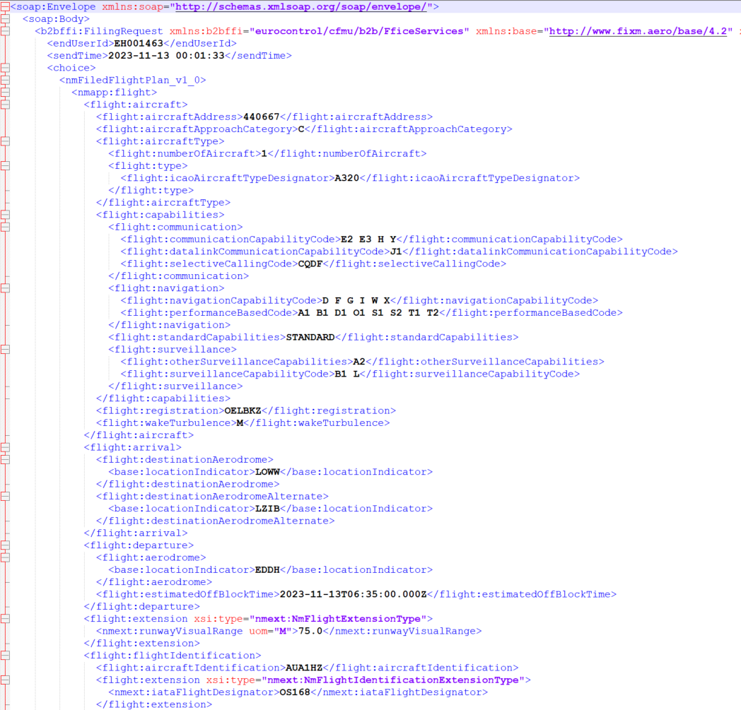
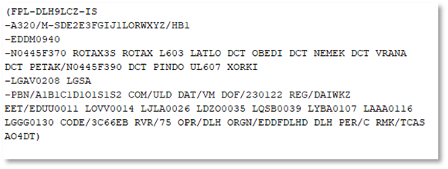
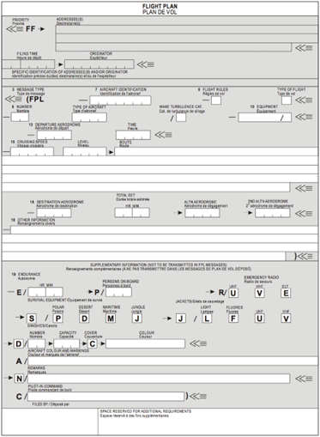
FPL 2012
FF-ICE Flight Plan (eFPL)

Slide 7
FF-ICE in the NM B2B
FF-ICE Services are integrated in the NM B2B Services, making use of both request/reply and publish/subscribe communication models
  Published on SWIM Registry - https://eur-registry.swim.aero/home
NM supports FIXM 4.3 and FIXM 4.2 (will be deprecated by the end of year - NM B2B policy)
Follows the ICAO implementation guidance, reflecting at the same time the European specificity of the IFPZ
NM Feedback does not include the flow impact - not yet defined by ICAO, nor supported in FIXM

Slide 8
Ancillary FF-ICE processes
Translation
Re-evaluation
Translation & Delivery

Slide 9
Mixed mode and transition operations
Flight Plan Processing and Distribution by NM

Slide 10
Future developments
Pre-departure phase
Post-departure phase
Preliminary Flight Plan implementation
Trajectory revisions during airborne phase on AU or ATM initiative not involving ATC
FF-ICE release 1(ICAO)
FF-ICE release 2(ICAO)
‘Network TBO’

Slide 11

Documentation
The IFPS Users Manual
(https://www.eurocontrol.int/publication/ifps-users-manual)
NM B2B Reference Manual
(https://ost.eurocontrol.int/sites/B2BWS/default.aspx)
FPFDE NFPM Implementation Guidelines
(https://www.eurocontrol.int/publication/fpfde-nfpm-implementation-guidelines)
Implementation Strategy for FPFDE NFPM (https://www.eurocontrol.int/publication/implementation-strategy-fpfde-nfpm)

Slide 12



