Slide 1
FAA TBO Experience & Innovation
Presented by: | Steve Bradford, Chief Scientific & Technical Advisor
Presented on: | June 4, 2024

Slide 2
What is Trajectory Based Operations (TBO)
Trajectory-based operations (TBO) is an air traffic management (ATM) method for strategically planning and managing flights throughout the operation by using time-based management (TBM), information exchanged between air and ground systems, and the aircraft's ability to fly trajectories in time and space. Aircraft trajectory is defined in four dimensions—latitude, longitude, altitude, and time.
TBO will increase airspace and airport throughput, flight efficiency, flexibility and predictability through TBM, PBN procedures, and increased collaboration with NAS users regarding preferred trajectories and priorities.

Slide 3
TBO Evolution

Slide 4
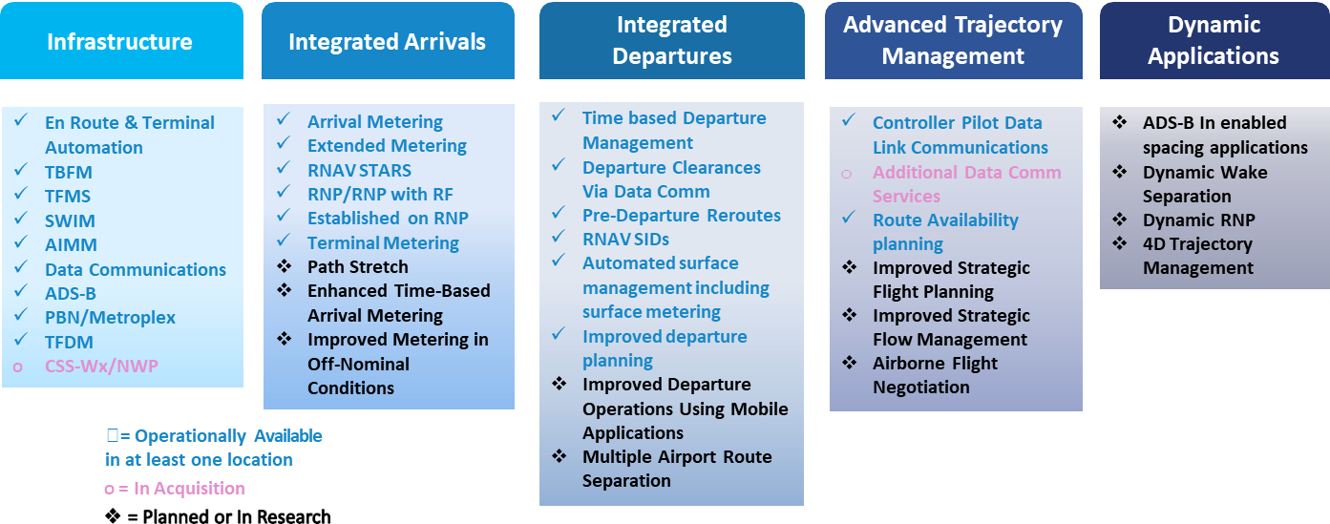
Key Capabilities by Theme

Slide 5
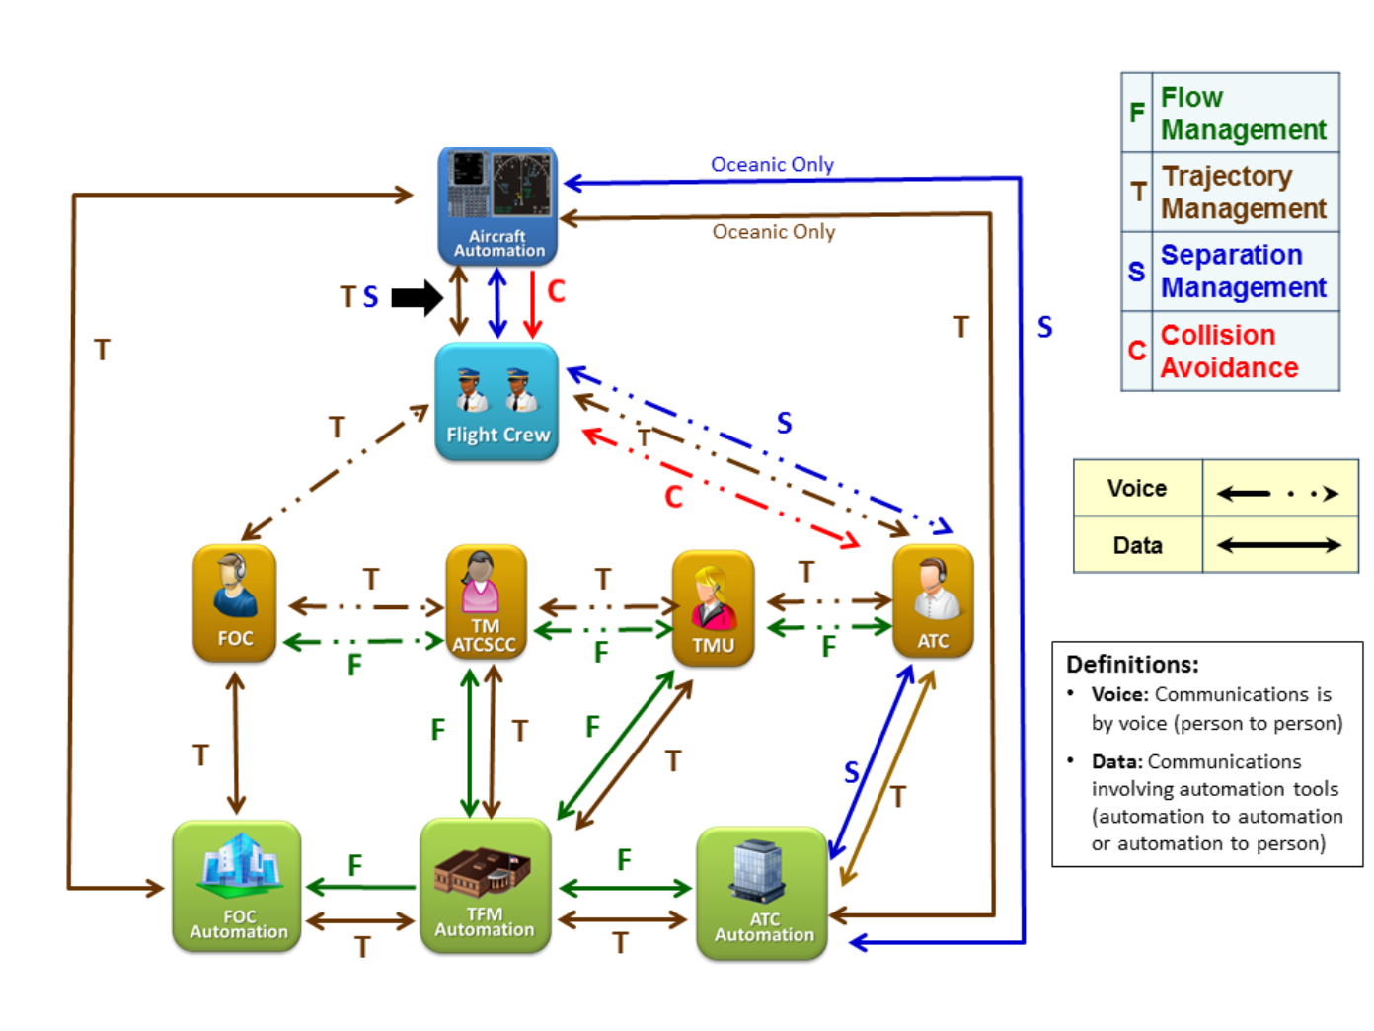
Present Day Interactions:
Between Automation and Stakeholders

Slide 6
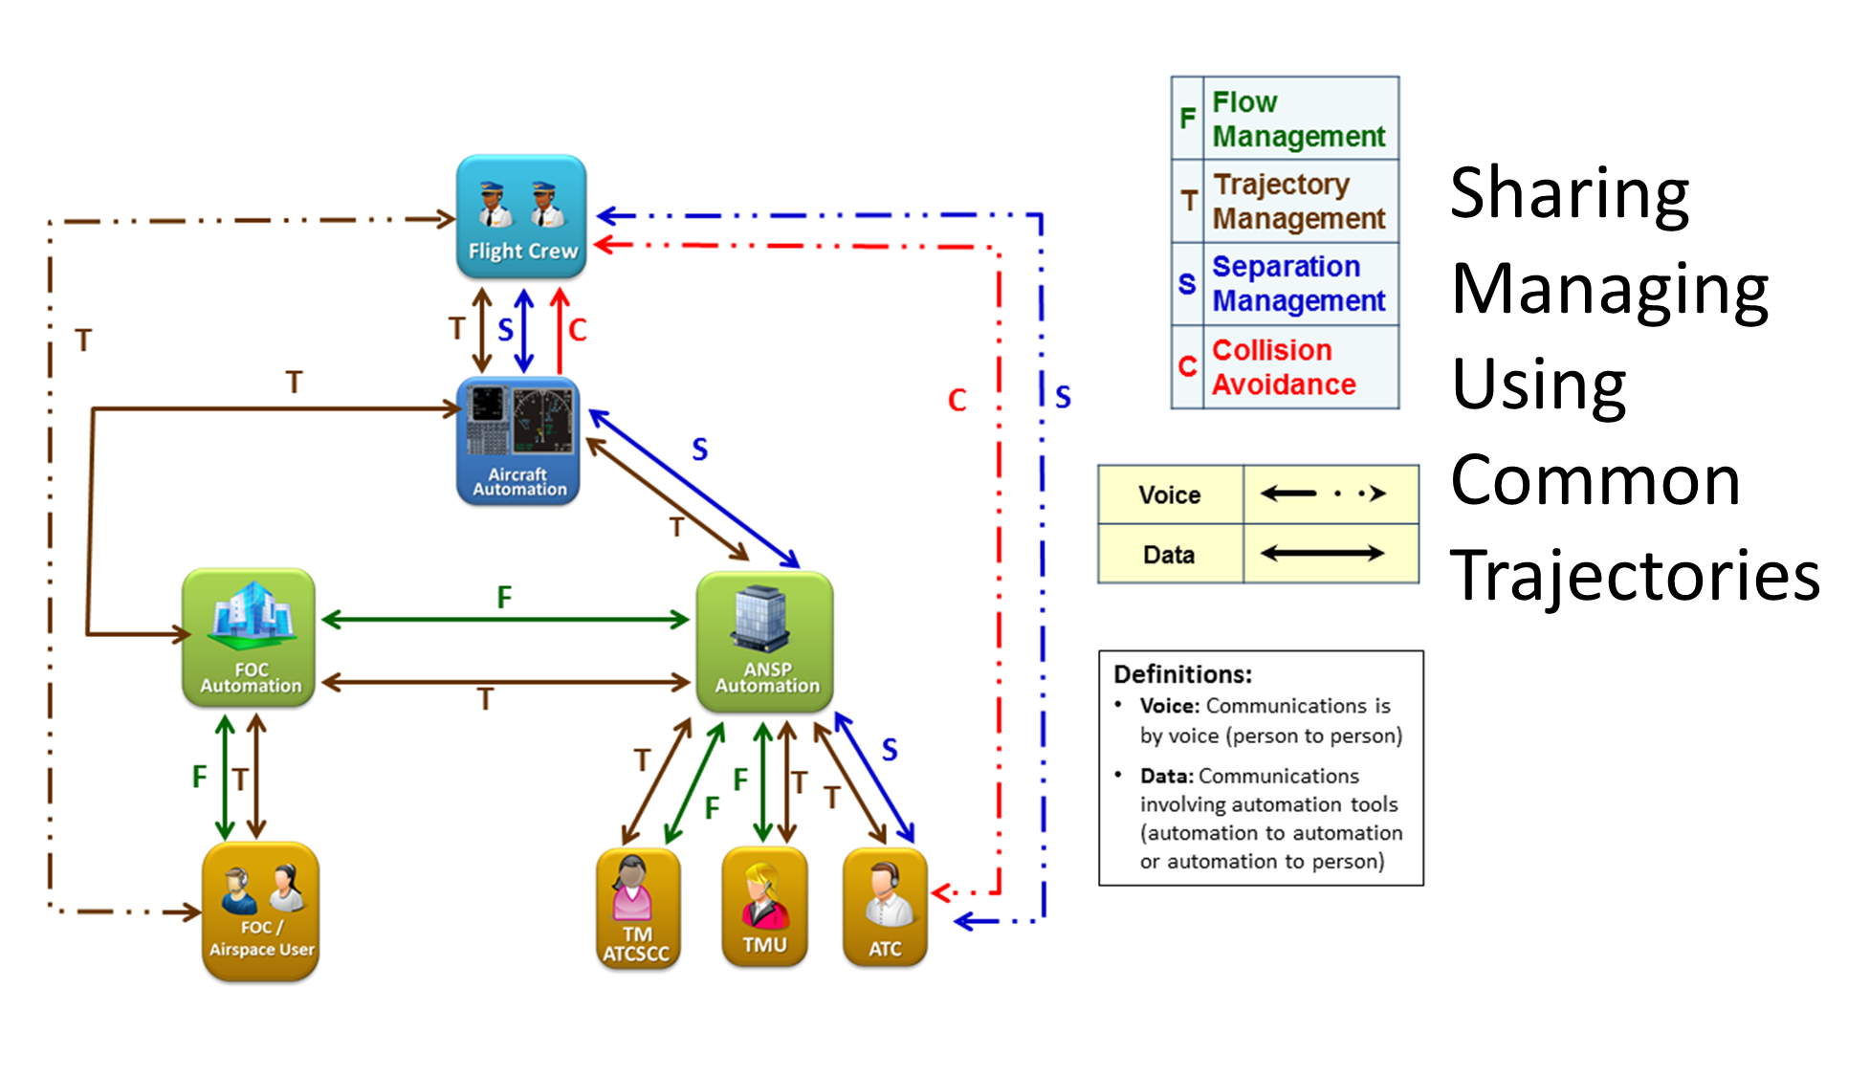
Future Interactions:
Between Automation and Stakeholders

Slide 7
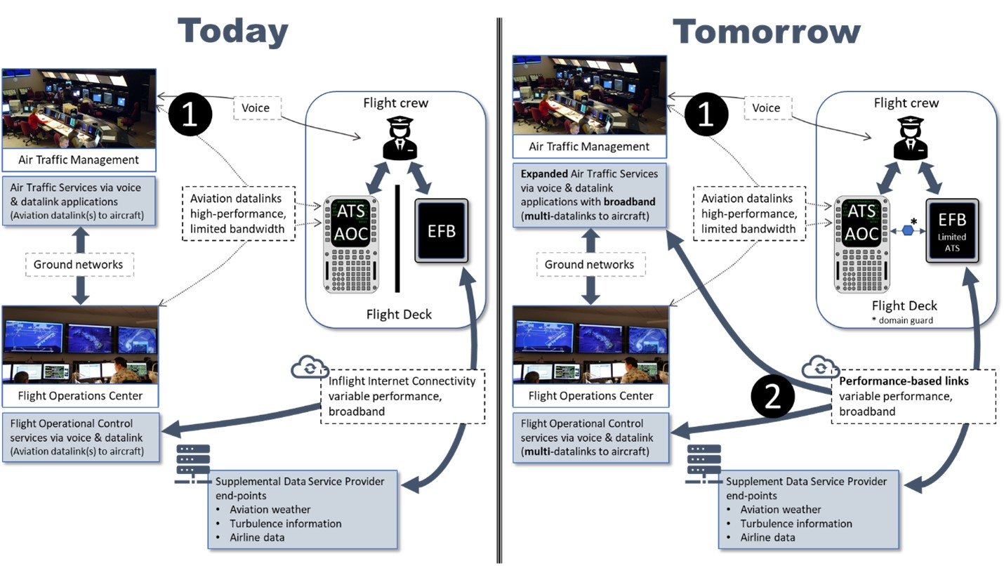
Innovation
Enabling the Air-Ground information exchange of tomorrow

Slide 8
Dynamic TBO Research
Connected Aircraft – ICAO conops on the use of commercial data link to share aircraft intent data, trajectory negotiation and clearance delivery
Example: Connected Aircraft Trajectory Information (CATI)
Flight and Flow Information for a Collaborative Environment (FF-ICE) R2 – managing flight information for active flights
Example: Multi-Regional Trajectory Based Operations (MR TBO)

Slide 9
THANK YOU

