Slide 1

TBO: SESAR R&D PERSPECTIVES
OLIVIA NUNEZ, SESAR JOINT UNDERTAKING
4 JUNE 2024

Slide 2








WHAT IS TBO?
What is TBO?
Strategic and tactical management of trajectories of individual flights, pre-departure and post-departure
TBO Objective
Enable all actors to collaborate towards optimising the trajectory all along the trajectory lifecycle
What TBO is NOT
A concept for the strategic management of flights where ATC will only be needed in exceptional situations
A/G Connectivity
In the execution phase, TBO requires increased data connectivity between the flight deck and ATC
Digitalisation
TBO both relies on and enables increased automation on the flight deck and on the ground (FOC, ATFM, ATC)

Slide 3






TBO PROCESSES
ASP / NM
FLIGHT
PLANNING
NETWORK ATFM/ASM
NETWORK TBO
REGIONAL NETWORK ALIGMENT
AU / FLIGHT OPERATIONS CENTRE
AU / FLIGHT
DECK
INTERNAL AU PROCESSES
ATC TBO
ATC SEPARATION
ATC TRAFFIC SEQUENCING
AIRPORTS
REGIONAL NETWORK ALIGMENT

Slide 4



FF-ICE: MORE THAN A NEW FPL FORMAT
FPL 2012 is the last “form-based” flight plan…
But the new FF-ICE format will not bring benefits if used in the same way as FPL2012
We need to take advantage of the new possibilities it opens!
R&D ongoing for strategic revision in execution in Network TBO project
EXAMPLES OF INITIAL BENEFITS IN THE EUROPEAN CONTEXT
  In 2015-2016 SESAR validations, provision of 4D trajectory in the flight plan allowed an increase of automatic acceptance of flight plan (19% of rejected FPL2012 are ok with 4D trajectory).
  In 2015 SESAR validations, over a sample of vertical alignment “problem flights” (median vertical deviation of 8000 ft) the eFPL 4D trajectory allowed a 50% improvement in vertical alignment.

Slide 5

AIRBORNE TIME CONSTRAINTS
Extensive research conducted in SESAR on concepts for ATC to uplink a time constraint to be self-managed on board through FMS RTA function
ATC TBO SEPARATION:
  In practice there is little margin for slow down -> only option is speeding up
  Negative impact on environment (see numbers on table!)
ATC TBO SEQUENCING OF ARRIVAL TRAFFIC:
  In high traffic density, self-management of each aircraft to a time is often NOT compatible with separation management
  Time-to-lose implemented through speed constraints provides the control all along trajectory needed for separation management
  Pre-departure ATFM (ground delay) is THE key to avoid bunching
NETWORK TBO DEMAND CAPACITY BALANCING:
  No real impact on prediction of traffic load (traffic prediction error follows normal distribution, late compensated by early)
  Uncertainty in time is mainly from take-off time – compensating a late departure ↑↑ fuel burn (if at all possible)
  Main uncertainty is in the vertical dimension (sector penetration)
Measure to establish 7 NM separation 200 NM downstream
Fuel impact
Time impact
Lateral separation 7 NM, initiated 200 NM before conflict
1,4 kg
+ 4 sec
Creating separation by CTO 7 NM, speeding up
46 kg
- 57 sec
Maintaining separation by CTO, encountering a wind error of -15 kts after 100 NM
+ 0 sec
42 kg
AIRBORNE TIME CONSTRAINTS ARE
NOT THE ANSWER

Slide 6


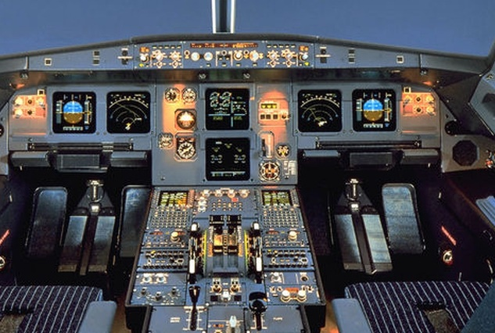


THE ANSWER IS ATS B2
ADS-C Rev A and first CPLDC use cases are ready for deployment and are a MP 2024 strategic deployment objective
SSR intent information comes from FCU/MCP
R&D (new use cases and increased automation) continues in ATC
TBO project
Flight crew manages who controls flight path (FCU/MCP or FMS), and ADS-C downlinks who controls the flight(in each dimension: horizontal/vertical/speed/time).
ADS-C intent information comes from FMS
Allows verification by ATC systems that CPDLC clearance has been correctly loaded -> this verification is essential for moving towards higher levels of automation.

Slide 7


CONNECTED AIRCRAFT
Electronic Flight Bag (EFB)
  EFB – FMS connectivity are complementary:
  EFB connection does not use a safety-critical link, but has more info than FMS
  ADS-C info (from FMS) is a (complex) has info on what the aircraft will really fly (as per current clearance) sent via safety-link (KEY POINT!), as well as some additional information items
  EFB will play a role in the FF-ICE/R2 CDM processes
  Knowledge of unconstrained desired trajectory (UDT) useful for ATM:
    Downlink UDT from EFB to ATC systems?
    UDT to be included in the eFPL and updated by FOC at any time (pre- or post-departure)?
    Flight crew can today fly UDT if compatible with clearance (e.g. small speed changes) and request clearance from ATC if needed (e.g. larger speed changes, level change…)
  On-board implementation of EFB “optimisation constraints”:
  If FCU/MCP -> predictability of the flight for ATC systems ↓↓
  Target concept is EFB “optimisation constraints” -> FMS (with automatic support)
No flight path control - lower level of certification
Faster update
cycle
↑Optimisation potential
Photo credits: Master Films, A. Doumenjou; EXM, H. Goussé, Airbus, S. Ramadier.
Connection to EFB (non-safety-critical) is complementary to ADS-C/CPDLC (safety critical). Development of connected aircraft is a strategic priority in the MP 2024.

Slide 8



NOT JUST REGIONAL...
Synchronisation NM <->ANSPs
Integration of airports in the European network
Sharing of trajectory data between systems from different vendors
but principles apply also:
  Within a single ASP: internal synchronisation flight planning <-> ATFM <-> ATC services
  Between ASPs within or across ICAO regions (e.g. current FSAs between NM and non-European ASPs) -> supporting move to global ATFM
  Airport CDM evolution -> AOP
  Applies the same to integration of airports in ASPs outside of Europe
  NM systems <-> ANSP systems
  Between ANSPs with different system providers
  Supports SOA/ new business models / cloud-based systems

Slide 9







KEY TAKEAWAYS
TBO changes all ATM processes
  Pre-departure/post-departure/strategic/tactical
  Time constraints are NOT as useful as originally anticipated
  The way to go is CPDLC + downlink of FMS trajectory + conformance monitoring
R&D results are that for ATC:
Deployment of ADS-C and first CPLDC v2 use cases is a strategic deployment objective
  Further development of ATS B2 is a MP2024 development priority
TBO = COLLABORATION
Connected aircraft is a
new strategic development priority for SESAR
  Complementary to ADS-C and CPDLC
  Focus on flight optimisation
Regional TBO is not just regional
  Useful also within and between ASPs, within or across ICAO regions

Slide 10
THANK YOU FOR YOUR ATTENTION

