Slide 1
Why TBO ? Operational Benefits
Hugues de Beco – Airbus – head of ATM program

Slide 2
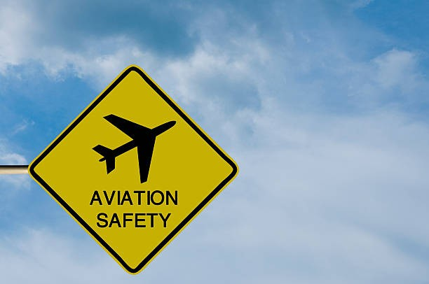
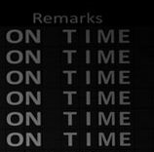
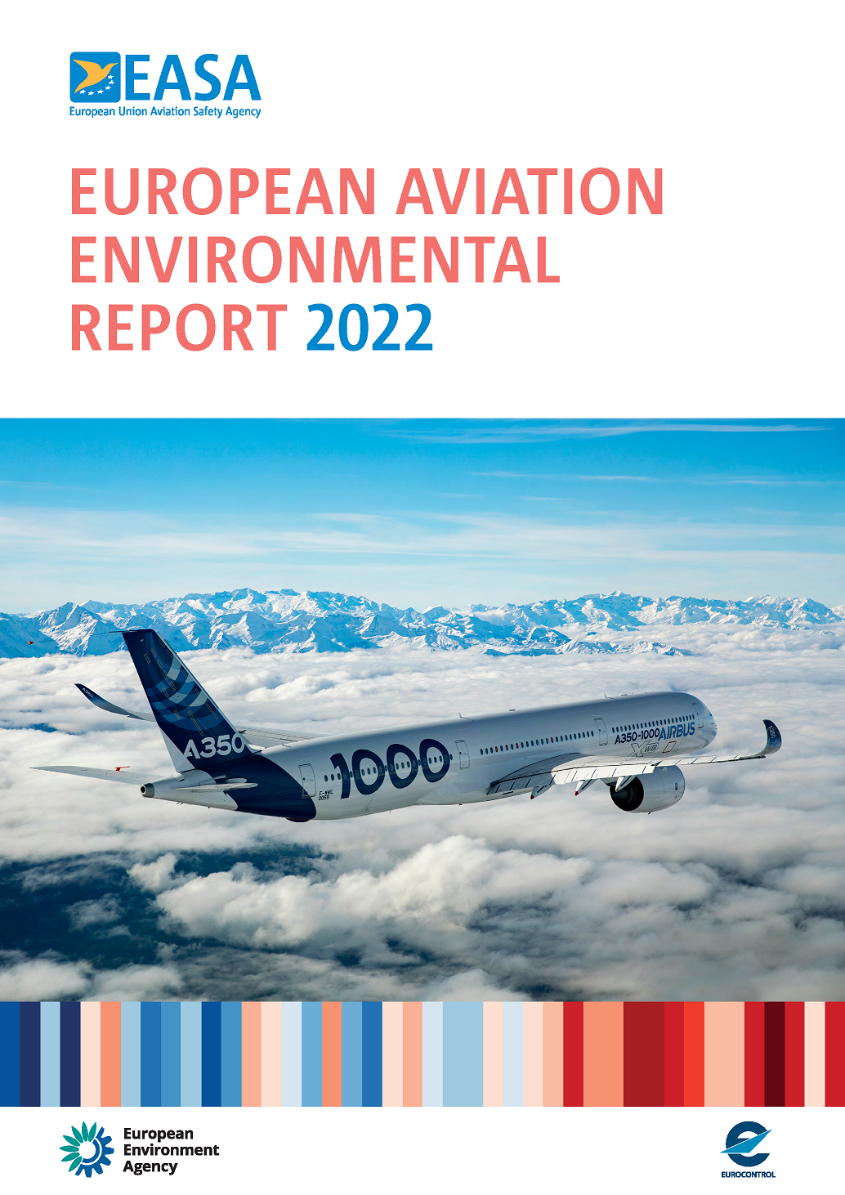
TBO - Why?
ATM Stakes
Safety
Punctuality
Reduce Environmental footprint: CO2, Noise, Non CO2
A Complex environment
Unequal geographical repartition of the flow,
Season & daily peaks
Cross-borders, high number of stakeholders
Speed. 10 sec -> 1,4 NM ⁽¹⁾
Disruptions: Weather, Military-Civil, …
(1): @ 500knt gnd speed

Slide 3
TBO - Why?
individual Flight Optimizat°
Tactical Execution
To allow each flight to fly as close as possible to its optimal trajectory,
To get the best ATM global optimization
Maximize the use of the airspace (capacity),
To lower the environmental footprint.
Traffic Optimizat°
Strategic Flight & Flow Planning
Removing the unnecessary buffers

Slide 4
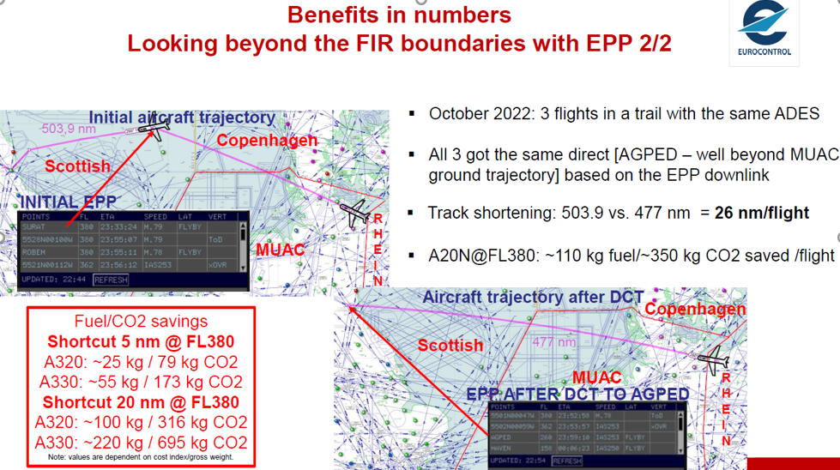
TBO - Why? MUAC example – use of EPP
individual Flight Optimizat°
Tactical Execution
Traffic Optimizat°
Strategic Flight & Flow Planning
Track Miles savings
Avoid premature descent
EPP: Extended Projected Profile, down link of FMS trajectory

