Slide 1
TBO building blocks - Enabling technologies & trajectory sharing
Hugues de Beco – Airbus – head of ATM program

Slide 2
Data Link – the digital enabler for Air-Gnd collaboration
Continental dense airspace
ATC/ATM Functions
Conformance Monitoring
Conflict Detection
Traffic Synchronization
Dynamic Capacity Balancing
Complexity Management
ATC
Flight Plan
AIRCRAFT
Flight Plan
Tomorrow
AF6
TODAY
Tomorrow
Digital Enabler
ATS B2
EPP
ATN B1
ATN B1
ATS B2
TODAY
RnT => Tomorrow
Foundations
VDL mode2
IRIS (Inmarsat)
LDACS
Hyper Connected ATM
Ku/Ka
Lband

Slide 3
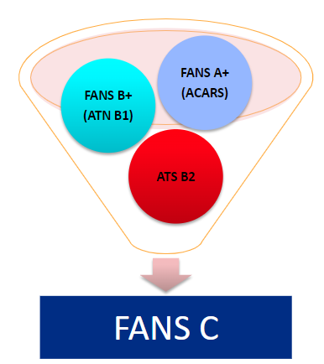
A320 & A330^{(*)}
Eo 2024 | Eo 2027
420 | ~ 1100
^{(*) operating in Europe}

Slide 4
TBO and Collaborative Decision Making
Destination Arpt
safety critical
ACC
Voice
Data Link (B1,EPP,B2)
ACC
ACC
ACC
ACC
Trajectory Sharing
non critical CDM
FMS-EFB-FOC
Airline FOC
Network Manager

