Slide 1
SESAR NETWORK TBO and ATC TBO
Gérard Mavoian & Peter Alty (EUROCONTROL)
Session 3: Experience & Innovation
Global TBO Symposium
Brussels, 04 June 2024

Slide 2
SESAR TBO overview & scope
Pre-departure phase
FF-ICE/R1
Strategic execution
FF-ICE/R2
Tactical execution
Lateral/vertical CPDLC clearances and aircraft downlinked trajectory (EPP)
NETWORK – ATC trajectory synchronization in execution
NETWORK TBO
ATC TBO

Slide 3
The problem
Network Manager
I have the reference trajectory
I have the reference trajectory
ATC
Flight operations Center
I have the reference trajectory
I have the reference trajectory
Pilot

Slide 4
The stakeholders
I need Network services to ease trajectory coordination with AUs and other ANSPs
ANSP
Network Manager
I need to provide network trajectory management services both in planning & execution
ATM Industry
I need Network data and services to improve local trajectory management services
AU Industry
I see important business opportunities. Developments both for dispatchers & pilots
I need less constraints and more flexibility.
I prefer worldwide standardised solutions
Airspace User

Slide 5
Solutions Overview
Project overview
Solution #1
Pre-Departure Phase(FF-ICE/R1)
Lead: EUROCONTROL
Solution #2
Strategic Execution(FF-ICE/R2)
Lead: AIRBUS
Solution #3
Trajectory synchronisation in execution
Lead: EUROCONTROL
Better integration of planned ATC constraints in the AU flight plan and FMS
FF-ICE/R1 Preliminary Flight Planning
Trajectory revision in strategic execution either on FOC, pilot or ATM initiative
Focus on CDM processes involving all ATM actors
NM trajectory updates linked to ACC coordination (OLDI over SWIM)
Use of EPP data in NM processes/systems
Partners (22)
3-years project – Sept. 2023 – Sept. 2026
EUROCONTROL, AIRBUS,
SWISS, CAE, FLIGHTKEYS, COLLINS
SKYGUIDE, ENAV, DSNA, PANSA, BULATSA,
ROMATSA, NATS, COOPANS, SKYSOFT,
THALES, INDRA, LEONARDO, DLR, ENAC
Advisory Board (8)
LUFTHANSA, AIR FRANCE, DASSAULT AVIATION, NAVBLUE, LVNL, DFS, MUAC, SDM
LinkedIn@SESAR 3 Network Trajectory Based Operations (TBO) Project

Slide 6
Network TBO project cooperations
Project links
SESAR
ATC TBO
Green deal projects
Network Manager
FF-ICE
Implementation project
Deployment Manager
NETWORK TBO
TBO IOP European Coordination Group
OLDI
modernisation
INM
Trajectory CONOPS
ICAO ATMRPP
TBO, FF-ICE
Connected aircraft

Slide 7
Probabilistic PTRs
FF-ICE/R1 constraint information & AI model
See the demo at the SESAR TBO stand !
45%
95%
Better integration of ATC constraints in AU flight planning & FMS
AI model to filter out ATC constraints to be considered in pre-departure phase
Enable some ATC TBO use cases using EPP Top of descent information

Slide 8
Trajectory revision in strategic execution
Trajectory revision in strategic execution
Coordinated with ICAO FF-ICE release2 developments
In early phase of developments, tabletops:
European tabletops (2022 & 2023)
Joint tabletop with FAA, IATA and NavCanada for interregional traffic (June 2023)
European FF-ICE/R2 services in phase of prototyping
Additional tabletops to address other ICAO regions and new use-cases (e.g. Green Deal projects)

Slide 9
NETWORK TBO beyond 2026
2023 2026 2029
Solution 1 Pre-departure phase (TRL6)
Industrialisation LOAs integration & AI model
Industrialisation FF-ICE planning service
Solution 2 Strategic execution (TRL4)
FF-ICE/2 services validation (TRL6)
FF-ICE/R2 services preliminary demonstrations
OLDI over SWIM demonstration and industrialisation
Solution 3 Trajectory synchronisation in execution (TRL6)
EPP use in NM
Industrial research
Demonstration
Implementation

Slide 10
ATC-TBO
NET-TBO
ATC-TBO
Planning>Strategic Execution>Tactical Execution
Coordination & Separation
ATM aims to optimise network performance, whilst minimising deviations from airspace users’ requested trajectories
But trajectories may need to change in flight due to crossing traffic, weather hazards, arrival procedures, airspace user operational needs..!
ATC-TBO validates use cases that provide flexibility to deal with uncertainty in flight execution..
Source = draft ICAO Global TBO Concept version 0.11
Notes:
This slide originates from the SESAR3 Members TBO Focus Group which was formed to coordinate TBO proposals for the SESAR3 IR Wave1 around May 2022. The slide aims to give a wide range of stakeholders a common framework for TBO.
Derived from the Trajectory Management Document which in turn is based on ICAO documentation:
1- Tactical execution? The tactical execution phase is within the coordination and separation horizon of the executive and planner ATCOs. Where, in most cases, coordination is about the conditions under which aircraft are transferred between air traffic controllers (e.g. flying on a radar heading or a trajectory :-)) or otherwise operate near the border between their areas of responsibility (e.g., flying parallel but close to the border).
2- Why tactical execution? Once a flight is in execution, the trajectory may need to change, for example, due to weather hazards, crossing traffic, restricted/danger areas, and arrival procedures and runway configurations at the destination airport, separation management, airspace user operational needs.
The Global ATC TBO Concept (draft version 0.11) at section 3.3.6 (IN-FLIGHT RE-PLANNING AND AGREED TRAJECTORY REVISIONS ) highlights the following reasons for in-flight trajectory revisions:
• The AU may initiate re-planning as updates to forecasts, fleet management, or changing mission objectives may require modifications to the Agreed Trajectory
• Perturbations to a previously-agreed trajectory (e.g., due to wind uncertainty, or conflict management (CM) actions) may result in the update no longer complying with required constraints
• Updates to forecasts result in the re-evaluation of the concept component objectives, these may require revisions to the Agreed Trajectory to meet the objectives (e.g., a change in arrival capacity requires a revision for DCB)
• Improvements in prediction accuracy as the flight operates allows constraints to be relaxed for all impacted flights.
3- What are the links between the NET-TBO and ATC-TBO projects. NET-TBO addresses TBO in the planning and pre-departure phase.
The TMD at edition 02_02_00 contains the following statement at section 6.3.1.4.2:
“SESAR 3 NETWORK TBO-3 “Trajectory Synchronisation in Execution”: This solution contributes to the Trajectory Based Operation by improving both ATC and network processes through synchronization of network and ATC local trajectories. Its target is to validate at TRL6 maturity level the following concepts:
The synchronization of network and ATC local trajectories will be achieved by improving the information exchanges between the Network Manager (NM) and ANSPs, by providing the ADS-C report and inter ACCs coordination information to NM and by enhancing the inter ACC coordination.
The improvement of the information exchanges between the Network Manager and ANSP includes the provision to NM of the inter ACC coordination results and of the Clearance in Advance uplinked to the aircraft. This information and the ADS-C report (including EPP) is used by NM to improve the flight trajectory predictions.”

Slide 11
Use case example – enhanced vertical clearances
The Problem
The Solution
Uncertainty
-> Inefficient flight profiles
-> High controller workload
Optimised flight profiles
Reduced fuel-burn / emissions
Reduced controller workload
ADS-C EPP downlink
-> Reduced Uncertainty
Conflict Resolution Algorithm
-> Non-penalising constraints
CPDLC
-> Auto-load for quick entry into FMS
-> Separation Assured
Visit Demo in Lobby!

Slide 12
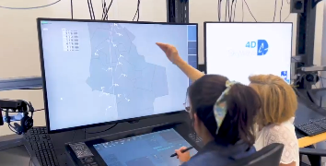
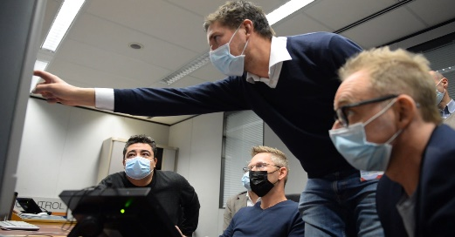
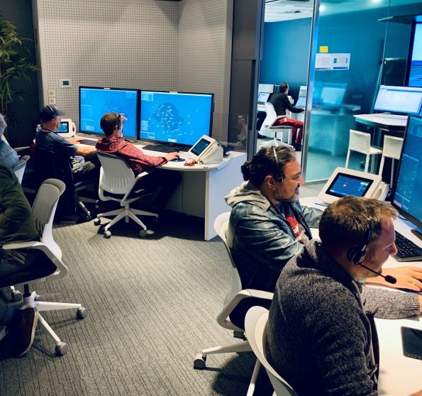
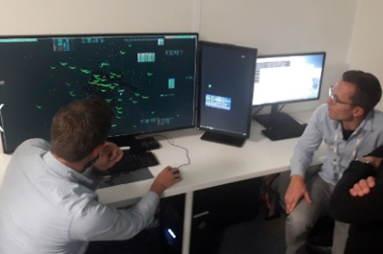
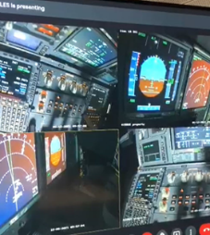
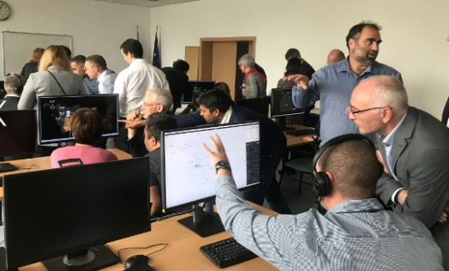
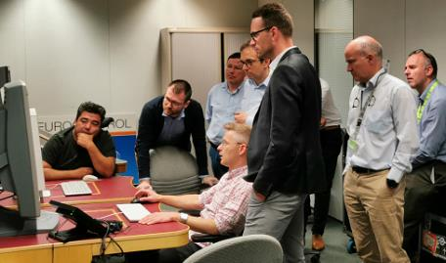
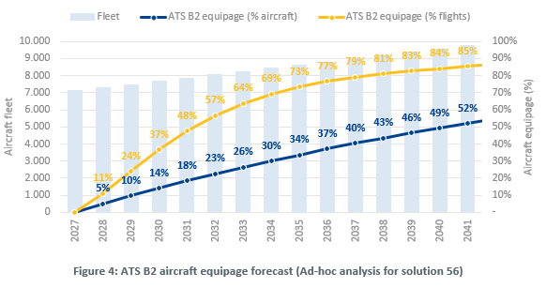
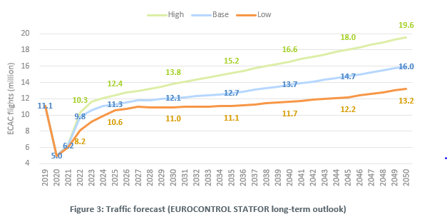
SESAR 2020 outcomes – 4DSkyways to 2023
Use case validation:
Enhanced TP accuracy for trajectory prediction and conflict detection & resolution, alerting adverse weather areas…
CPDLC complex clearances: lateral issued downstream, vertical with non-penalising constraints, conformance monitoring….
Increasing traffic and ATS-B2 (ADS-C EPP + CPDLC) equipage scenarios
Real-time simulations on multiple industry/operational platforms across Europe
Concepts/enablers operationally feasible (V2+/TRL4+):
Improved trajectory prediction and improved CD&R tools with more reliable detection envelope
Lateral and vertical complex CPDLC clearances enables ATCO workload reduction and increased capacity especially combined with enhanced TP accuracy use cases
In line with outcomes from SESAR large scale demos (e.g. ADSCENSIO) and experience in the field at MUAC

Slide 13
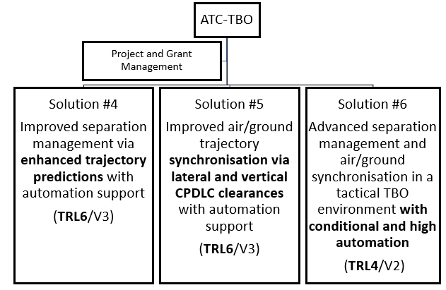
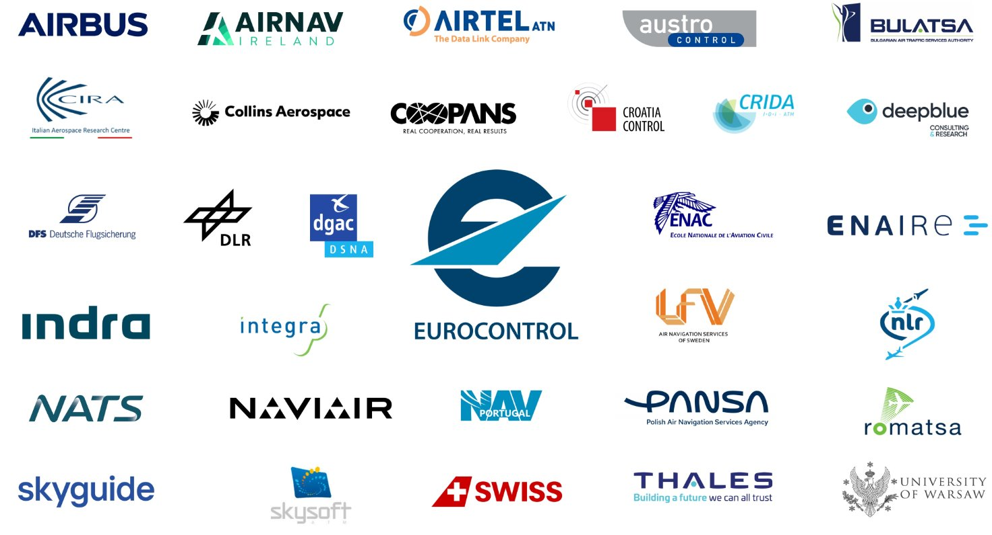
SESAR3 ambitions – ATC-TBO until mid-2026
Solutions #4 and #5
Complete validation of operational and technical integration aspects to assess TRL6 maturity
Engage with airspace users, ANSPs and industry, to align expectations on benefits and operational acceptability to facilitate deployment
Solution #6
Validate operational feasibility for future TBO concepts with actions increasingly initiated by automation to assess TRL4 maturity
Focus on value throughout:
Validating environment, capacity, operational efficiency, cost efficiency, safety, security benefits
Supported by validation reports, performance assessments, Safety/HP/Security assessments, CBA

Slide 14
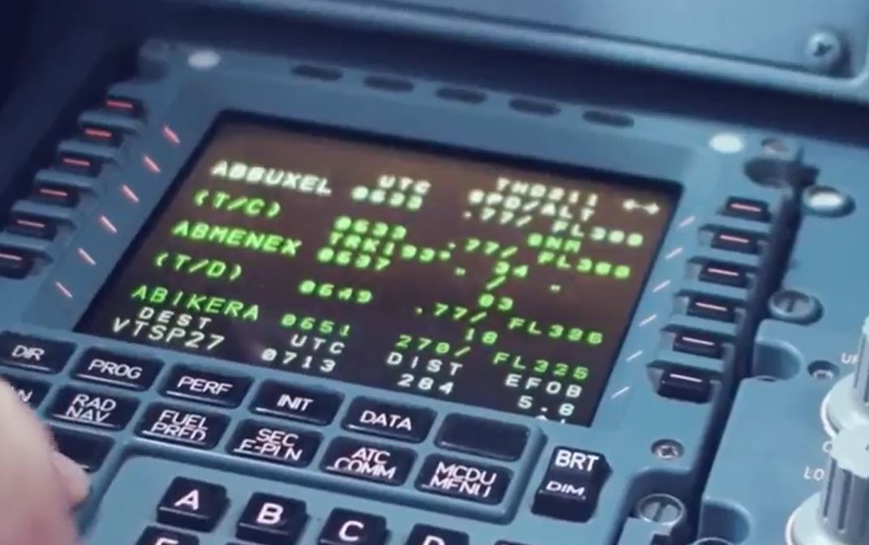
Key insights from past and current R&I work for ATC-TBO
Benefits strongly linked to rate of ATS-B2 (ADS-C EPP and CPDLC) equipage
Latency and channel capacity influenced by air/ground communications network performance
Validation of complexity and workload in the cockpit is key
Strong ATCO and Flight crew involvement key to gain trust notably for automation aspects

Slide 15
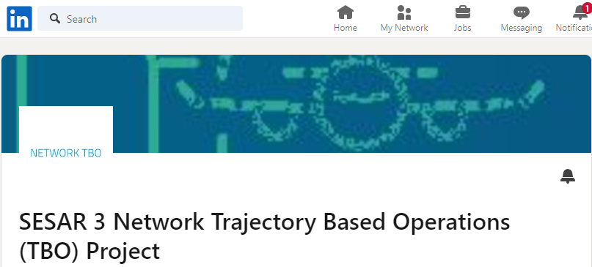
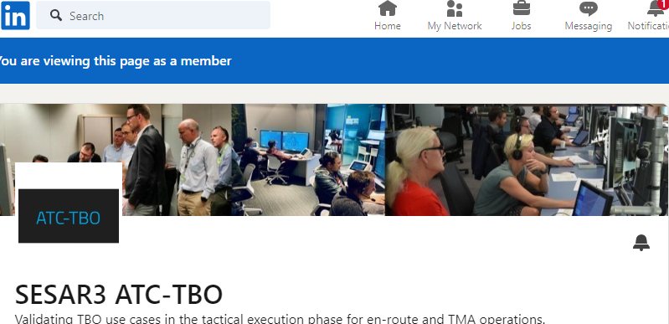
THANK YOU!
This project that has received funding from the SESAR 3 Joint Undertaking under the Horizon Europe’s research and innovation programme under grant number grant agreement No 101114748.
This work has received funding from the Swiss State Secretariat for Education, Research and Innovation (SERI)
This project has received funding from the SESAR3 Joint Undertaking under the Horizon Europe’s research and innovation programme under grant number 101114808.
This work has received funding from the Swiss State Secretariat for Education, Research and Innovation (SERI)
UK participant NATS in ATC-TBO receives funding from UK Research and Innovation (UKRI) under the UK government’s Horizon Europe funding guarantee [grant number 10109613].

