Slide 1
Asia Pacific TBO Pathfinder
Global TBO Symposium
Session 7 – Regional Perspectives
5 June 2024
Notes:
Good afternoon to all.
Sharing on Asia Pacific’s initiatives and effort to progress TBO in the region.

Slide 2
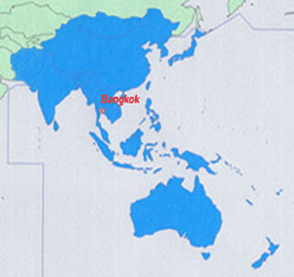
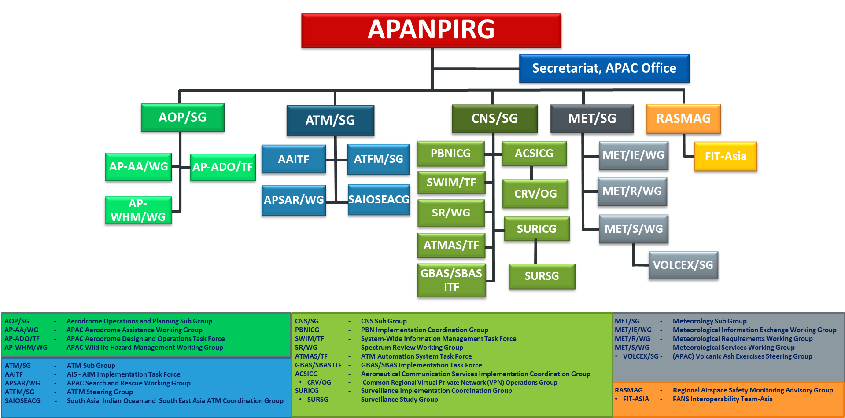
Overview
- ICAO Asia and Pacific Region
ICAO Asia and Pacific (APAC) is a diverse region
  39 Contracting States
APAC Air Navigation Planning and Implementation
  Planning and Implementation Regional Group (PIRG) and contributory bodies
  Asia/Pacific Seamless ANS Plan for harmonised improvements
APAC Seamless ANS Plan
  Anchored to Global Air Navigation Plan (GANP)
  Implementation
    Phase IV by 27 Nov 2025
    Phase V by 23 Nov 2028 (being defined)
ICAO Asia and Pacific Region
Planning and Implementation Regional Group
Notes:
Sharing on the background and set up of the ANSPs in Asia Pacific.
APAC is formed up of a diverse group of ANSPs, with 39 contracting states, with unique ATM challenges.
In the Asia-Pacific region, air traffic management is coordinated through the Asia-Pacific Air Navigation Planning and Implementation Regional Group (APANPIRG), which operates under the ambit of the International Civil Aviation Organization (ICAO). On the right you can also see the contributory bodies focused on the various areas such as aerodrome operations, ATM, CNS, Met, Regional Airspace Safety Monitoring Advisory Group that covers the spectrum of implementation matters.
The main guiding document to coordinate on ATM developments and initiatives in APAC is through the APAC Seamless ANS Plan, linked to the GANP.

Slide 3

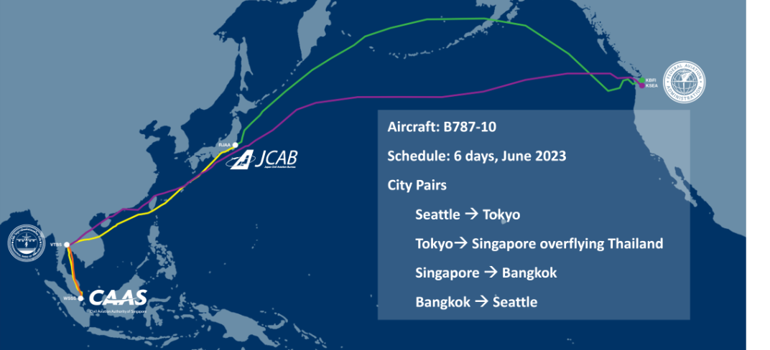

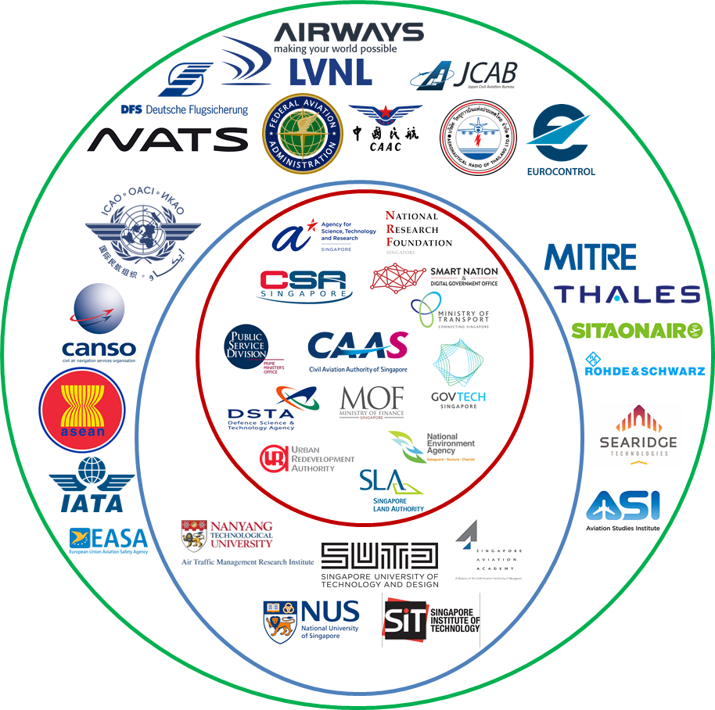
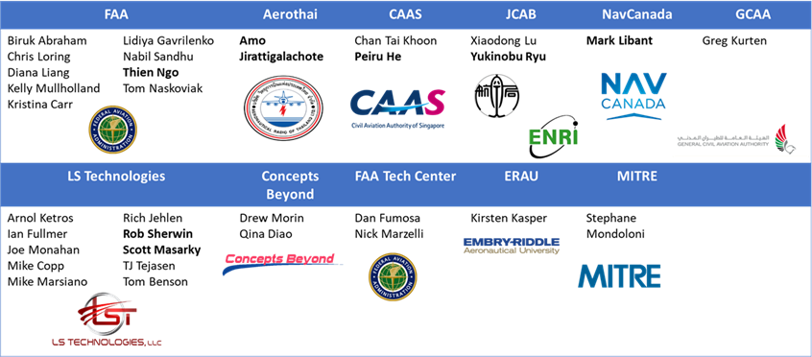
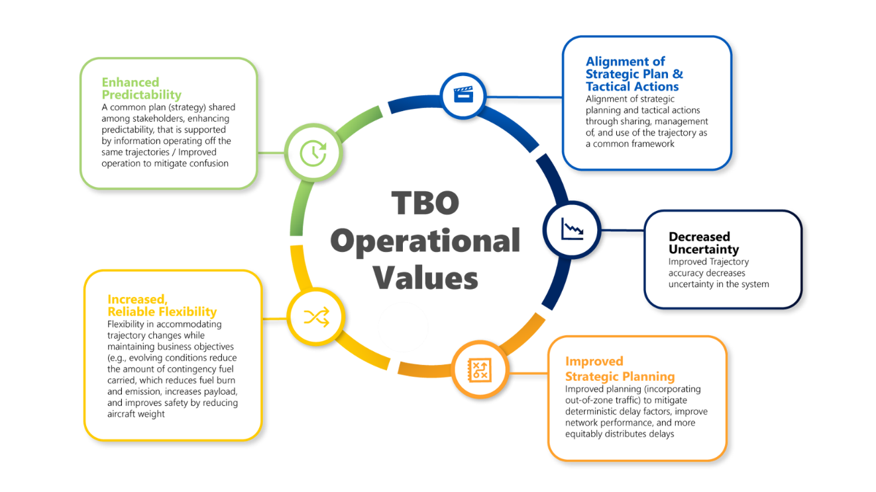
Progressing global TBO concept in APAC
- Multi-Regional TBO
Multi-Regional TBO demonstration
  Aims to identify, mature, and demonstrate key TBO capabilities with international partners
  Five ANSPs (i.e. AEROTHAI, CAAS, FAA, JCAB and NavCanada)
Duration
  July 2020 – June 2023
TBO scenarios showed capabilities such as
Trajectory negotiation (pre and post-departure)
Exchange of updated trajectory b/w ATM stakeholders
Improved collaborative decision making
Enhanced demand and capacity balancing
Mixed-mode operations
KSEA
(Seattle-Tacoma)
CYYZ
(Toronto)
KLAX
(Los Angeles)
KIAH
(Houston)
RJAA
(Narita)
VTBS
(Bangkok)
Alignment of Strategic Plan & Tactical Actions
Enhanced Predictability
WSSS
(Singapore)
Decreased Uncertainty
Lab Scenarios
Live Flight Demonstration
Increased Reliable Flexibility
Initial work to envisage TBO in the APAC region
  TBO scenarios were developed and demonstrated in lab simulations
  Live flights demonstration
Improved Strategic Planning
Notes:
In 2020, some APAC partners came together to participate in the MR TBO project.
The MR TBO was a multi-regional project, led by the FAA, and a collaboration between Japan, Singapore, Thailand, to identify, mature, and demonstrate key TBO capabilities with international and industry partners.
The project spanned over 3 years, and included lab demonstrations of the operational scenarios to be tested, and ended with a Live flight demonstration.
Partners came together to design operational scenarios that would showcase capabilities such as Trajectory negotiation, enhanced DCB and mixed-mode operations.

Slide 4
Progressing global TBO concept in APAC
- APAC TBO Pathfinder
APAC TBO Pathfinder Project will define high-level planning and implementation towards evolutionary step 3 of GANP conceptual roadmap
Recall GANP conceptual roadmap
Role of APAC TBO Pathfinder Project
  Define, develop, demonstrate TBO for APAC
  Discover pathways and establish roadmaps
Evolutionary Steps:
Flight ops in a digital rich environment
Time-based operations enabled by an information revolution
TBO enabled by full connectivity through the internet of aviation
Total performance management system focus on business/mission needs
Notes:
Following the conclusion of the MR TBO live flight demo, the region was looking towards other opportunities to continue the good work done at the MR TBO. This led to the formation of the APAC TBO Pathfinder, as one of the initiatives from the APAC ANSP Committee, a committee formed under DGCA.
To recap, as part of the GANP conceptual roadmap evolutionary steps, step 3 looks at TBO enabled by full connectivity through the internet of aviation.
The APAC TBO Pathfinder is set to define, develop and demonstrate TBO for the region, to have the high-level planning and implementation on the Evolutionary step 3.

Slide 5

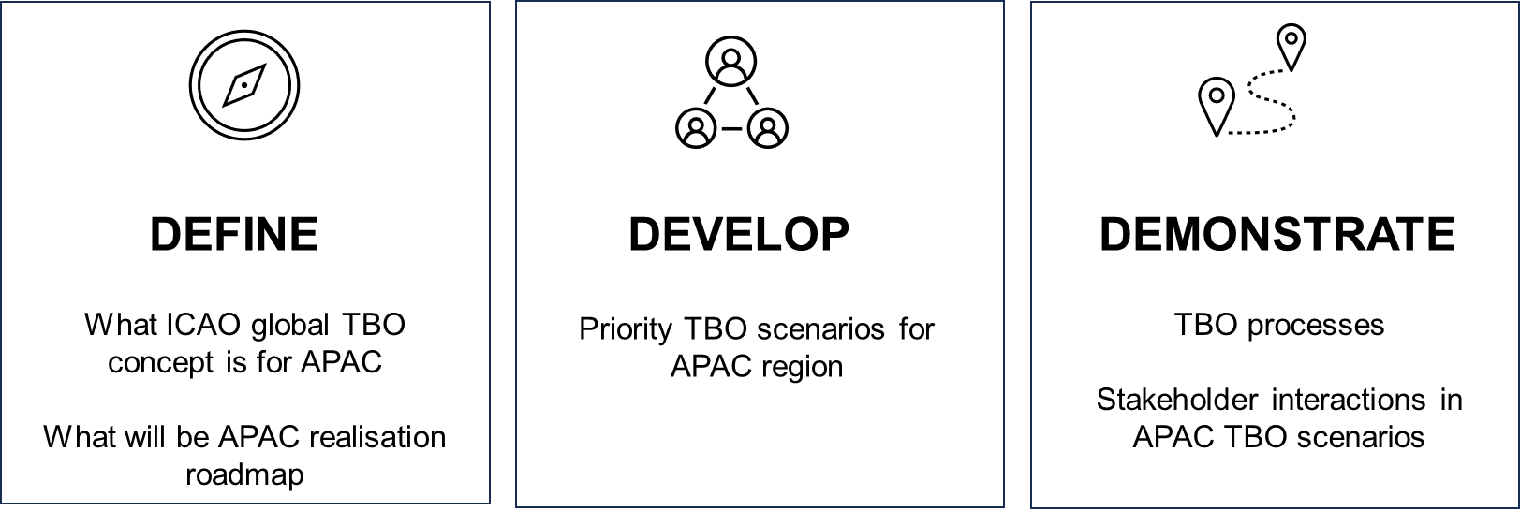











An initiative under the Asia and Pacific ANSP Committee
- APAC TBO Pathfinder
Letter of Intent (LOI) signed on 23 October 2023, now involving 11 ANSPs, CANSO and IATA
Over the next 4 years:
PARTICIPANTS
OBSERVERS
Notes:
The objective of the APAC TBO pathfinder is to define, develop and demonstrate.
We now have 9 ANSPs and 2 Ios coming onboard, and another 2 ANSPs as observers.

Slide 6
APAC TBO Pathfinder
- Kick-Off Meeting (3 to 5 April 2024)
Agreed on goals of APAC TBO Pathfinder Project
Agreed on organising framework
  Grouping and Tasks
  Leads of each group will form Core Group that steers project
  Members of each group
Agreed on high-level deliverables and timeline
  For each of the goals
Facilitated consultation and information exchange
  Sharing on global TBO concept, SWIM, FF-ICE and Connected Aircraft concepts
  TBO from airline’s perspective
  ANSPs’ plans and state of development for TBO and/or enablers
Tiered- Level Participation
Full
Capabilities:
- SWIM, FF-ICE, Connected Aircraft
Key Focus : Trajectory revision
Key activity: Operational data collection
Partial
Capabilities: SWIM, FF-ICE/R1
Key Focus : Filing and negotiation
Observer
Broadening Opportunities
Notes:
Held the first Kick-off meeting in Singapore, from 2 – 5 April.
The project participants came together to discus and agree on the goals, organising framework, high-level deliverables and timeline.

Slide 7
Organising Framework
- 3 Workgroups with each leading specific goal(s)
Workgroup 1
Goal 1 Achieve a common understanding of what ICAO global TBO concept is for project participants and for APAC ATM stakeholders
Objective Influence executives that TBO is a priority and achieve commitment to drive the necessary outcomes Inform technical & operational stakeholders on what TBO is and what it means for the region Support continuous learning by APAC ATM stakeholders
Workgroup 2
Goal 2 Recognise and appreciate operational values arising from demonstrating identified regional TBO scenarios and city-pairs Implement SWIM for 1st operational use case in the region Implement initial FF-ICE/R1 services with identified city pairs
Objective Study and articulate operational values of TBO in APAC through definition & demonstration of regional TBO scenarios and city-pairs participation
Workgroup 3
Goal 3 Analyse benefits of regional TBO scenarios and achieve consensus among project participants that APAC has to realise TBO in line with regional needs and ICAO global developments
Objective Analyse benefits of regional TBO operational scenarios with identified city pairs Deliver APAC TBO Roadmap agreeable to project participants which will be tabled, to APAC ANSP Committee and to APANPIRG for adoption in APAC Seamless ANS Plan at earliest opportunity
Notes:
The project participants came up with 3 main goals for the Pathfinder project, and formed 3 workgroups to drive the goals and deliverables under each workgroup
The first group is focused on achieving a common understanding of the ICAO Global TBO concept, for the APAC ATM stakeholders. This includes working with regional leadership on recognising that TBO is a strategic priority, so as to set aside resources to deliver the outcomes of the project. This includes getting the technical and operational stakeholders involved. One of the deliverables for this group also includes coming up with a curriculum plan and repository to support continuous learning of TBO concepts and their enablers.
The second group is tasked to recognise the necessary ops values, to be demonstrated through the ops scenarios and city pairs that would be jointly designed. A nearer term goal, in parallel, is to support the work on implementing SWIM and initial FF-ICE/R1 services.
The last group is focused on the benefits analysis of ops scenario, as design by WG2. One key deliverable of the Pathfinder project, as we shared at the beginning, is the defining the APAC TBO realisation roadmap. This would be completed by the end of the project timeline, and eventually be tabled and submitted to AAC and APANPIRG to be incorporated in the APAC Seamless ANS Plan.

Slide 8
Key Milestones and Timelines
2024
2025
2026
2027
2028
IP to CNS SG/28
DGCA/59
(draft edu frmwrk)
Completion of TBO Education Framework
Annual review & update of package
Annual review & update of package
Annual review & update of package
Update to DGCA/60
IP to ATM/SG
WG1
Update to APANPIRG/35
Complementary materials developed
CANSO APC3
Start developing complementary materials
Update to APANPIRG/36
Launch of Repository
Determine
Cap Levels
Ops Value
Ops & Tech Interaction
Initial Use Cases
Develop FF-ICE/R1 Scenarios, Required Applications
Integration and test
FF-ICE/R1
Dry Run
Demo event
Completion of Connected Aircraft System Test (tentative)
TBO Execution completed
WG2
Transfer of FF-ICE/R1
FF-ICE/R1 readiness test & Develop Demo plan
TBO Trial prep
Completion of FF-ICE/R2 Lab Demo (tentative)
Roadmap completion
WG3
Info #1 @SG (April)
Kick-off Meeting
Info #2 @ Thailand (June)
FF-ICE/R1 Workshop + Table-top Ex (TTX)
TBO Trials
Info #4
Info #3 @ US (July) Connected Aircraft
Project Meeting #2
Lab Demo #1
Project Meeting #4
Project Meeting #5
Project
Meeting #3
Info #4
Agreement on data elements
Availability of sample data
Complete initial Benefit Analysis
Conduct experimental analysis
Initial draft of roadmap
Document feedback / qualitative benefits
Initial post trial analysis
Notes:
This table presents the timeline of all the major activities that has been planned out by all the Workgroups

Slide 9
Summary
APAC TBO Pathfinder creates the opportunity for APAC ANSPs to collaboratively evolve the region towards TBO
As an initial step, it facilitates a common understanding of TBO for APAC aligned to the global TBO concept
Going forward, it can be a platform and focal point for APAC to collaborate on inter-regional TBO developments and harmonisation

Slide 10
Thank you

