Slide 1
Global TBO Symposium
4-6 June 2024
Session 1
Why TBO? What are the operational benefits?
Razvan BUCUROIU
Head of Airspace and Capacity Division
Network Manager
EUROCONTROL

Slide 2


The Challenge
Busy day in 2035
50000 flights

Slide 3





3 major priorities to meet the network performance challenges
Seamless airspace organisation
Open digital infrastructure
Air ground integration

Slide 4

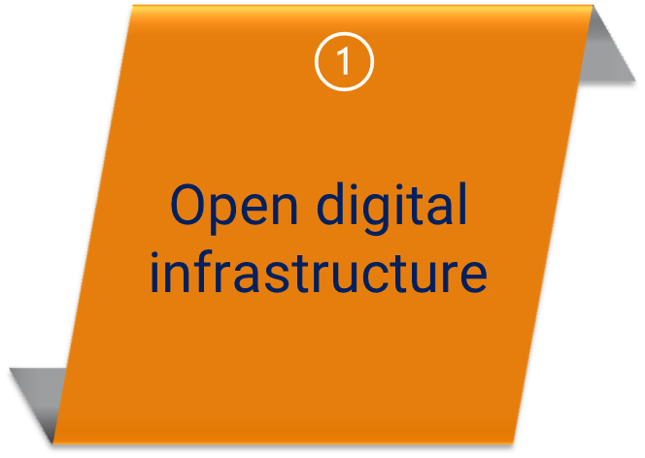


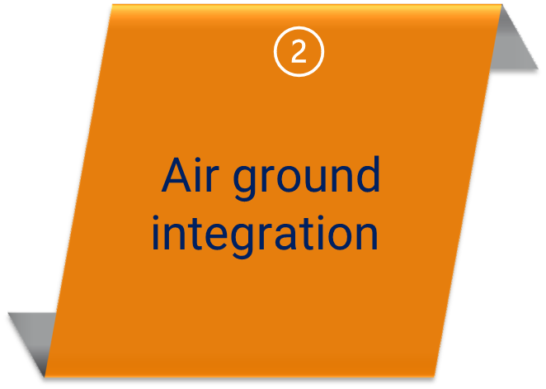
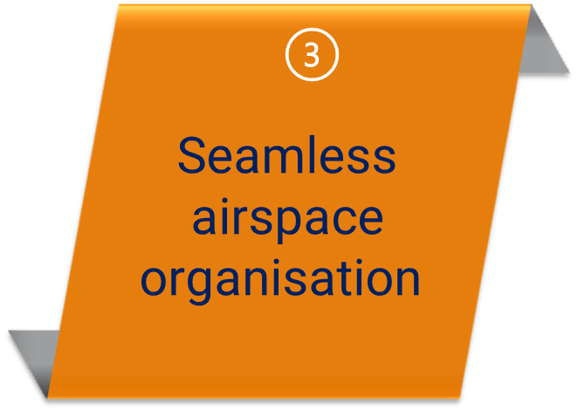


























40
  ATM SYSTEMS
  DIFFERENT EVOLUTIONS
  Open & Modular Architecture
  Flexible Systems

Slide 5
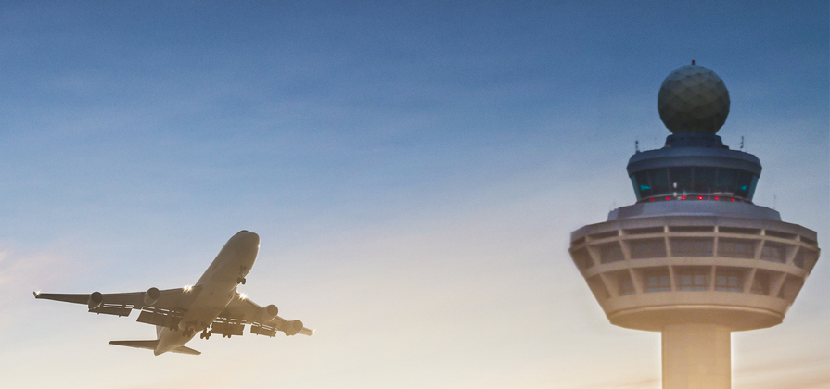
Air ground
INTEGRATION

Slide 6

SEAMLESS
airspace organisation

Slide 7
Solid strategic context

Slide 8











Optimisation of airspace situational awareness
Dynamicity/ scalability/ flexibility/
resilience of network operations
  Reduced ATC workload
  Increased Capacity
TBO
  Environmental benefits
Benefits
Integration of new entrants
Increased predictability and more accurate demand capacity balancing
Better use of available capacity,
meeting of the challenges of demand waves
8

Slide 9
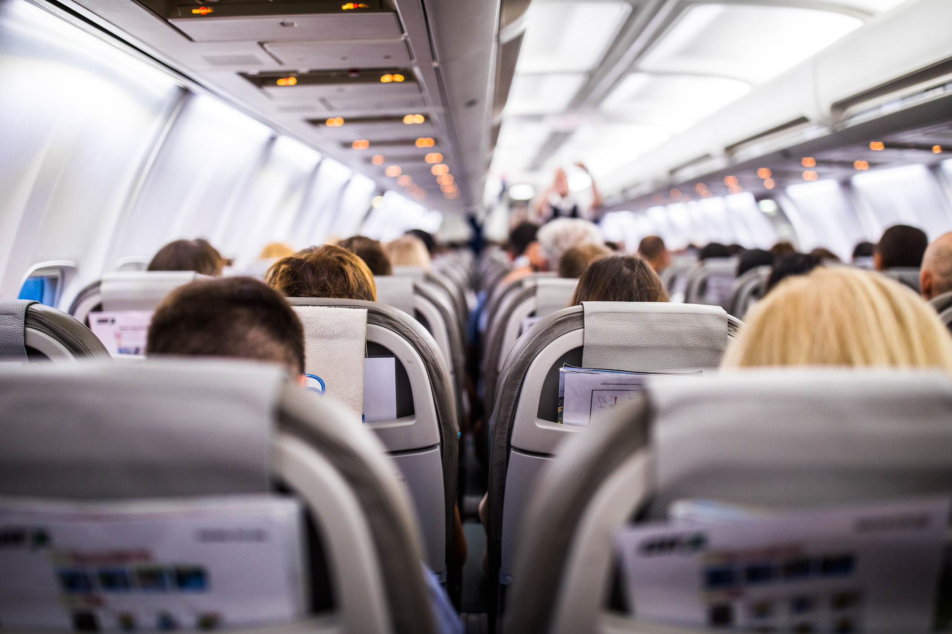
En-route ATCO Productivity expected to double
Average working time to process 100 flights (current vs 2040):
Reduced by ~50%
100% sector capacity increase:
45 flights/hour (current) → 97 flights/hour (2040)
Mode S over-interrogation on 2 March 2023

Slide 10

TBO Possible European Network Benefits
Reducing air transport delay
700 million €
Environmental benefits
6.5 million tons CO2 – 1.7 billion €
Reduction of strategic delays – structural savings
(less range of buffers around the scheduled times)
Less variation between the flight planning and airborne phase
Improvement of flight efficiency and predictability
(better estimation of the TMA entering gate and the vertical descent profile)

Slide 11

Shortening Time to OPS – the single value chain
RND
PLANNING
DEPLOYING
OPERATIONS

