Slide 1
GLOBAL TBO SYMPOSIUM Towards global trajectory-based operations (TBO)
Session 4. TBO building blocks: Enabling technologies and trajectory sharing
V. Travers Sutter, Head of iCNS Unit, EUROCONTROL

Slide 2
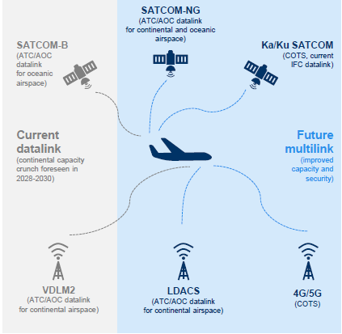
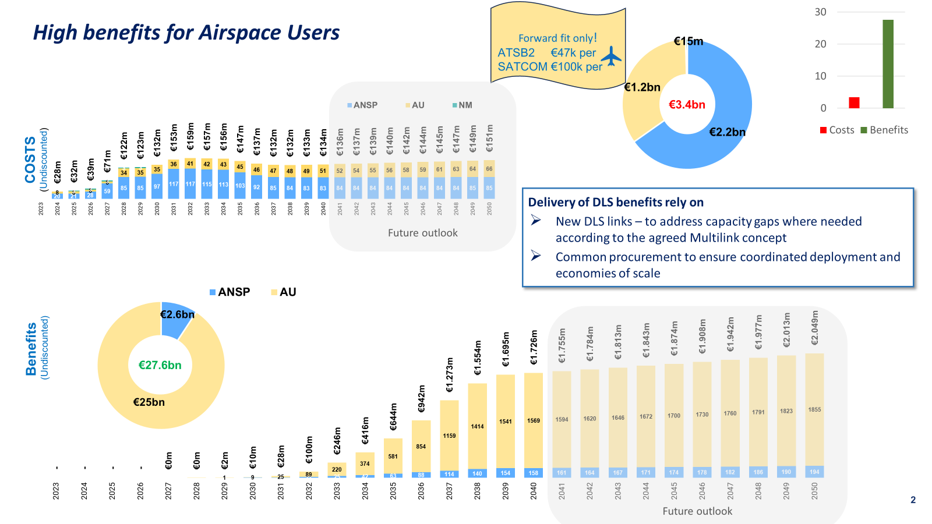
Future Datalink Services (DLS) as a key building block for a Digital European Sky
2023
2024
2025
2026
2027
2028
2029
2030
2031
2032
2033
2034
2035+
ATS B2 applications
ATN B1 services (CPDLC v1)
ATS B2 (ADS-C/EPP + CPDLC v2)
ATC-TBO (Trajectory Based Operations) deployment and operations (progressive ramp-up)

Slide 3
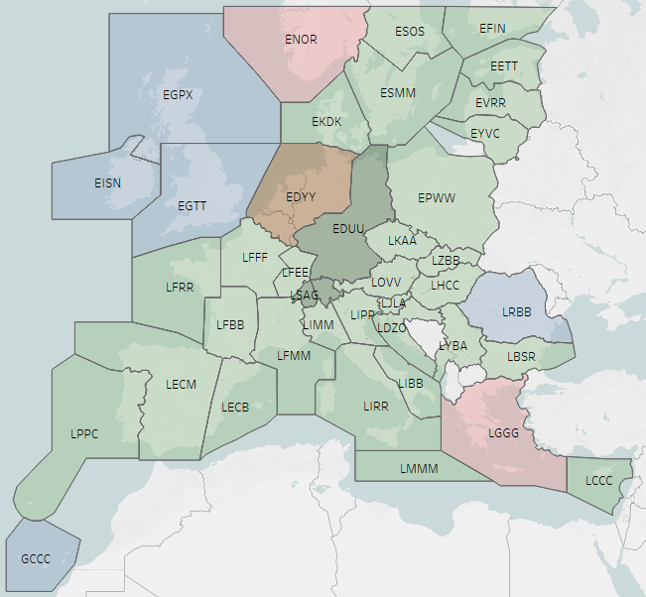
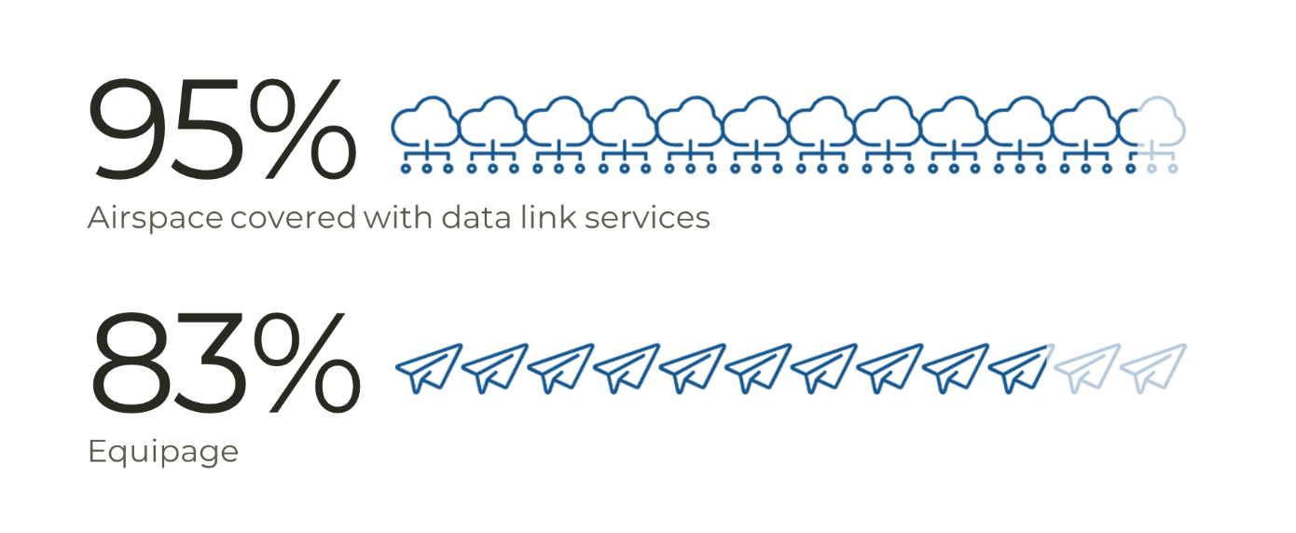
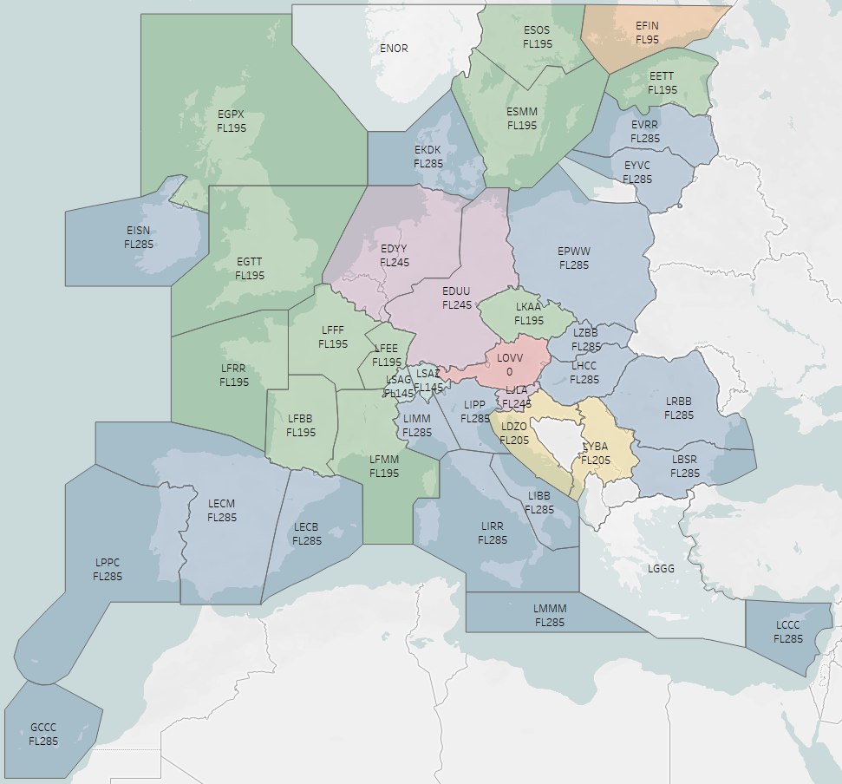
Today’s European datalink services implementation
Since 2023
Operational usage +30 %
Notes:
Map 1 : services / Logon LIST EDYY, EDUU, LSAG, and LSAZ (not visible) with France planning to join the club
Map 2 : implementation flight level – European rule is DLK services at FL285, we observe some going below. !!! The colour codes are not the same.
Recently LYBA is a newcomer in the DLK operations. We expect Norway to join (2025)

Slide 4
Tomorrow’s Multilink approach
Supplement VDLm2 with new links :
with a SATCOM Class B system
Available Certified Service (IRIS)
And/or Other future links
Other SATCOM links
new terrestrial technology such as LDACS
Commercial Of-The-shelf Services (hyper–connected ATM).
IRIS implementation step to be decided end of 2024

Slide 5
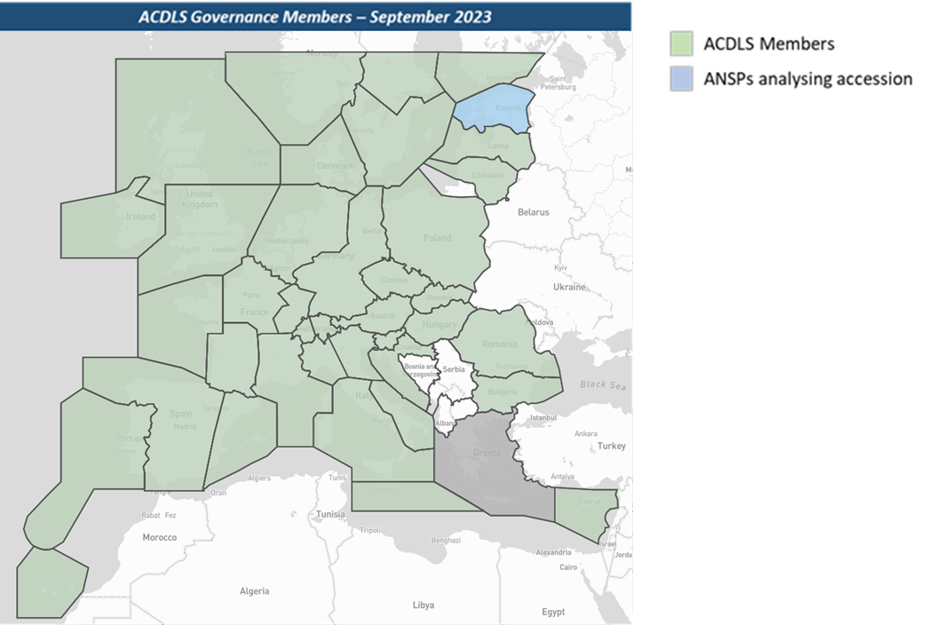
ACDLS (ATS Common DLS procurement)
A Structural Enabler to reduce fragmentation and foster market evolution
What is in the call?
VDLM2 as a baseline, SATCOM and ADS-C CS as an option
SLA targets, Monitoring infrastructure
Who ? 26 ANSPs
CSP
CSP
ISP
Future Links…
Datalink
Service
Provider
What for?
Increasing European datalink performance through the harmonisation and optimisation of DLS services.
Facilitating the implementation of new services and technologies, thereby facilitating the modernisation of the infrastructure in a consistent way (exple, SATCOM Class B / IRIS)
Ensuring a common prioritisation and resolution of DLS issues,
Pooling datalink expertise to commonly drive developments
Delivering a DLS certified pan-European service
Mutualising service delivery costs
Enabler for CP1/AF6 deployment
ANSPs
09 2025

Slide 6
AF6 Initial Extended Projected Profile (EPP) applications
MUAC operational
Supporting Standards for ADS-C / EPP
SESAR initial trajectory information sharing
Comparison of FMS 3D trajectory with ground trajectory –– CP1 mandate
(Industrial gate passed)
Vertical profile improvement thanks to visibility of FMS Top-of-descent (TOD) by ATC
CONOPS was a pre-requisite for this specification
(builds on SESAR deliverables & demonstrations)
Based on existing MUAC operations, ongoing demonstrations and deployment
Covers Logon and ADS-C Common Services
delivered end 2023

