Slide 1
HQ Air Force Flight Standards Agency
UNCLASSIFIED
Embrace Opportunities ~ Provide Results
Benefits of Trajectory-Based Operations
Mr. Edgar Wright
Executive Director
HQ AFFSA
June 2024
This Briefing is: UNCLASSIFIED
UNCLASSIFIED
1

Slide 2
TBO Benefits
Flexibility:
State (military) aircraft have unique operational requirements; TBO allows for customized trajectories to accommodate these needs efficiently
Efficiency:
TBO allows for more direct routing, reducing fuel consumption and emissions while optimizing airspace usage
Predictability:
Providing a clear trajectory for each aircraft, TBO enhances predictability in ATM, reducing the likelihood of conflicts and delays

Slide 3
TBO Benefits
Safety:
Clear and predefined trajectories help ensure safe separation between aircraft, reducing the risk of conflicts or airspace infringements
Cost Savings:
With optimized routing and reduced delays, TBO can lead to cost savings for all aircraft operators in terms of fuel, maintenance, and overall operational expenses

Slide 4
Incentive Program
Mission Execution Excellence Program (MEEP)
Incentive-based, cultural change initiative focused on optimizing aviation fuel use in heavy aircraft
Encourages energy efficient behaviors
Assessed based on multiple metrics, including
Accurate fuel planning
Implementation of best practices
Advancements in operational energy processes
Projected to save approximately $80 million annually

Slide 5
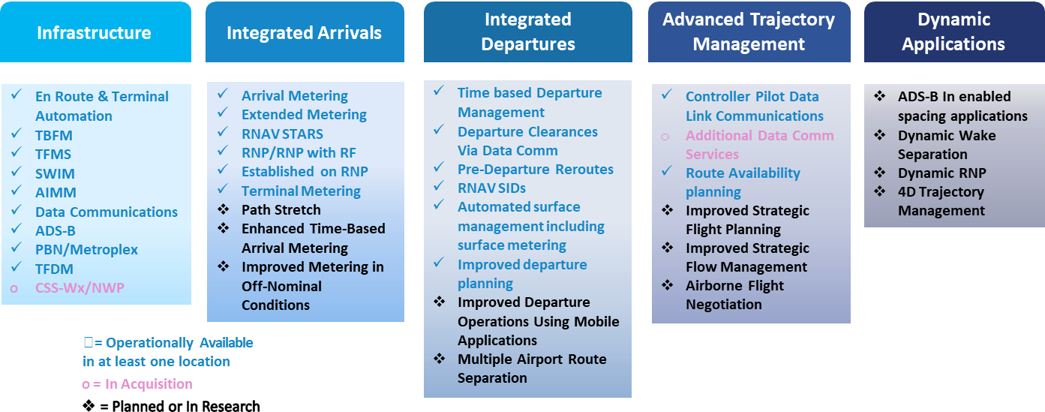
Key Capabilities by Theme
Advantageous
Favorable

Slide 6
Summary
TBO could be advantageous for certain military aircraft that fly standard routes
(ex. air refueling and transport-type)
fuel savings
airspace scheduling
flight operations deconflicting civil and military users
Despite these potential benefits, military operators may prefer not to have their operations managed by TBO, as it involves timing dictated by flow control
The military prioritizes mission effectiveness over efficiency, so there may be minimal benefit realized using TBO
TBO is not designed with military needs in mind

Slide 7
Questions?

