Slide 1




Taking TBO Global:
SDM/EUROCONTROL & FAA Collaboration
On FF-ICE Implementation
June 5, 2024

Slide 2


Introduction- Why are US & EU coordinating this?
Support global harmonization between the FAA’s and EU's implementation of ICAO concepts / technologies
Assist with the coordination of deployment
Planning and implementation activities.
Promote harmonization and interoperability
EXCOM
CCOM
DCOM
SWIM
Data Link
MoC
FF-ICE

Slide 3



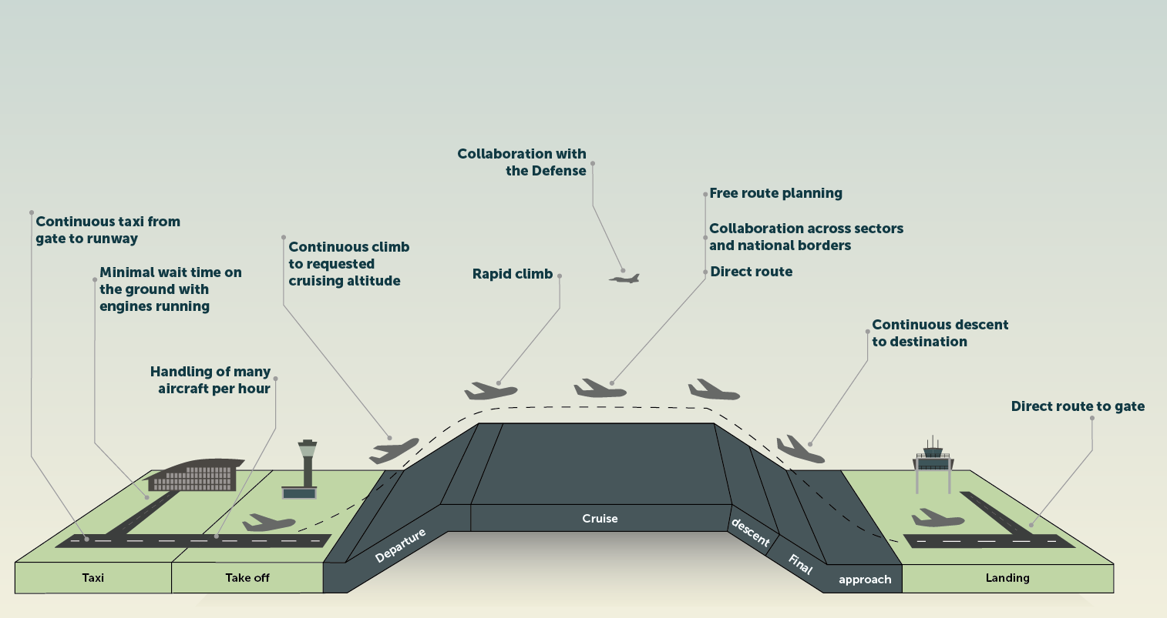
FF-ICE Enabling TBO – it is about trajectories
eASP
Agreed Trajectory Updated as needed, to align with Tactical Changes issued by ATC or other factors
Strategic Renegotiation as needed, resulting in new Agreement that’s coordinated with ATC for Delivery to Pilot
Preliminary Flight Plan Filing
Flight Plan Filing
Desired Trajectory
Agreed Trajectory
Re-evaluation of Agreed Trajectories as Constraints Emerge
Initial Negotiation with eASP(s)) Resulting in an Agreed Trajectory
Post-Departure Negotiation & Flight Re-Planning
Pre-Departure Flight Planning & Filing
Predeparture
Execution
Post Flight
FF-ICE R1
FF-ICE R2
System Wide Information Management (SWIM)

Slide 4


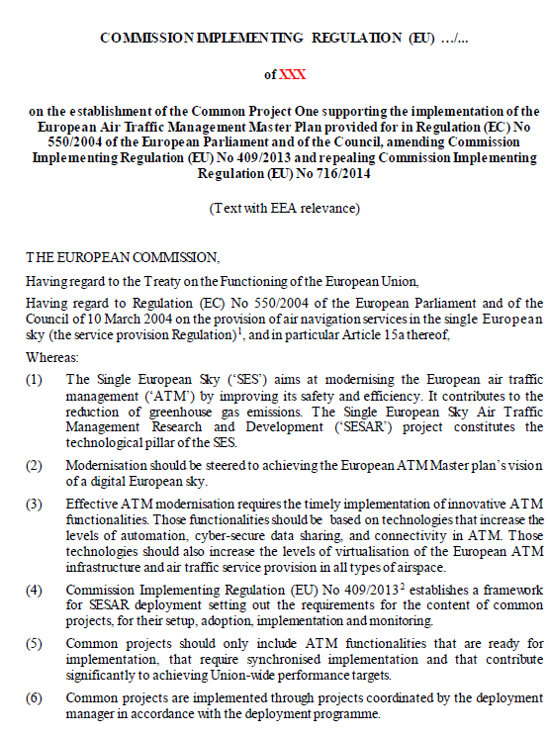
FF-ICE mandate in Europe
SESAR DEPLOYMENT PROGRAMME
Geographical Scope
Common Project One Reg. (EU) n.116/2021
All IFR GAT AUs operating in the EATMN Airspace are mandated by the CP1 regulation
Ground mandate
“ANSPs must upgrade their ground systems to process and receive the eFPL, but also to make operational use of it.
EATMN in CP1 = EU+ Switzerland & Norway
European mandate with Global impact

Slide 5


Why FF-ICE? - Benefits
Airspace Users
Ground
Fewer rejected flight plans
Better trajectories
Fly closer to optimal desired trajectory
More efficient flow planning
Improved planning services
More efficient surface movements
More informed decision making
Improved predictability for sector-sector and ANSP-ANSP coordination
Increased data accuracy
Improved Flow Management
Improved predictability
Improved efficiency
Flexibility
Cost efficiency
GLOBAL
INTEROPERABILITY

Slide 6
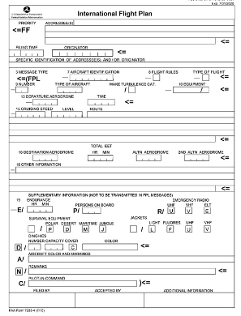

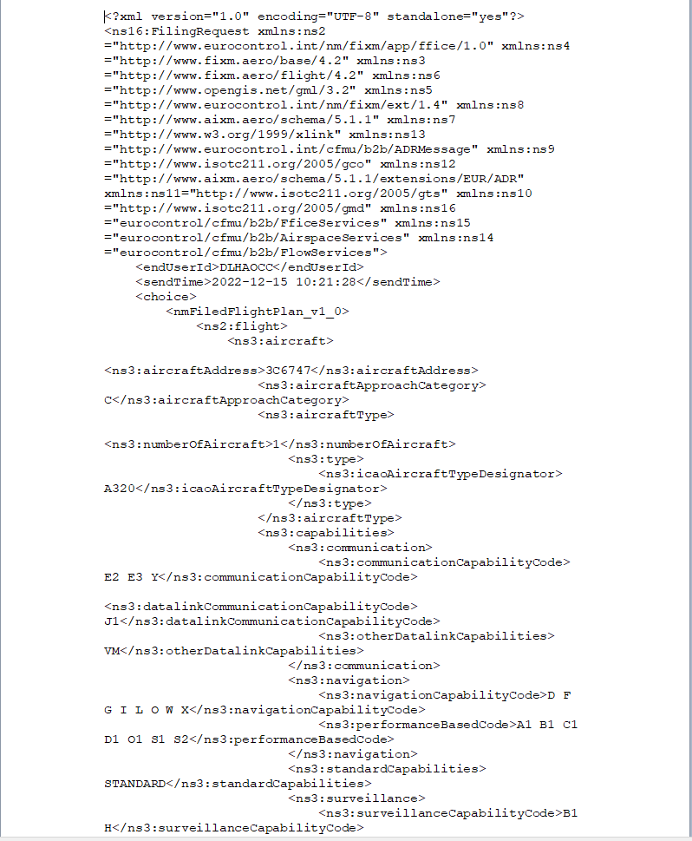

Additional information driving TBO through the eFPL
eFPL
FPL2012
Limited information
51 FPL2012 information elements
Manual process
Anticipated sunset date 2032/3034
Richer and digital information
30 New eFPL information elements
4DT for improved Flow Management

Slide 7
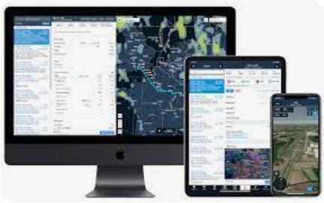

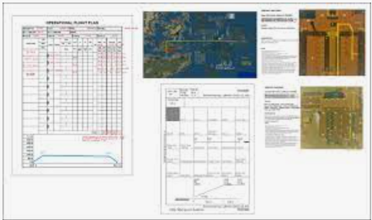
The change - towards one flight plan shared by all!
Computer flight plan service Providers (CFSP)
ATC Flight Plan
eFPL
Used by ATC
ATS Reporting Office (ARO)
Operational Flight Plan
Used by Pilot
Will ensure that Ground and Air have same information

Slide 8
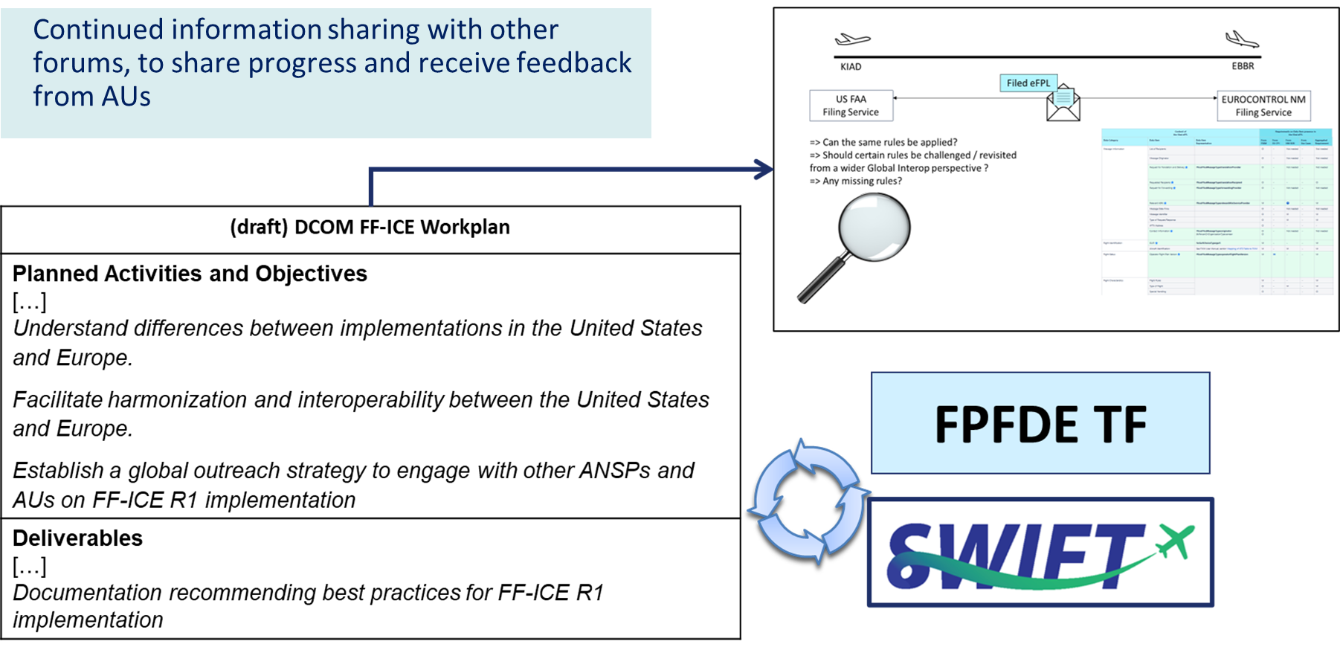
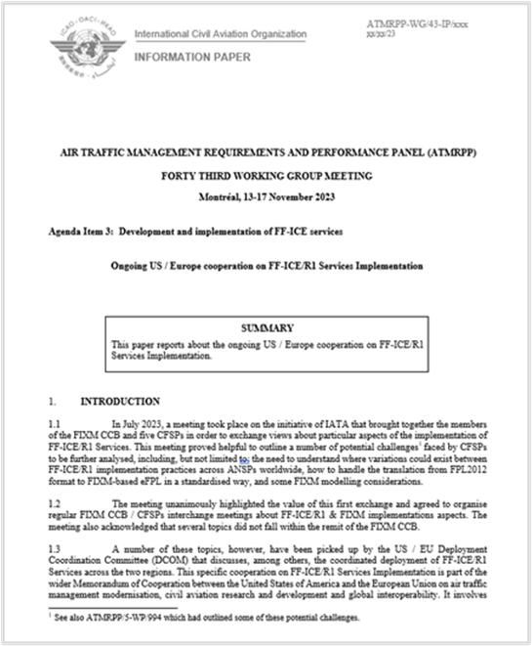
Collaboration & Stakeholder Engagement

Slide 9
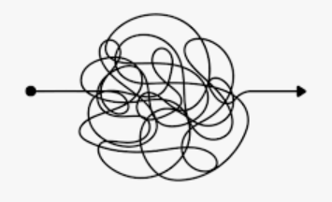
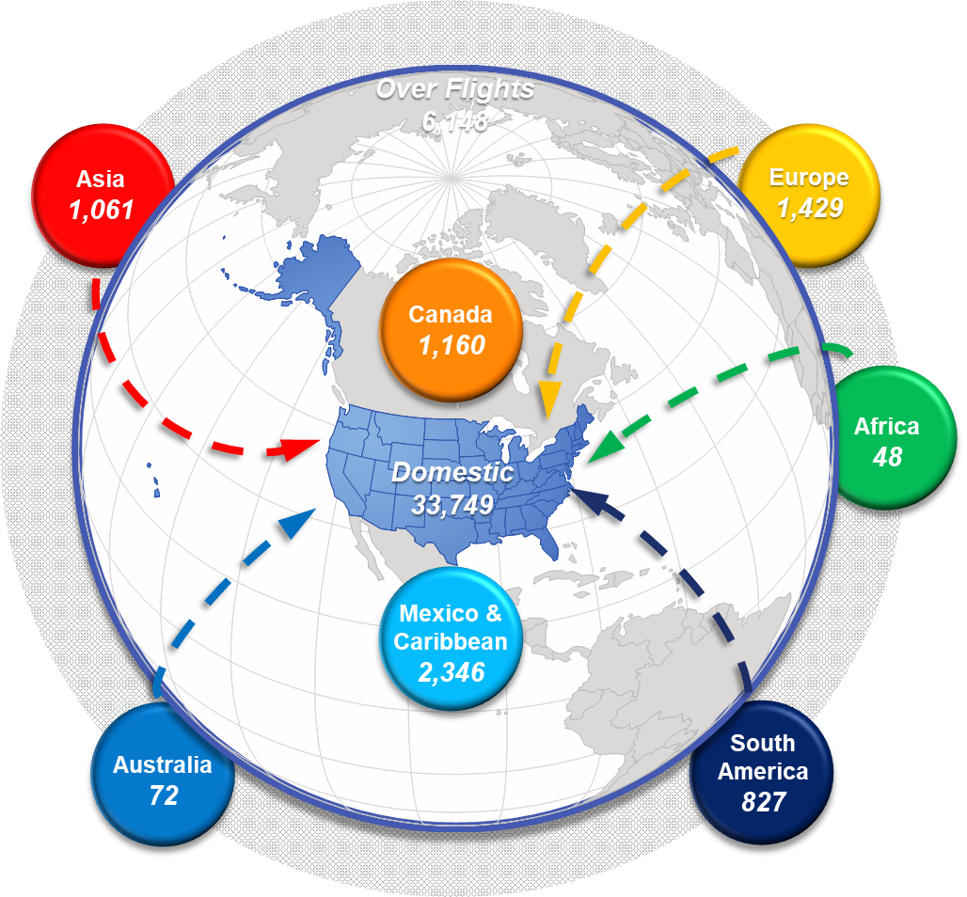
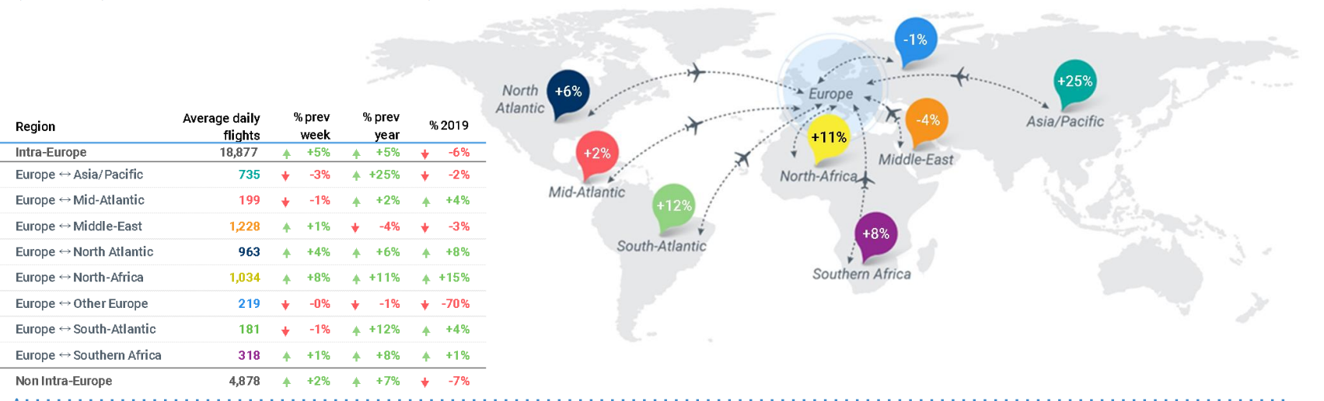
The need for an aligned approach globally to FF-ICE
Flight plans received in Europe filed from more than 50 different countries
Different processes from country to country and AU to AU
More than 900 operationally active Airspace users worldwide
Monthly Scheduled carrier traffic:
~190 Commercial Carriers filing in the US
~385 Commercial Carriers filing in Europe
*US data for April 2024
Notes:
FAA Source: FAA Traffic Flow Management System (TFMS) via Office of Performance Analysis

Slide 10
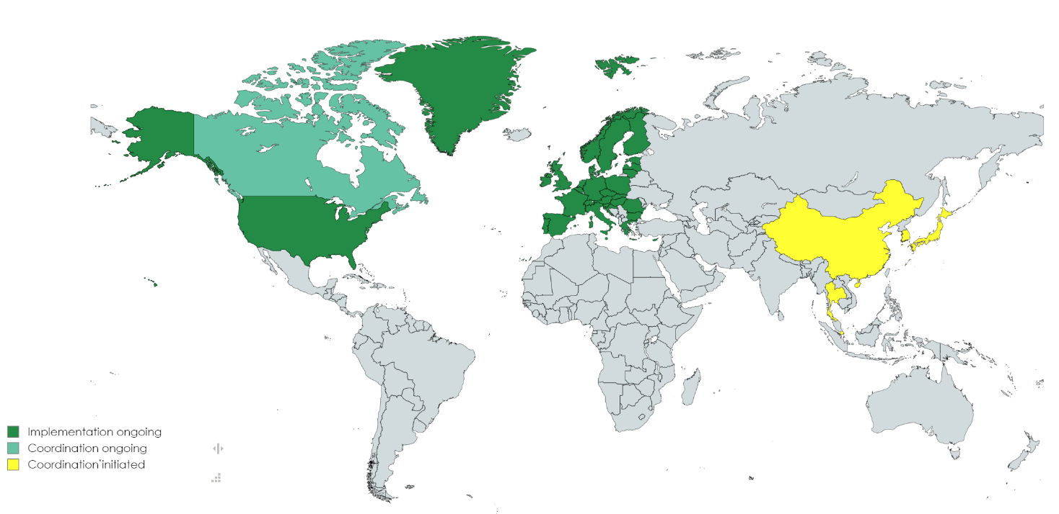
General FF-ICE Global Harmonization Needs
Not only a flight plan format change
Various exchange mechanisms in place now (AFTN, AMHS, SWIM)
FF-ICE introduces enhanced information
Alignment between US and Europe not enough
Benefits only achieved if implemented globally
How do we push forward the rest of the global FF-ICE implementation?

Slide 11
Joint Timeline and Common Approach to FF-ICE
CY 2020
CY 2021
CY 2022
CY 2023
CY 2024
CY 2025
CY 2026
CY 2027
CY 2028
CY 2029
CY 2030
CY2023
CY2024
CY2025
CY2025
CY2028
RRA
Flight Planning & Filing
Risk Reduction Activity- Jan ‘23
Ph1 IOC 1 - Q3'28
Ph1 IOC 2 - Q1'29
FIA
FF-ICE in US
Phase 1: Flight Data Sharing, Flight Plan Filing, Trial Service
Phase 2: Preliminary Flight Planning & add’l enhancements
NM
NM 24.0
NM 25.0
NM 26.0
NM 27.0
iNM
EATMN
Transition to FIXM 4.3.0 Q2 ‘23
FF-ICE CP1 Mandate In Europe Q1 ‘26
ALL EU ANSPs fully transitioned to eFPL Q1 ‘32
Phase 1: Filing Service, Trial Service, Flight Data Request Service
FF-ICE in Europe
Phase 2: Notification Service, eFPL
Phase 3: Planning Service, Consolidated feedback, EUR ANSPs feedback to NM

Slide 12
Summary
Pre-departure trajectory negotiations via a SWIM environment, using FF-ICE/R1 and supporting data sharing services drives us closer to the ICAO TBO vision where the flown flight path is as close as possible to the user-preferred flight path. Resolving demand/capacity imbalances earlier and more efficiently.
Goal for Harmonization of eFPLs, to have a single format of eFPL that AUs can send to any eASP with respective extensions (extensions can be ignored to avoid FP rejections)
Globalisation in terms of ATC system collaborations underlines the need for global coordination both on filing and distribution point of view of FF-ICE Flight plans.
Richer flight Information
Improved Planning
Improved decision-Making
Improved flow management
Towards trajectory exchanges

