Slide 1
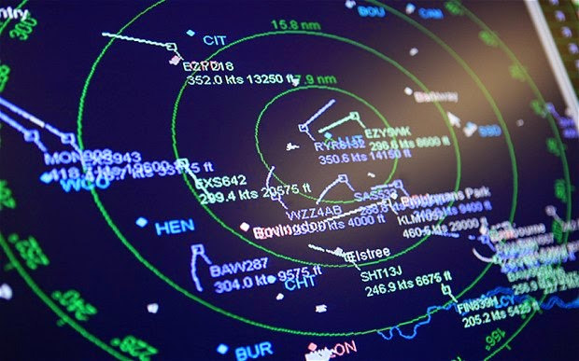
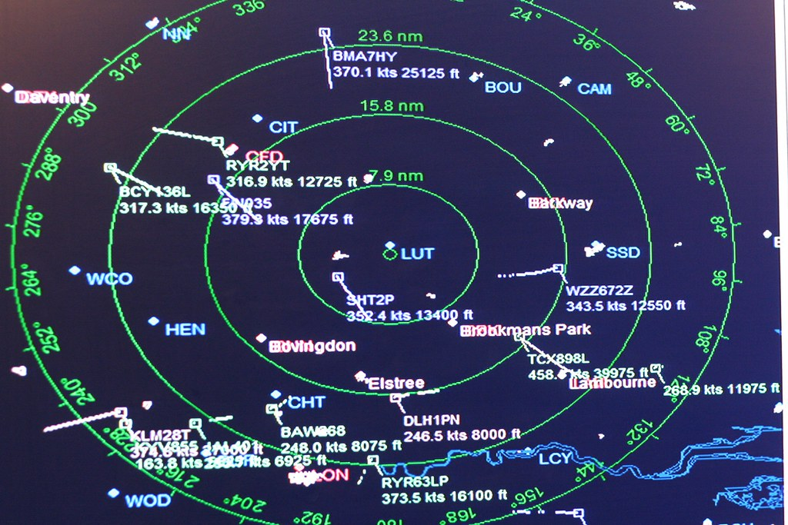
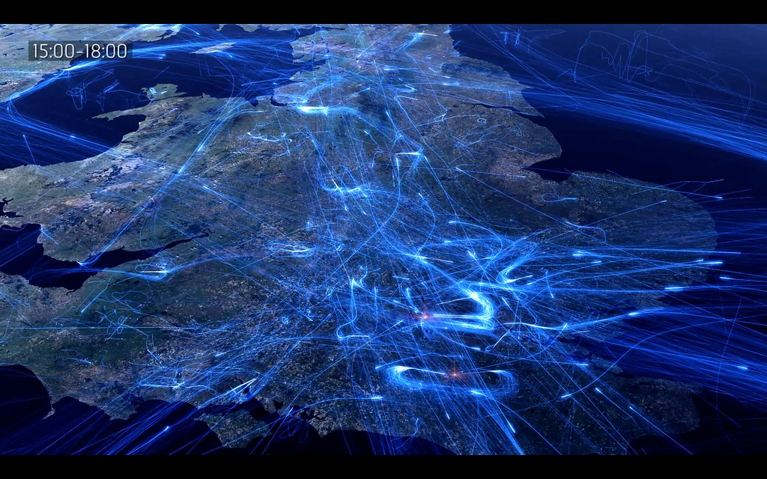
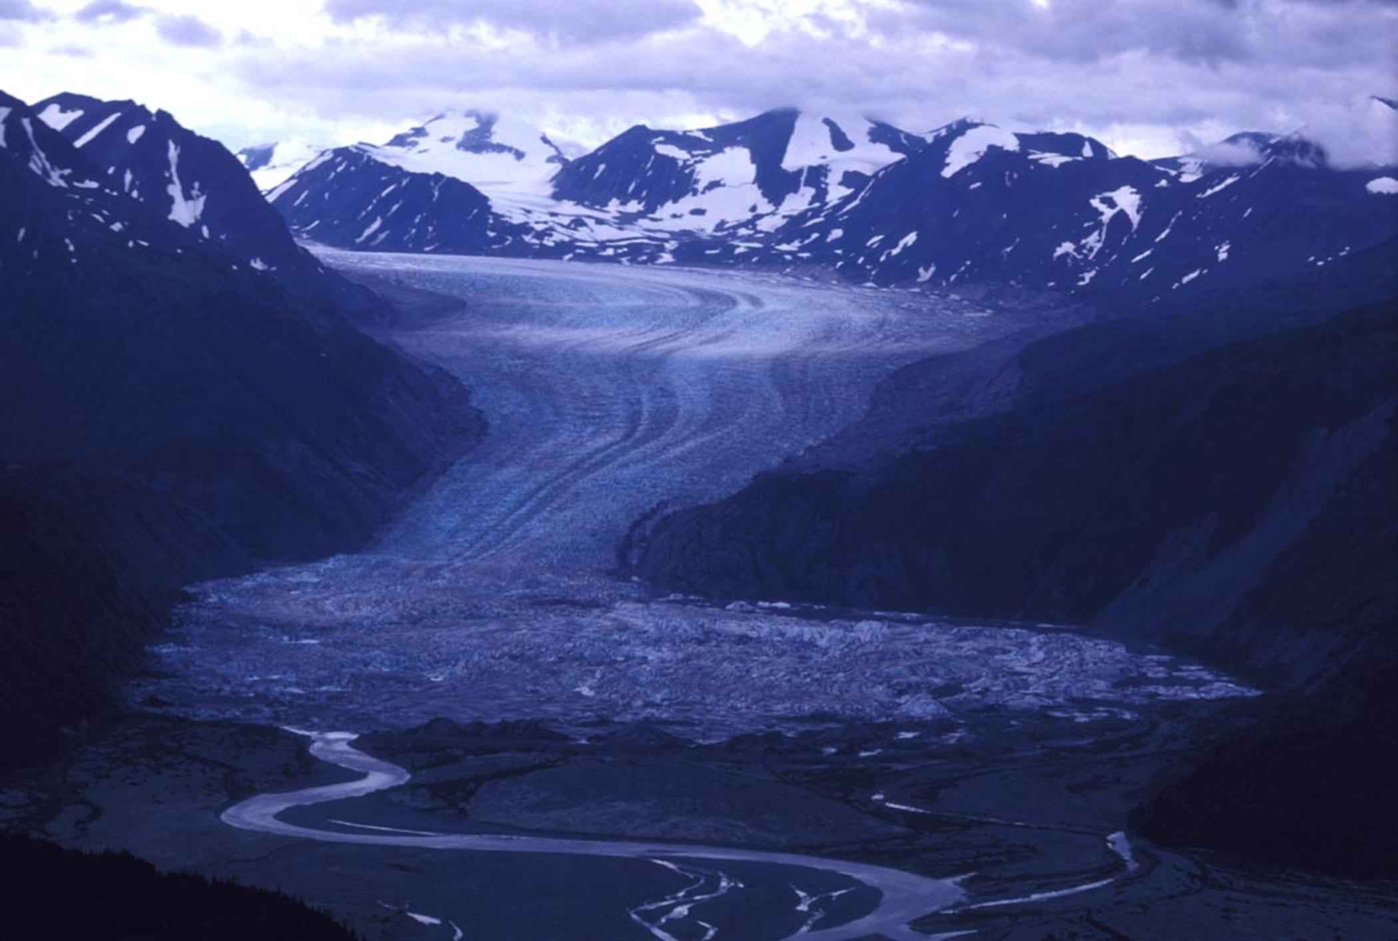
Taking TBO Global
Trajectory data will need to be shared between and across States and regions to enable collaborative decisions and TBO implementation on a global scale.
This session explores the associated challenges and needs to allow the global air traffic system to implement and benefit from the TBO concept in a coherent manner

Slide 2
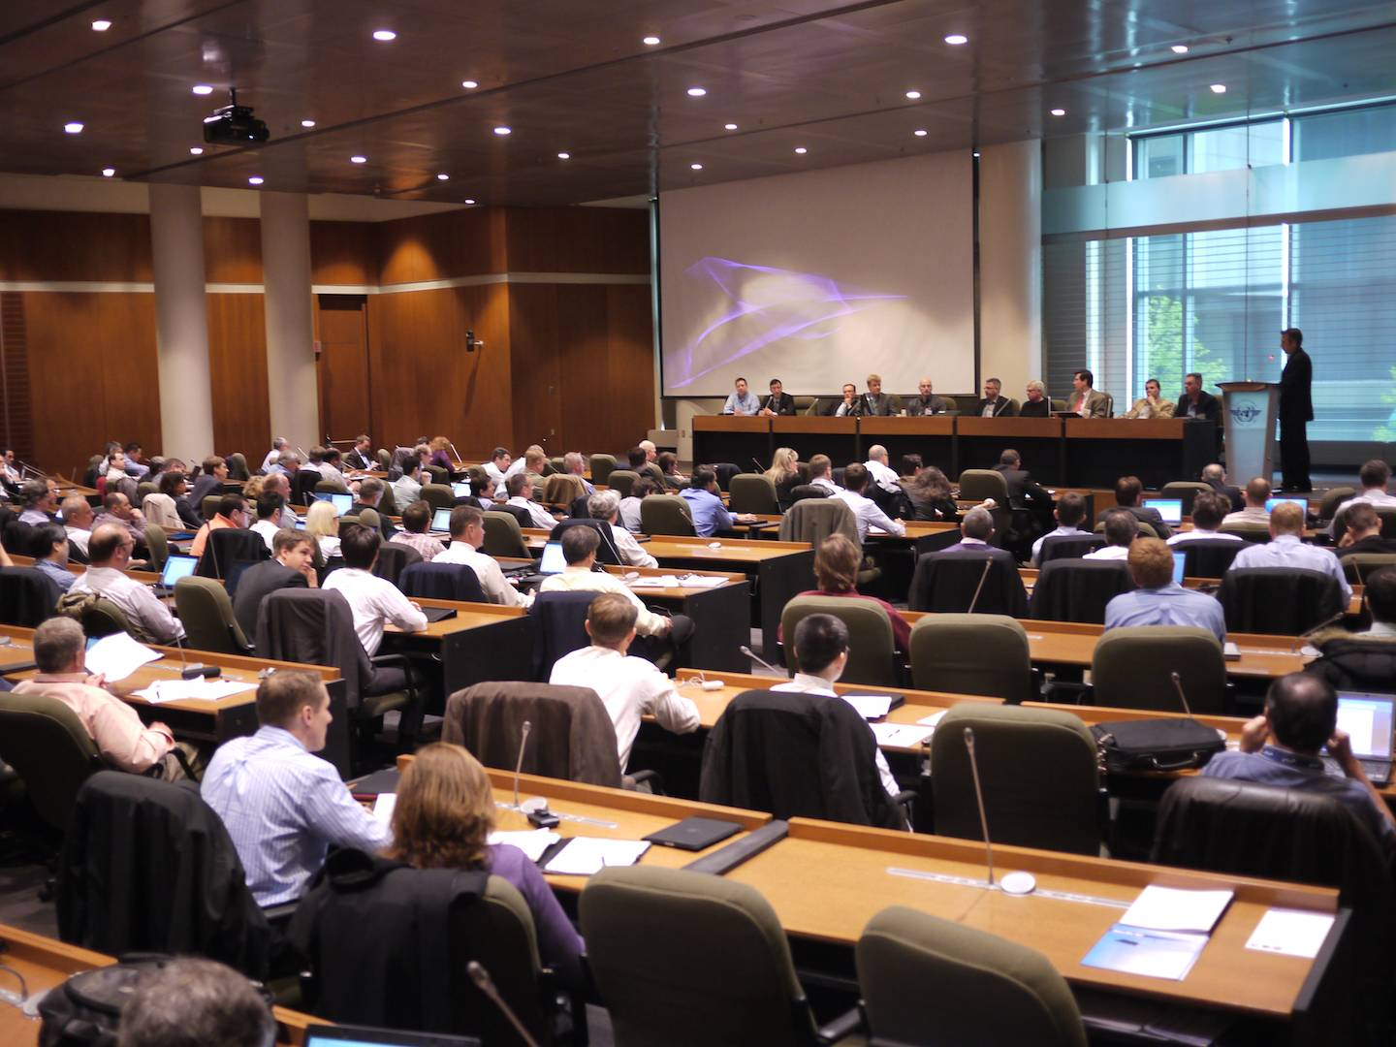
May 19, 2011

Slide 3
Taking TBO Global
Trajectory data will need to be shared between and across States, regions and all airspace system users to enable collaborative decisions and TBO implementation on a global scale.
This session explores the associated challenges and needs to allow the global aviation industry to implement and benefit from the TBO concept in a coherent manner

Slide 4
The
5
Quick

Slide 5
The Imperative
Leadership
The Environment
The
5
Quick
Technology
The Definition

Slide 6
The Imperative
A Crucial Industry
Employs 87,000,000
$6.7 Trillion Global Trade
$3.5 Trillion Economic value
4.5 Billion Passengers
$870 Billion Passenger Spend
$850 Billion Tourism Spend
$28 Billion Profit
With Growing Issues
LHR. July 27, 2017
July 24, 2019
2019
8,800
8,800 canx every month by 2030
225,000 Global Busiest day in aviation history?
8,863
By NATS
67,000,000 thrown out
Airline delays major contributors to delay
Holding—a year’s savings gone in one arrival
$66 Billion
“System Delay”

Slide 7
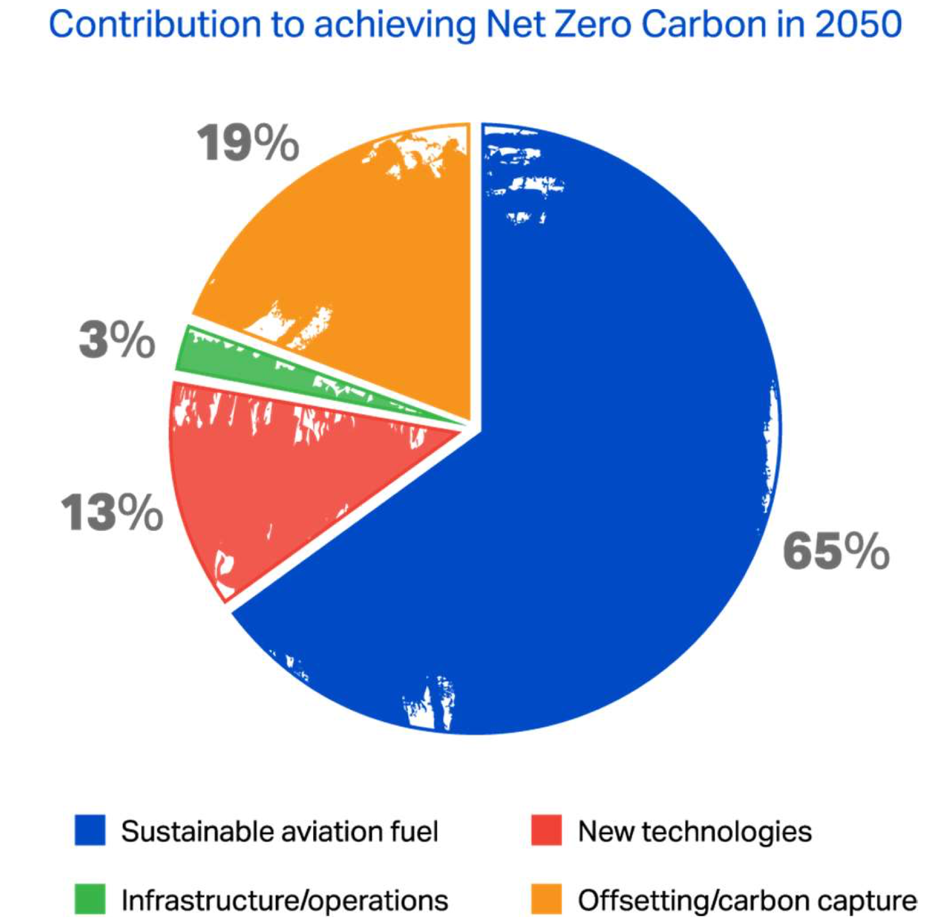
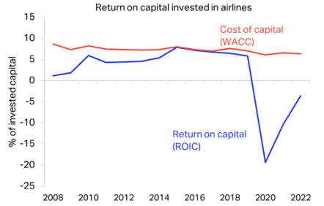
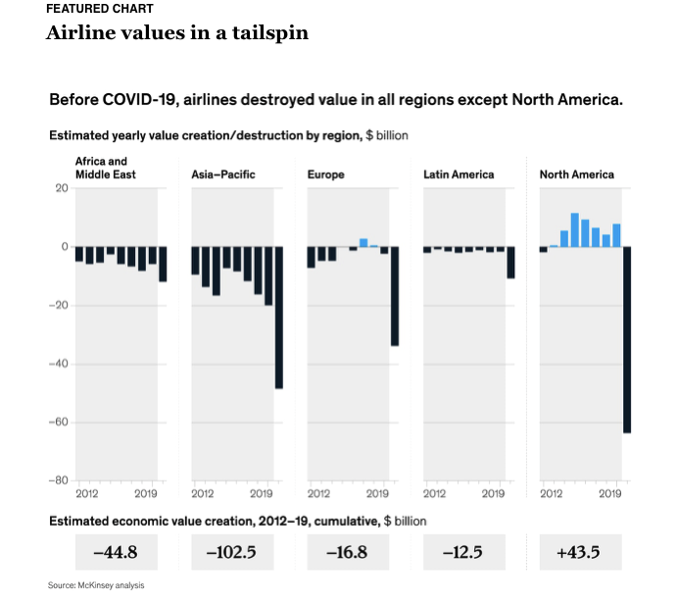
The Environment
IATA Net Zero Roadmap
Source: IATA
Source: McKinsey

Slide 8
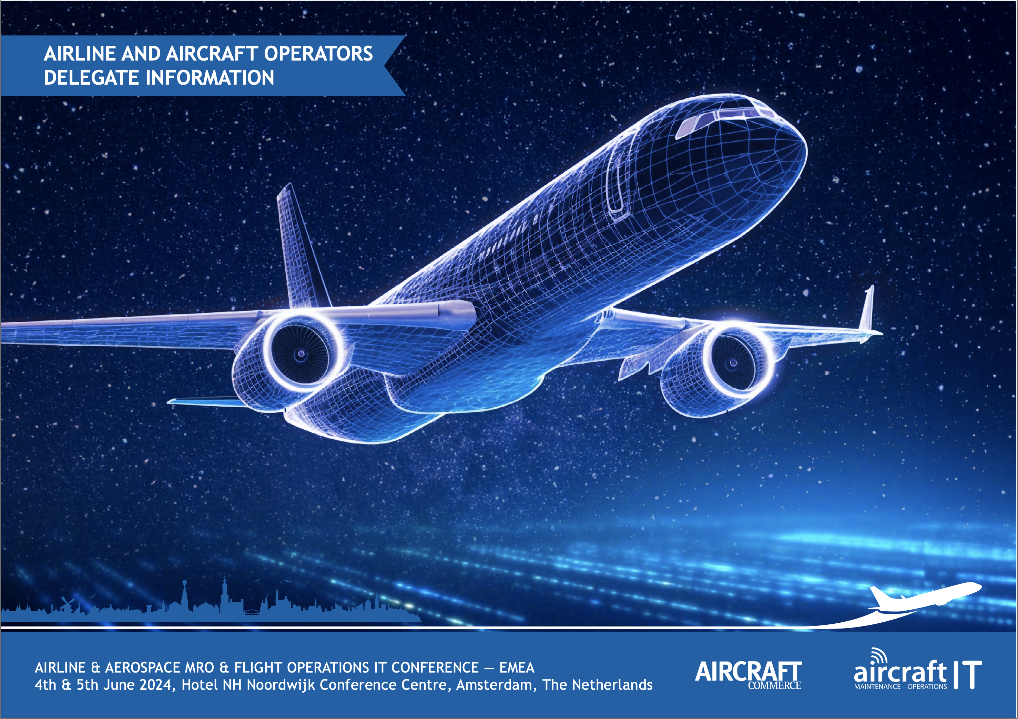
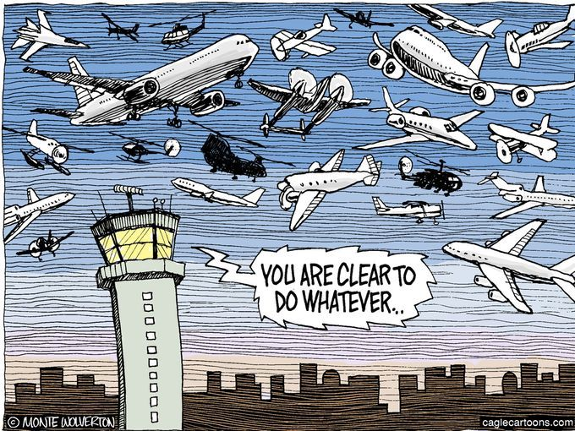
To achieve an interoperable global air traffic management system, for all users during all phases of flight, that meets agreed levels of safety, provides for optimum economic operations, is environmentally sustainable and meets national security requirements.
The Definition
Air traffic management (ATM) considers the trajectory of a manned or unmanned vehicle during all phases of flight and manages the interaction of that trajectory with other trajectories or hazards to achieve the optimum system outcome, with minimal deviation from the user-requested flight trajectory, whenever possible.

Slide 9
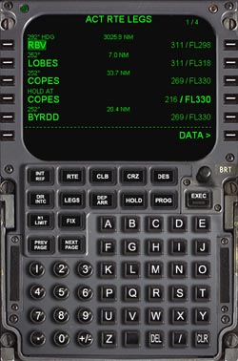
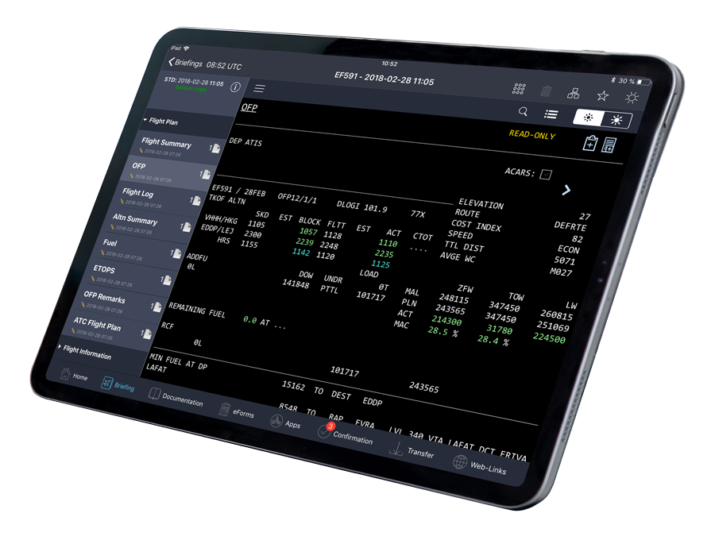
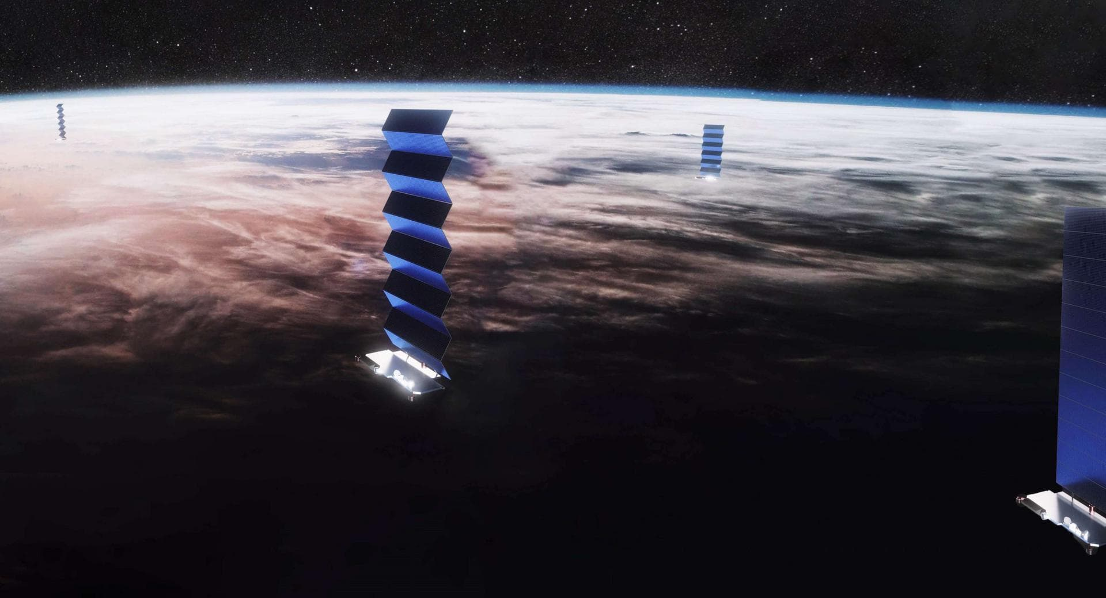
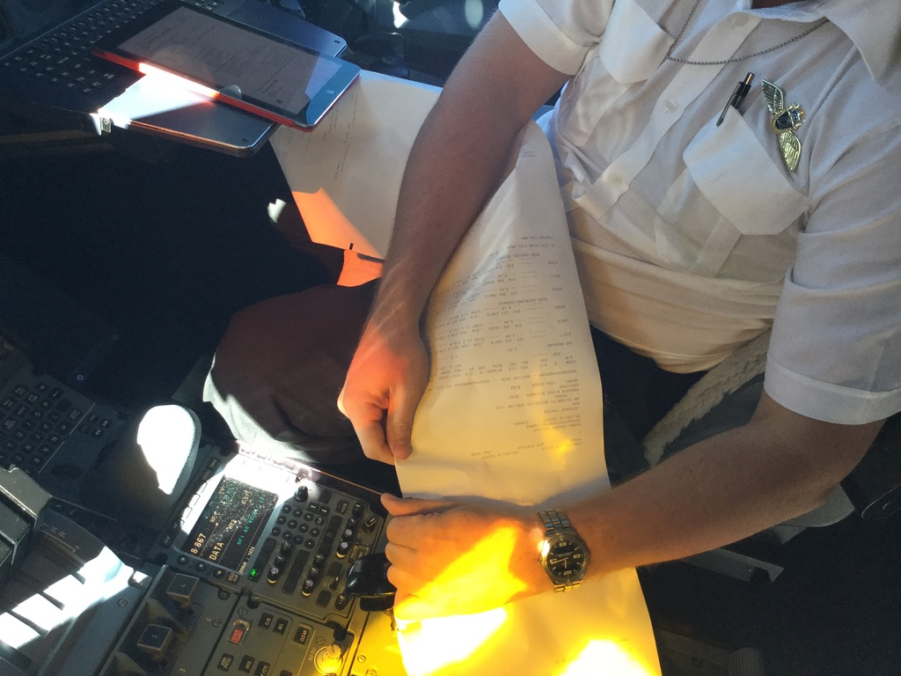
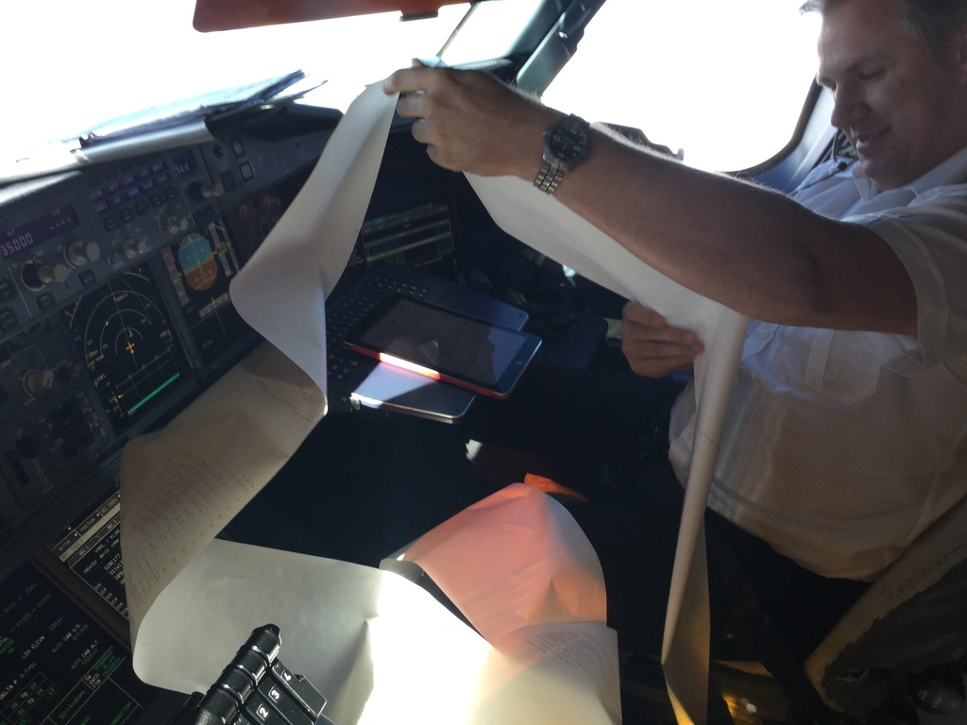
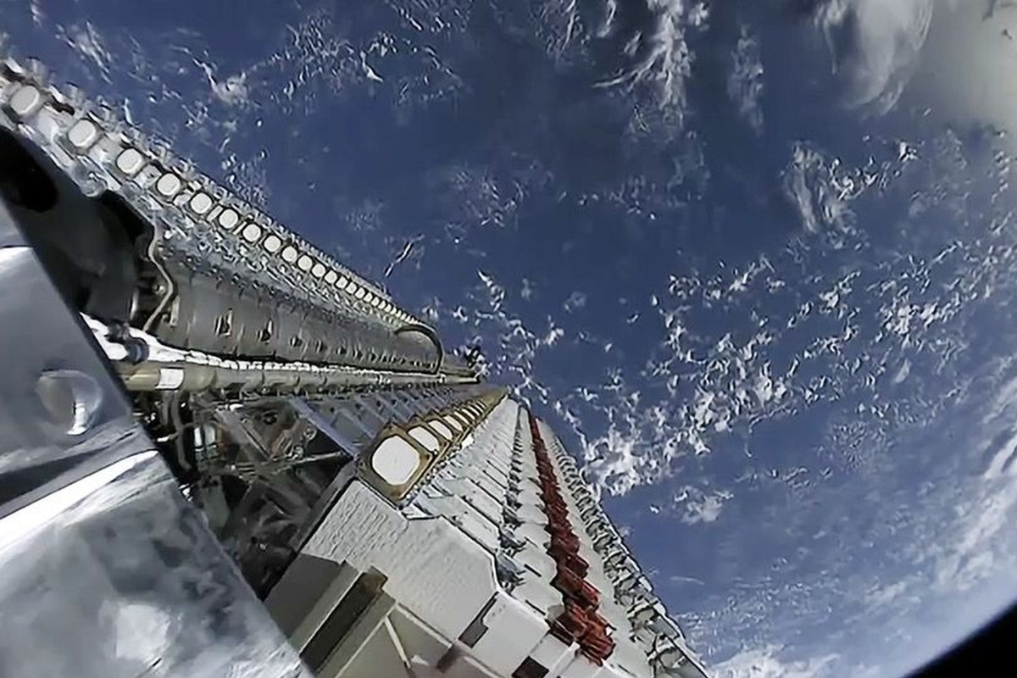
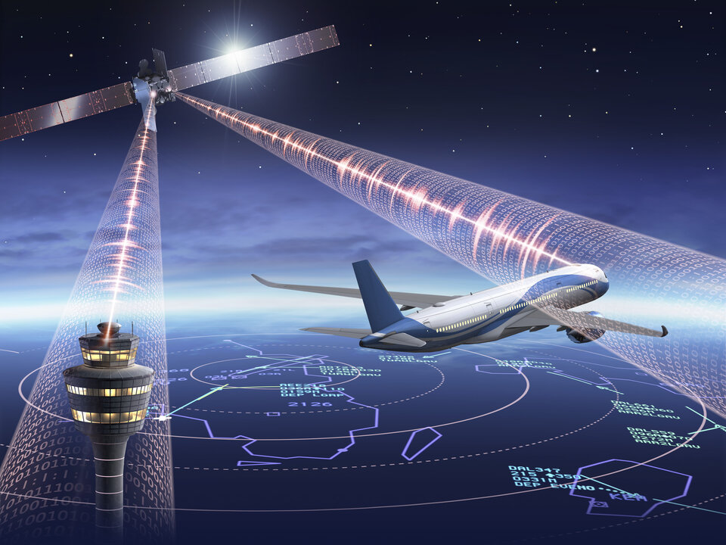
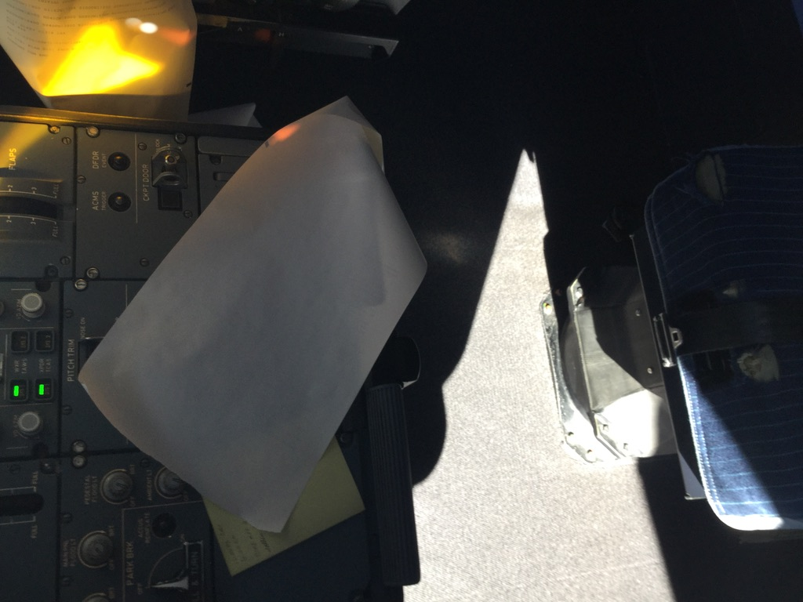
WXXM
PIXM?
Technology

Slide 10
WXXM
PIXM?
Technology
Noise?

Slide 11
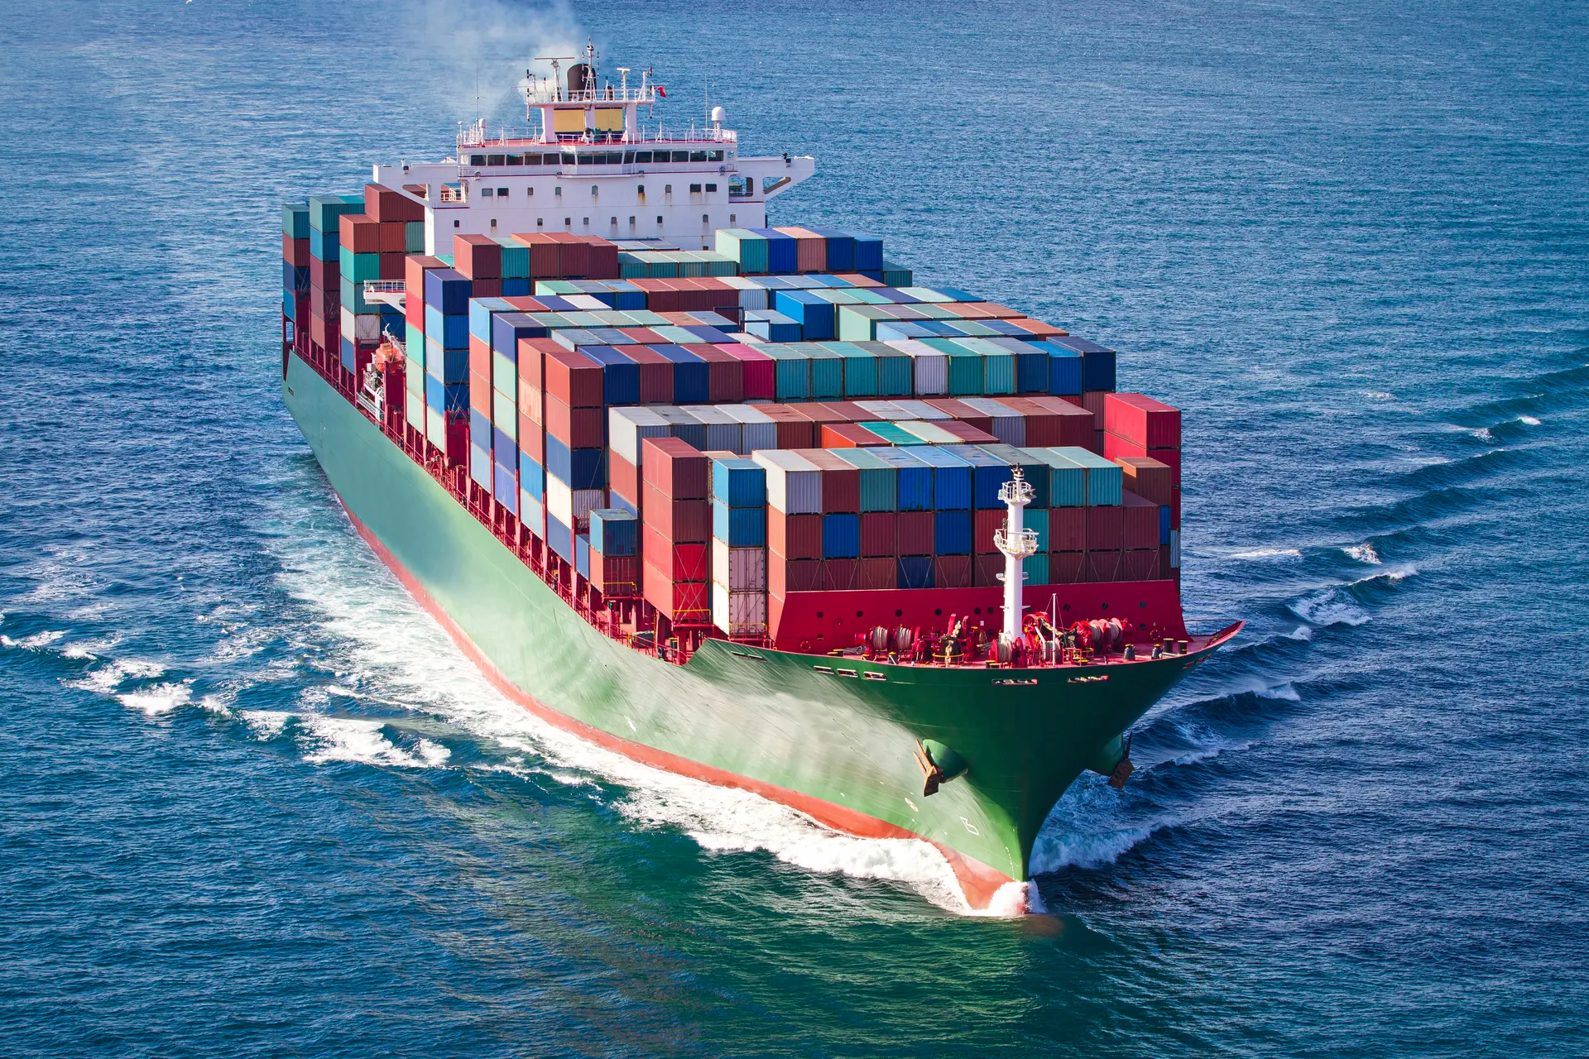
Leadership

