Slide 1
TBO – Implementation at MUAC
TBO Symposium 04-06 June 2024
Peter Hendrickx
Head ATM Development

Slide 2
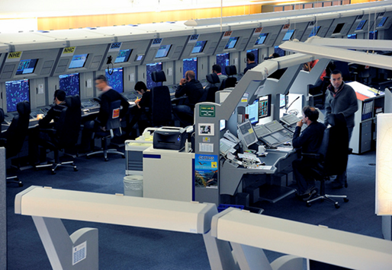
Datalink Implementation at MUAC
CPDLC Fully Operational
2009-2016
i4D under SESAR1
CPDLC v2
July
2019
2016-2022
CPDLC v1
2001
ATS B2/ADS-C under SESAR2020
December 2027
2012:
1st Flight Trial
2014:
2nd Flight Trial
July
2019
PRE-OPS
Fully Operational
CP1 Target
May
2022
Continuous Evolutions
Tool enhancements
Updates of Standards
HMI enhancements
Main pilar for TBO
All as evolutions, in small steps!

Slide 3
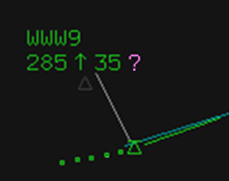
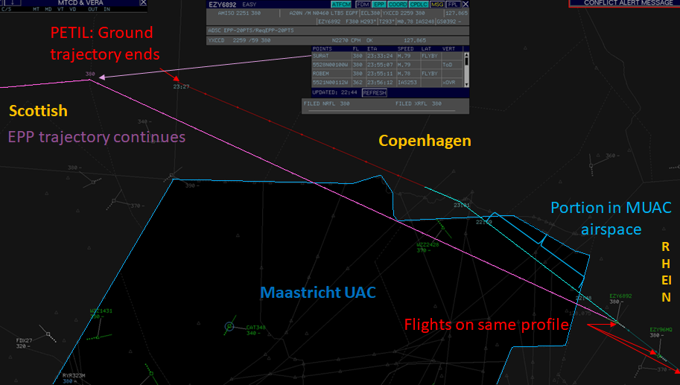
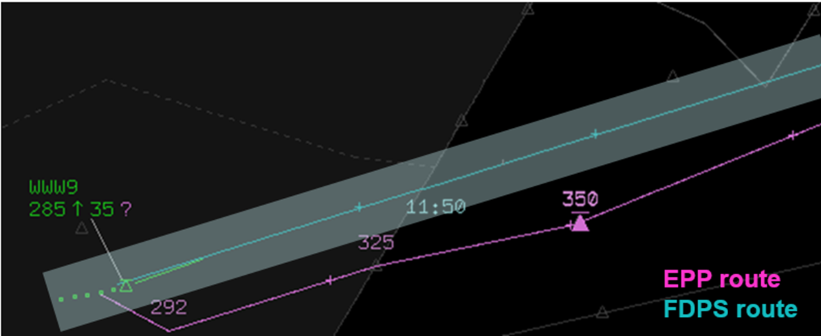
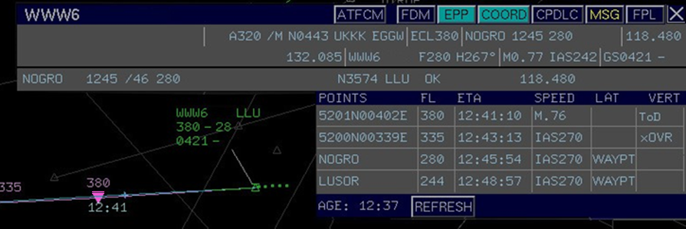
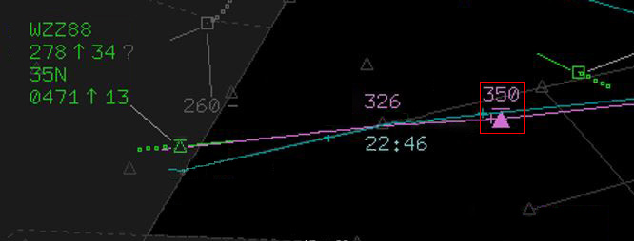
ATS-B2 MUAC
ADS-C
DISPLAY OF EPP (a/c intent trajectory up to 128 waypoints)
DISPLAY TOA RANGE (Time Of Arrival)
Latest time at point
EPP route
FDPS route
Earliest time at point
Discrepancy Indication
DISPLAY OF TOC & TOD
TOC
TOD

Slide 4
ATS-B2 MUAC
Safety Improvement / Workload Reduction
DISPLAY OF EPP (a/c intent trajectory up to 128 waypoints)
DISPLAY TOA RANGE (Time Of Arrival)
Latest time at point
EPP route
FDPS route
Earliest time at point
Discrepancy Indication
Safety Improvement
Reduction ATCO Mental Workload
DISPLAY OF TOC & TOD
TOC
TOD

Slide 5
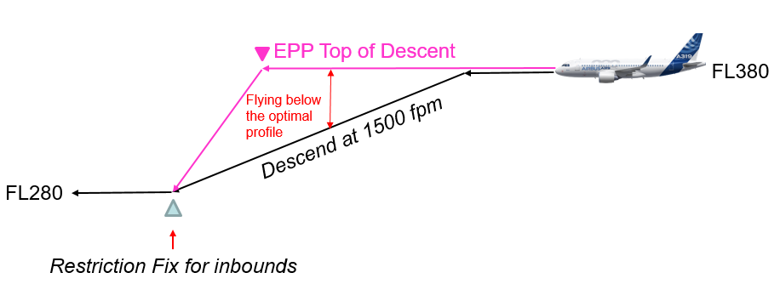
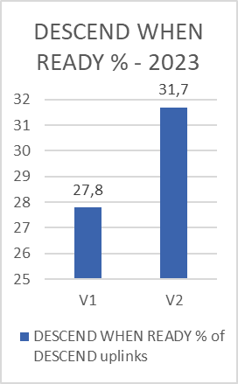
ATS-B2 MUAC
Efficiency improvement
DISPLAY OF EPP (a/c intent trajectory up to 128 waypoints)
DISPLAY TOA RANGE (Time Over Arrival)
Latest time at point
EPP route
FDPS route
Earliest time at point
Totals 15/11/2022-31/11/2023
Descend at ToD vs. 1500 fpm profile
22.205 nm maintaining
17.764 kg fuel saved
56.134 kg CO2 saved
Note: fuel/CO2 values are dependent on cost index/gross weight.
More “when ready”
DISPLAY OF TOC & TOD
TOC
TOD

Slide 6
ATS-B2 MUAC
Efficiency improvement
DISPLAY OF EPP (a/c intent trajectory up to 128 waypoints)
DISPLAY TOA RANGE (Time Over Arrival)
Latest time at point
EPP route
FDPS route
Earliest time at point
Fuel/CO2 savings
Shortcut 5 nm @ FL360
A320: ~25 kg / 79 kg CO2
A330: ~60 kg / 189 kg CO2
Shortcut 20 nm @ FL360
A320: ~100 kg / 316 kg CO2
A330: ~240 kg / 758 kg CO2
Note: values are dependent on cost index/gross weight.
DISPLAY OF TOC & TOD
TOC
TOD

Slide 7
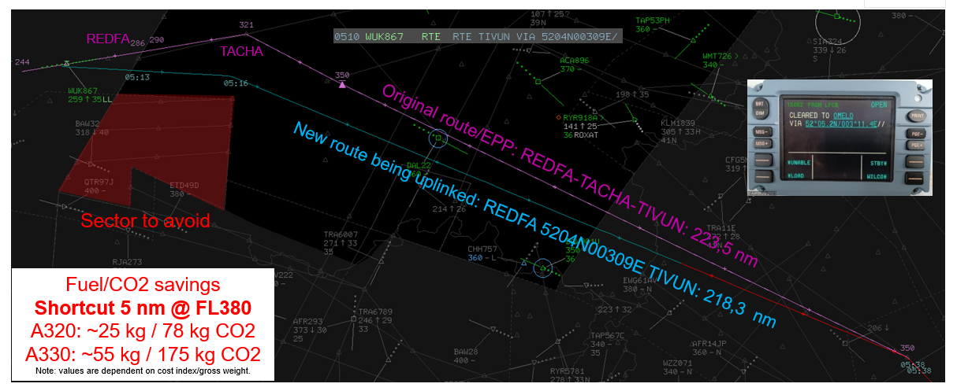
ATS-B2 MUAC
ADS-C with CPDLC V2 – Efficiency Improvement
DISPLAY OF EPP (a/c intent trajectory up to 128 waypoints)
DISPLAY TOA RANGE (Time Over Arrival)
Latest time at point
EPP route
FDPS route
Earliest time at point
DISPLAY OF TOC & TOD
TOC
TOD

Slide 8
ATS-B2 benefits
Controllers
Pilots
Safety enhancement
Workload reduction
Improving efficiency
Better traffic management
Safety enhancement
Workload reduction
Improving efficiency
Network
Airlines
Better prediction of sector loads & runway occupancy times.
More effective traffic management
Enabling capacity increase
Optimized profiles & routes
Time saving
Fuel saving
CO2 emissions reduction
Future
Improved meteo models
Enhanced Extended AMAN predictions
Enabling automation in ATC -> Capacity increase
Trajectory Based Operations

Slide 9
FF-ICE R1 Implementation
Implementation plan 2025 under construction:
Call for Tender for Industry being prepared
Full eFPL in FIXM Format processed by FDPS targeted 2026-2027
Expected benefits:
More data available:
Exact use TBD – depends on quality – TP/Display purposes
Being prepared for possible other FF-ICE R1 services:
Consolidated feedback
Unconstrained Desired Trajectory
Being prepared for FF-ICE R2:
Involvement of Local Flow Management in optimisations during execution phase
Subject of SESAR Network TBO Project

Slide 10
Thank you!
Peter.hendrickx@eurocontrol.int

