Slide 1
European TBO implementation
Network Manager perspective
Presented by EUROCONTROL Network Manager
05 June 2024

Slide 2
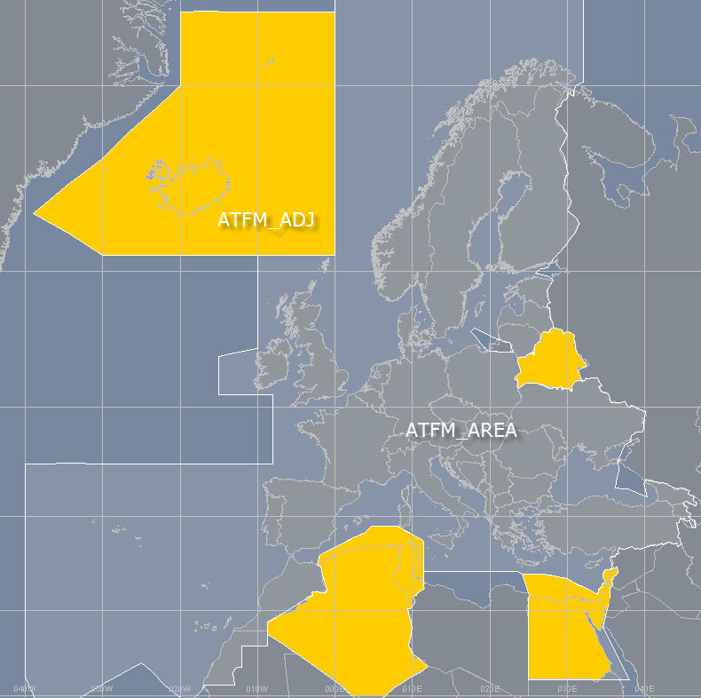
EUROCONTROL NM Area
  EUROCONTROL Network Manager (NM) provides a centralised flight plan processing and distribution service. The service is provided by the Integrated Initial Flight Plan Processing System (IFPS) and covers that part of the ICAO EUR Region known as the IFPS Zone (IFPZ).
  EUROCONTROL NM also provides a centralised Air Traffic Flow and Capacity Management (ATFCM) services with IFPZ and adjacent area.

Slide 3
Network traffic demand
The European ATM network needs to accommodate around 50 000 flights per day in a peak day in 2029, which is an approximate increase of 40% compared with the 2019 traffic demand. ( 37.000 flights in NM area)
Unexpectedly strong traffic growth needs to be accommodated.
The Network 4DT CONOPS addresses the needs of the substantial improvements of European ATM Network in terms of capacity, flight efficiency predictability, cost-effectiveness and sustainability.
50000 flights

Slide 4
Network 4DT CONOPS-Why (Main objectives)
This CONOPS is required to identify the conceptual elements required to fulfil the Network Strategy Plan (NSP) 2025-2029-Strategic Objective SO4/3 (Implementation and coordination of end to end 4D Business/Mission Trajectories at network level) for 2029 timeline.
This CONOPS is essential pre-requisite for iNM, in order to provide to the iNM contractor a visibility at conceptual level what is expected concerning the management of 4D trajectories.
This CONOPS will be the baseline for drafting of operational/user requirements for iNM.
It is also needed as indication for other Stakeholders (ANSPs, AUs, Airports) what is expected from their side in terms of updated or new processes and corresponding system improvements.
This CONOPS might be used by all Network actors to drive their planning and investments for achieving a common goal for cooperative trajectory management at Network level.
The CONOPS could be used to derive the common trajectory management requirements for other Stakeholders.

Slide 5
Guiding principles
Adherence of Network Strategy Plan (NSP) 2025-2029 and NETWORK CONOPS 2029.
Fulfilment of NSP Strategic Objective SO4/3 (Implementation and coordination of end to end 4D Business/Mission Trajectories at network level) for 2029 timeline.
Full alignment of the content and timelines agreed within Network CONOPS and other NM documents (FPFDE strategy).
Integration of relevant SESAR Deployment Programme capabilities mandated by CP1.
ICAO ASBU and SARPS.
Integration of relevant SESAR solutions, OI steps and enablers within the defined timeframe.
Take into account the mature components and those that are expected to reach V3 by the end of 2027/2028 and could be deployed by end of 2029.
The components of low maturity (expected V3 beyond 2028) to be covered with the aspirational goals.

Slide 6
Identified weaknesses
The current trajectory management process is mainly Flight Plan related and addresses the flight plan message exchanges.
Even within the same stakeholder, different trajectories still exist between different systems.
In case of NM, the difference between IFPS and ETFMS trajectory should be underlined.
Within ANSPs different trajectories exist (FDP trajectories versus traffic complexity trajectories).
The trajectories exchanges are done only via ETFMS Flight Data (EFD). NM B2B equivalent of EFD are not yet deployed. EFDs are received and implemented only by few ANSPs.
Basic OLDI notification and coordination messages (ABI, ACT, REV, MAC, PAC) are widely deployed, but these important coordination data are not feedback to NM.
In addition, some limited route info is exchanged via OLDI messages, but also deployed very rarely on few interfaces
The exchange of other OLDI messages (mainly dialogue ones) which can contribute to trajectory updates does not exist.
Main modality for receiving ATC tactical updates is still AFP, again not uniformly deployed and substantial number of ANSPs still do not provide them.
Coordination with AUs in post departure phase does not exist.
No CDM process in place for trajectory revisions.

Slide 7
  Current processes during the pre-departure phase
Airspace Users
ICAO 2012 FP messages (FPL/CHG/DLA/CNL)
NM
ETFMS
ASM/ATFCM impact
Traversed ATS units and other subscribers
Flight plan distribution service
FPL negotiation
IFPS
NM trajectory building
FP re-evaluation process
ICAO 2012 FP messages (DEP,ARR)
RQP,RQS
ATM community (ANSP, AU, airport)
Information exchanges with ETFMS
Information exchanges with IFPS

Slide 8
  Current processes during the departure preparation phase
ANSPs
Airspace Users
NM
TT distribution
ETFMS
TT distribution
TT management
IFPS
ICAO 2012 FP messages (FPL,CHG,DLA,CNL)
Handling of trajectory revisions and updates
Subscribed Users
TT distribution
EFD distribution
DPI
Airports
Information exchanges with ETFMS
Information exchanges with IFPS

Slide 9
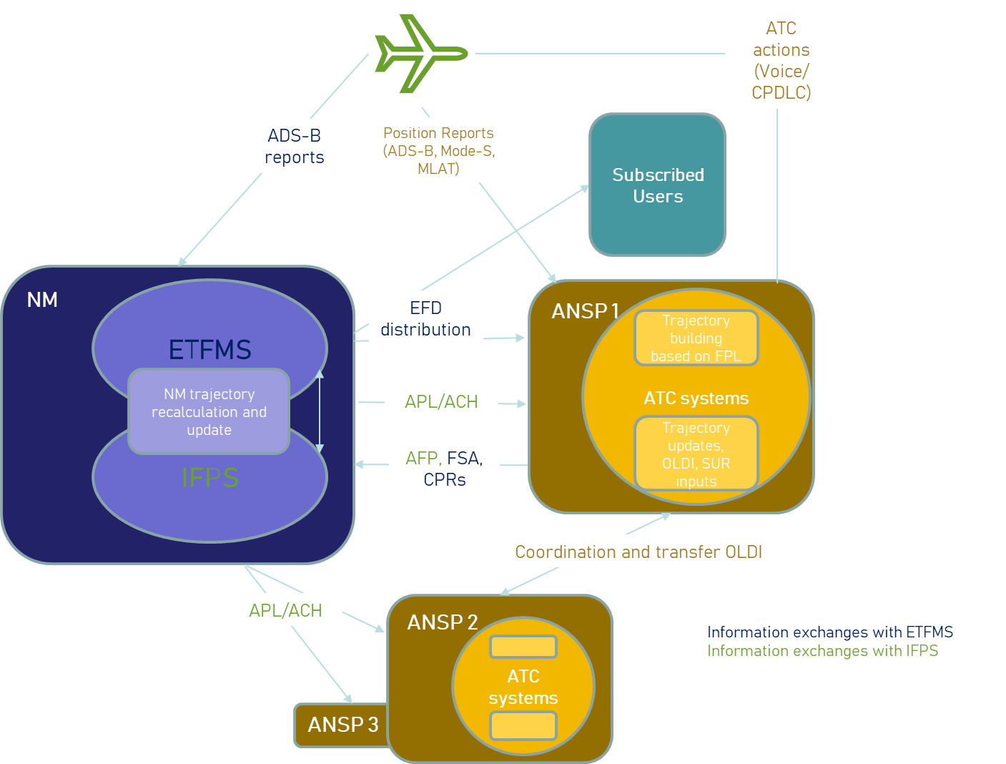
  Current processes during the flight execution phase

Slide 10
  Required improvements
Network 4DT CONOPS groups the trajectory management process into three clusters as:
  Pre-departure phase;
  Departure preparation phase;
  Flight execution phase;
Besides these three clusters, this document also addresses the identified improvements of the other trajectory management processes (VFR flight planning, OAT flight planning, Flow and airspace data exchanges, Adverse Weather, Flight planning for new entrants).
The main goal of this CONOPS is to establish a common agreed trajectory that can be shared, revised and used by all Operational Stakeholders.
This common agreed trajectory could be used by different Stakeholders and different ATM services and roles ( ATFCM, extended planner, multi-sector planner). It should be stressed that the agreed trajectory (NM trajectory services) by no means intends to be used for tactical ATC.

Slide 11

  Stakeholder components in pre-departure phase
Traversed ATS units and other subscribers
Airspace Users
NM
Distribution service
iNM
PFP
NM trajectory building
eFPL filing
ASM/ATFCM impact
NM trajectory service (distribution of ground agreed trajectory)
eFPL re-evaluation process
Subscribed Users
TT distribution
Data request
Notification
Service
P-DPI
Airports
ATM community (ANSP, AU, airport)

Slide 12
  Stakeholder components in departure preparation phase
ANSPs
TT distribution
Airspace Users
NM
iNM
TT distribution
TT management
Traversed ATS units and other impacted actors
FF-ICE Distribution service
Pre-departure updates and revisions
Handling of trajectory revisions and updates
TT distribution
NM trajectory service (distribution of ground agreed trajectory)
Subscribed Users
DPI
P-DPI
API
Airports

Slide 13
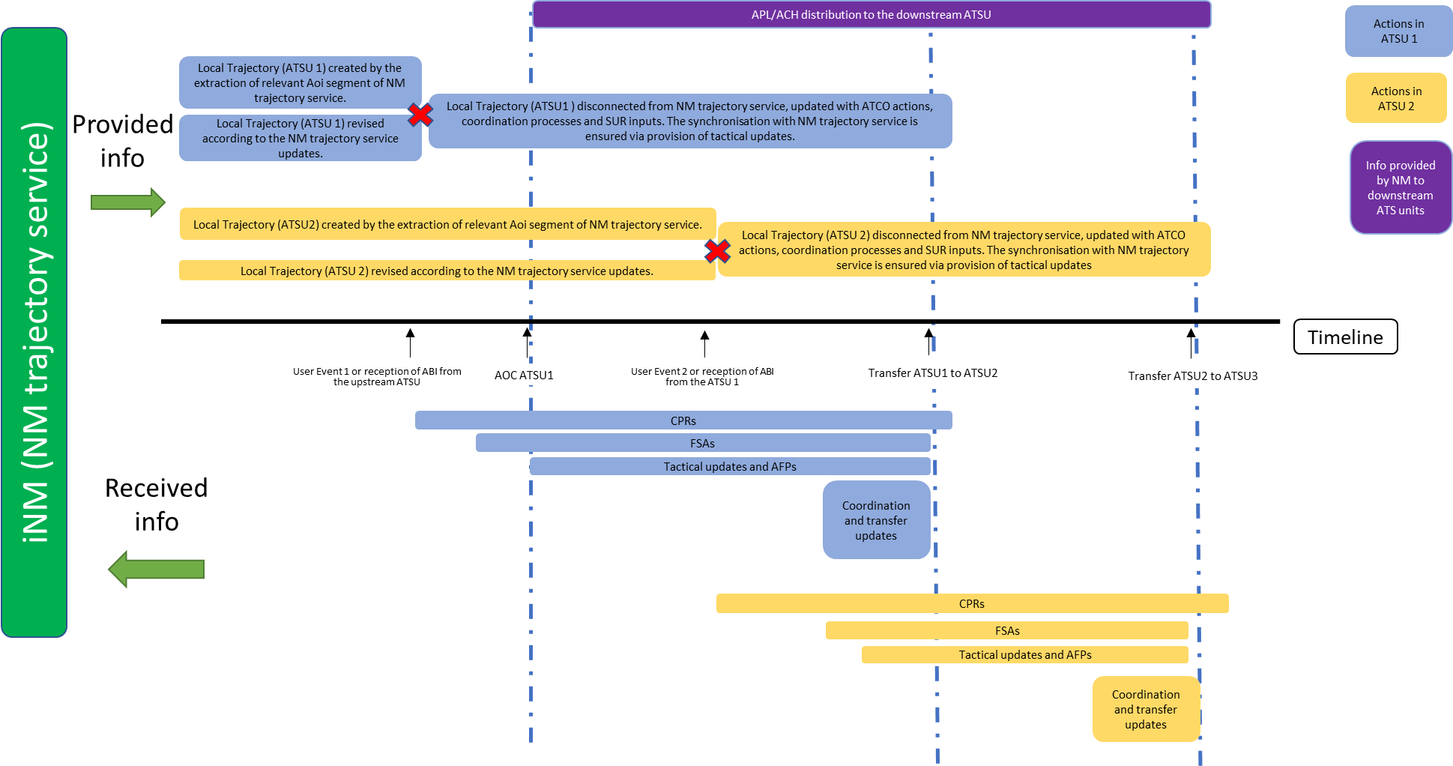
Utilisation of NM trajectory service for building the local ATC trajectory

Slide 14
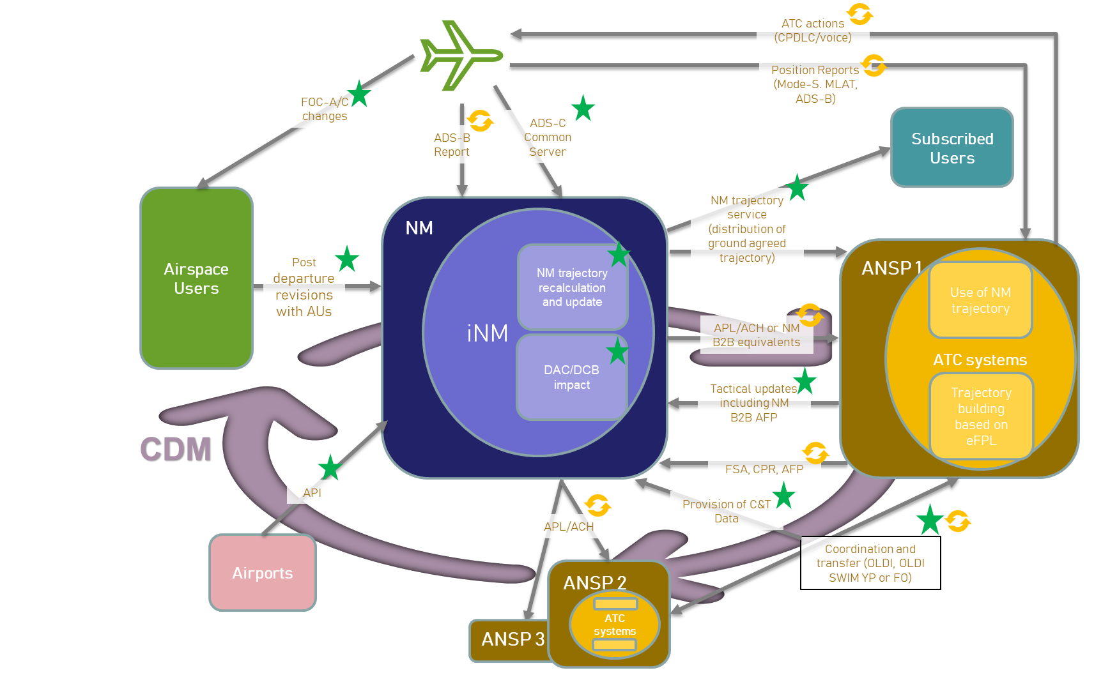
  Stakeholder components in flight execution phase

