Slide 1
TBO building blocks – Enabling technologies and trajectory sharing
EFB Enhanced Flight Deck
Sherry Yang, TBO Lead

Slide 2
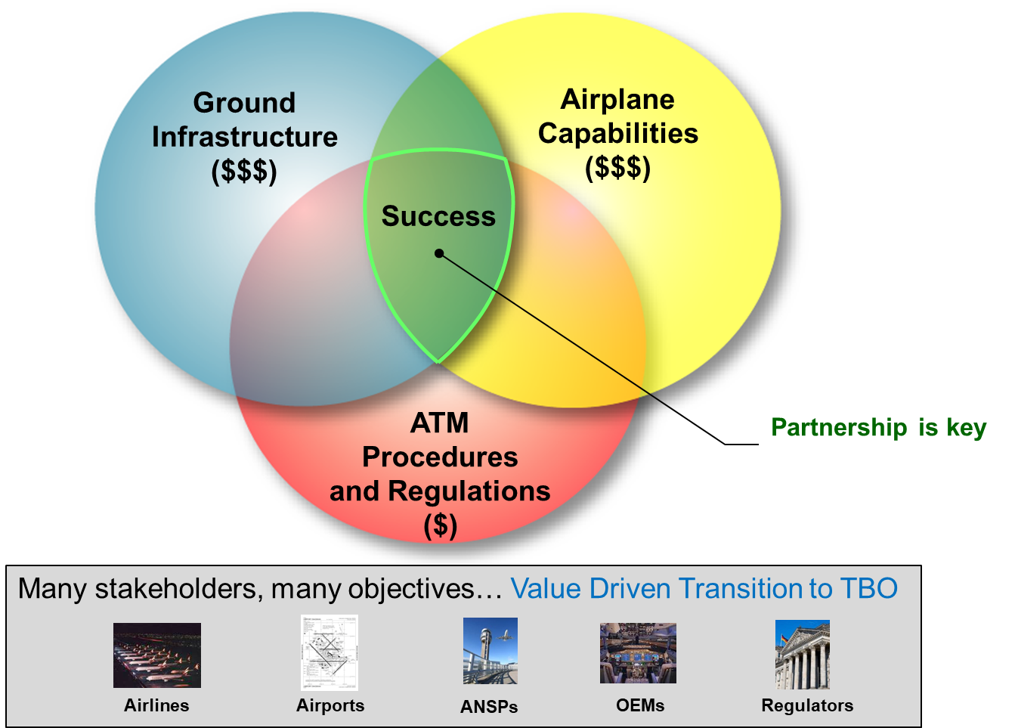
Shared Vision for Safe, Secure, Sustainable and Affordable Operations

Slide 3
EFB – Forefront of Flight Deck Innovation for TBO

Slide 4
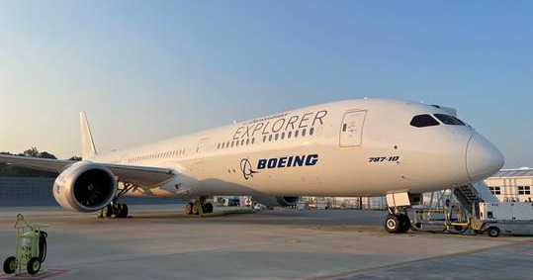
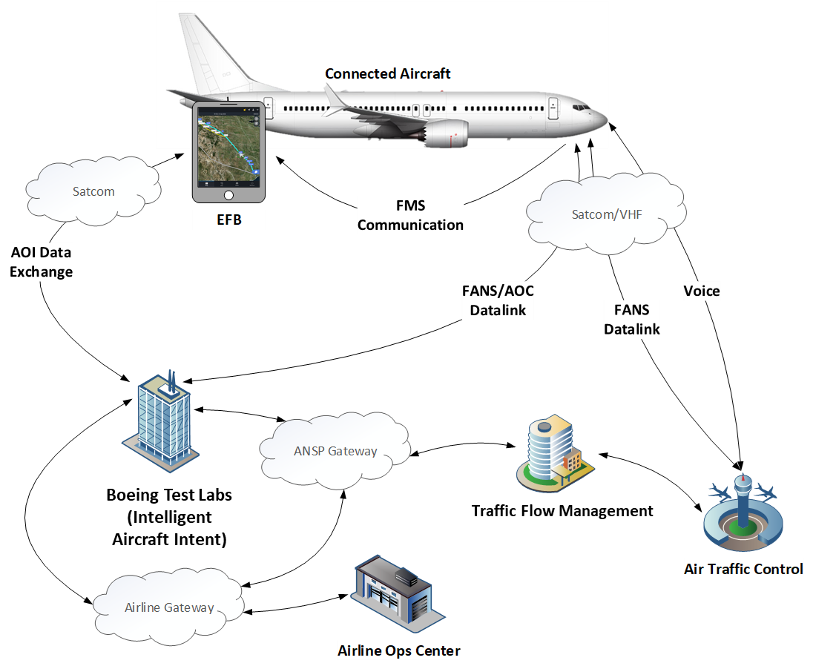
Key Takeaways from On-going Research
EFB-based solutions for modern aircraft to be TBO-capable
widely adopting key operational efficiency tools in EFB
leveraging multiple datalinks
creating speed, flexibility and low cost implementation
reducing safety-protected spectrum saturation issue
allowing feedback for an extended period before investment decisions on aircraft and ground automation
Accurate short-term predictions from B2 ADS-C EPP when aircraft
having accurate forecast temp& winds, and
not in tactical maneuver
B2 ADS-C EPP mandate forward fit in EU
what about the existing fleet
integrating with AI/ML and cloud computing, aircraft intent from EFB may provide enhanced end-to-end trajectory predictions to meet operation needs
Aircraft operational intent (AOI)
4D Trajectories (EPP-like)
Temp & Winds
Boeing works with airlines, ANSPs, airports and other partners to make TBO a global reality for a safe, secure, efficient and sustainable aviation

Slide 5
Thank you !

