Slide 1
TBO Building Blocks
Jason Rossiter
Director TBO Architecture

Slide 2
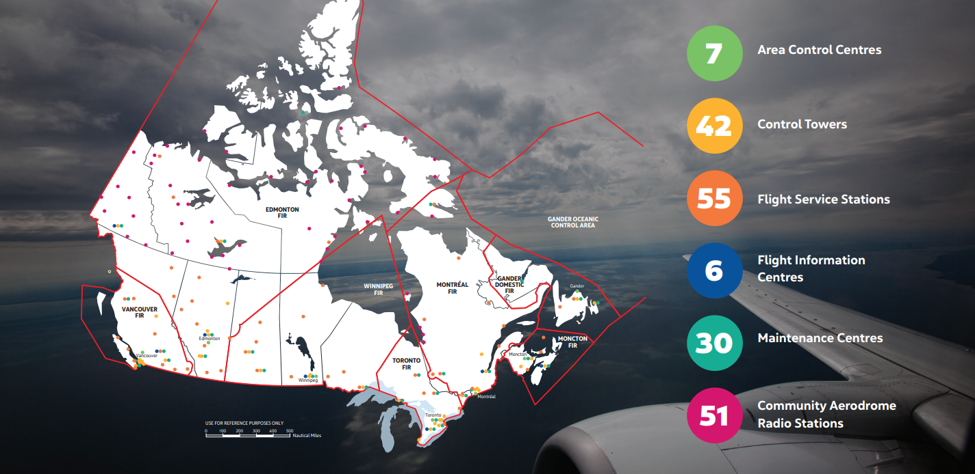
NAV CANADA Airspace and Facilities
Flights to and from the 4 Majors represent 29% of all flights in 2022
18 M square kilometres of airspace managed by NAV CANADA

Slide 3
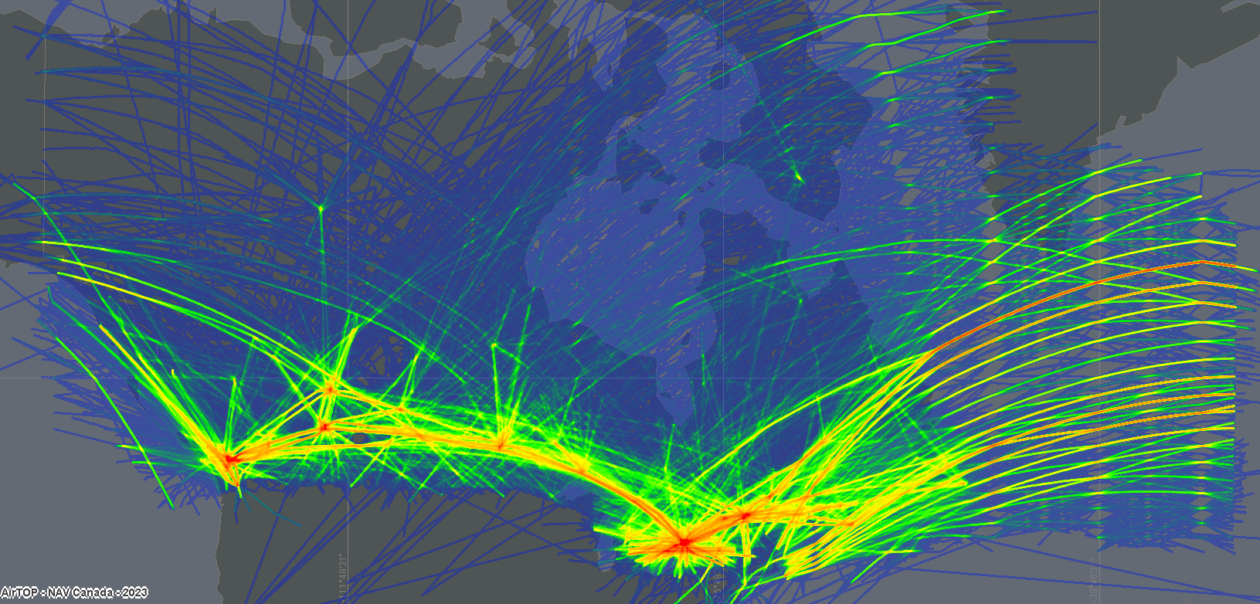
NAV CANADA Flight Density
August 18, 2022

Slide 4
Environment for TBO
As the owner and operator of Canada’s civil air navigation system, NAV CANADA tracks and guides aircraft from all over the world safely through Canadian airspace. Our role begins well before takeoff and continues right up to arrival.
ENROUTE
PRE-FLIGHT
LANDING
APPROACH
TAKEOFF
Notes:
Pre-flight: The pilot files a flight plan or flight itinerary with an air traffic control unit, a flight service station or a community aerodrome radio station.
Takeoff: Once pre-flight checks are done, the pilot contacts the air traffic controllers in the tower for clearance to taxi and then take off. The controllers also provide instructions and information to help ensure a safe flight.
Enroute: As the aircraft crosses the country, air traffic controllers “hand off” the flight between flight information regions and give pilots updated weather information as well as directions to help them maintain safe distance from other aircraft.
Approach: Air traffic controllers at the area control centre merge the descending aircraft into a single-file line with other aircraft approaching the airport. Controllers give instructions to pilots on heading, speed and altitude.
Landing: Air traffic controllers in the tower give the pilot clearance to land and guidance on final approach. After the plane lands, they direct pilots to an exit taxiway and terminal gate.

Slide 5
Trajectory Based Operations (TBO)
Building air traffic services that take into account the full picture of a flight, from takeoff to landing.
Preferred routes for airlines
Reduced fuel use and greenhouse gas emissions
Minimized enroute delays
Increase predictability
Integration of new entrants through RPAS traffic management (RTM)
Notes:
Currently, an aircraft can be subject to several tactical interventions by ATS during its flight. This can include several altitude changes, speed instructions, holding patterns, etc.​
These interventions are done with the limited information available and are generally based on the conditions within a controller’s specific airspace. ​
Interventions can have unintended impacts on sectors down the road.​
TBO brings the entire route of flight, in 4 dimensions, to light.​
Technically speaking: TBO considers the trajectory of an aircraft during all phases of flight and strategically manages its interaction with other trajectories or constraints to achieve the optimum outcome, with minimal deviation from the original request.​
This means that the aircraft will know its exact flight from end-to-end before it departs, including time of arrival. And all players in the process will work together to manage that trajectory. This will enable that increased predictability that customers are looking for, with potential environmental benefits too.​
TBO allows flight data to be shared with all FIRs and with all impacted stakeholders. Any interventions that are still required in-flight can be done with a full view of entire flight trajectory.​
This also means that we will be heavily reliant on technology to enhance communications and data exchange between airline, airport and ATS through all phases of flight. And so, there is a lot of work to do in this area to get there.​
This is an imperative and is mandated by ICAO as part of the Aviation System Block Upgrades (ASBUs). In Europe, the SESAR Joint Undertaking has progressed TBO for more than 10 years and the FAA NextGen office is advancing its TBO strategy at pace. ​
IATA and our airline customers are fully supportive of TBO and they are collaborating with us in these early design stages. ​
Video: https://vimeo.com/640504201
Embed: <iframe src="https://player.vimeo.com/video/640504201?h=1289502862&title=0&byline=0&portrait=0" width="640" height="360" frameborder="0" allow="autoplay; fullscreen; picture-in-picture" allowfullscreen></iframe>
<p><a href="https://vimeo.com/640504201">Trajectory-Based Operations</a> from <a href="https://vimeo.com/navcanada">NAV CANADA</a> on <a href="https://vimeo.com">Vimeo</a>.</p>

Slide 6
Current State
No single instance of the entire Trajectory of a Flight
No single high quality data record per flight
Flow Management is airport and FIR centric
Limited data exchange between FDP systems
Does not support Airspace Modernization
Not data center ready
FLIGHT PLAN
FLIGHT PLAN
FLIGHT PLAN
FLIGHT PLAN
FLIGHT PLAN
FLIGHT PLAN
FLIGHT PLAN
CAATS
VR
CAATS
EG
CAATS
WG
CAATS
YZ
CAATS
UL
CAATS
QM
CAATS
QX
Partial
Trajectory
Partial
Trajectory
Partial
Trajectory
Partial
Trajectory
Partial
Trajectory
Partial
Trajectory
Partial
Trajectory

Slide 7
Future State
Flow Manager
Network Management
- Intent sharing
- Constraint feedback and negotiation
- ATFM negotiation and clearance coordination
- Synchronization
FLIGHT OBJECT
Central Trajectory
Central FDP
iTEC
VR
iTEC
EG
iTEC
WG
CAATS
VR
CAATS
EG
CAATS
WG
iTEC
QM
CAATS
YZ
CAATS
UL
CAATS
QM
CAATS
QX
iTEC
YZ
iTEC
UL
iTEC
QX
Decision Support Tools

Slide 8
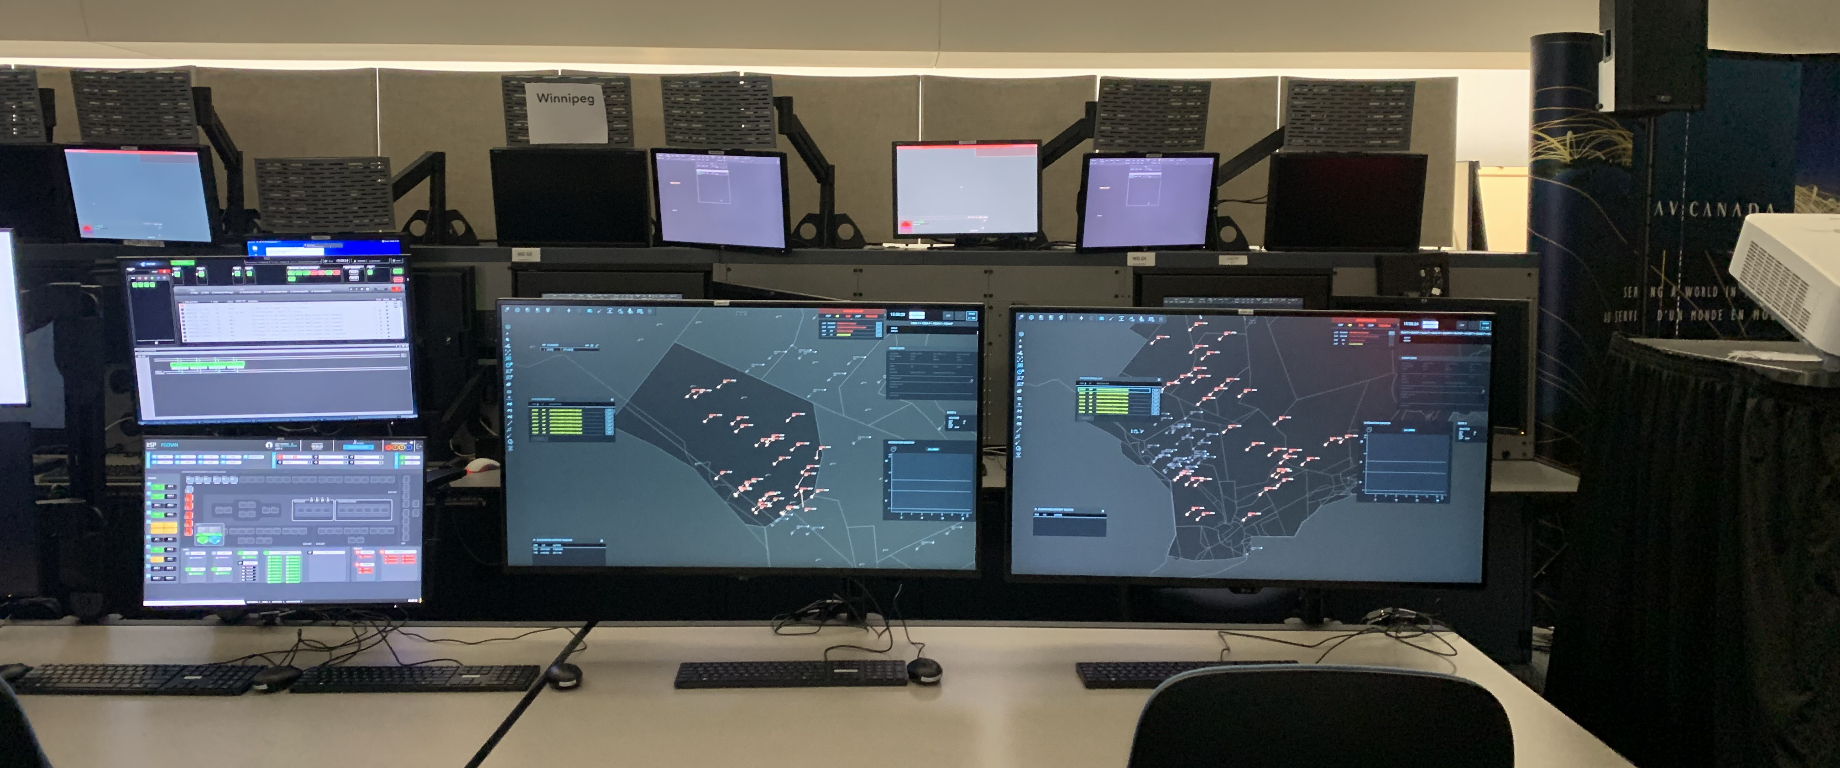
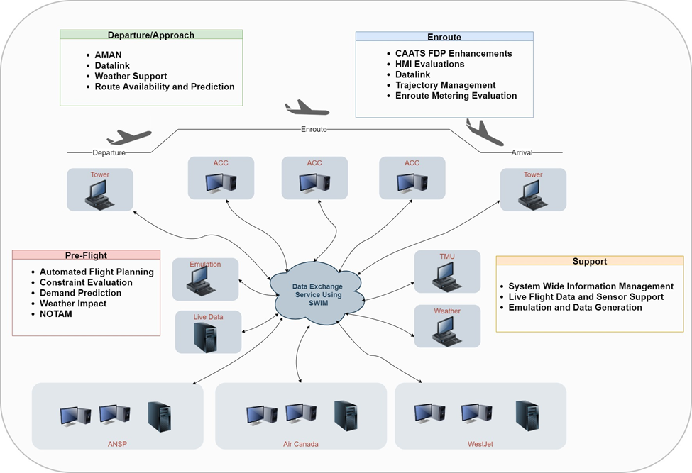
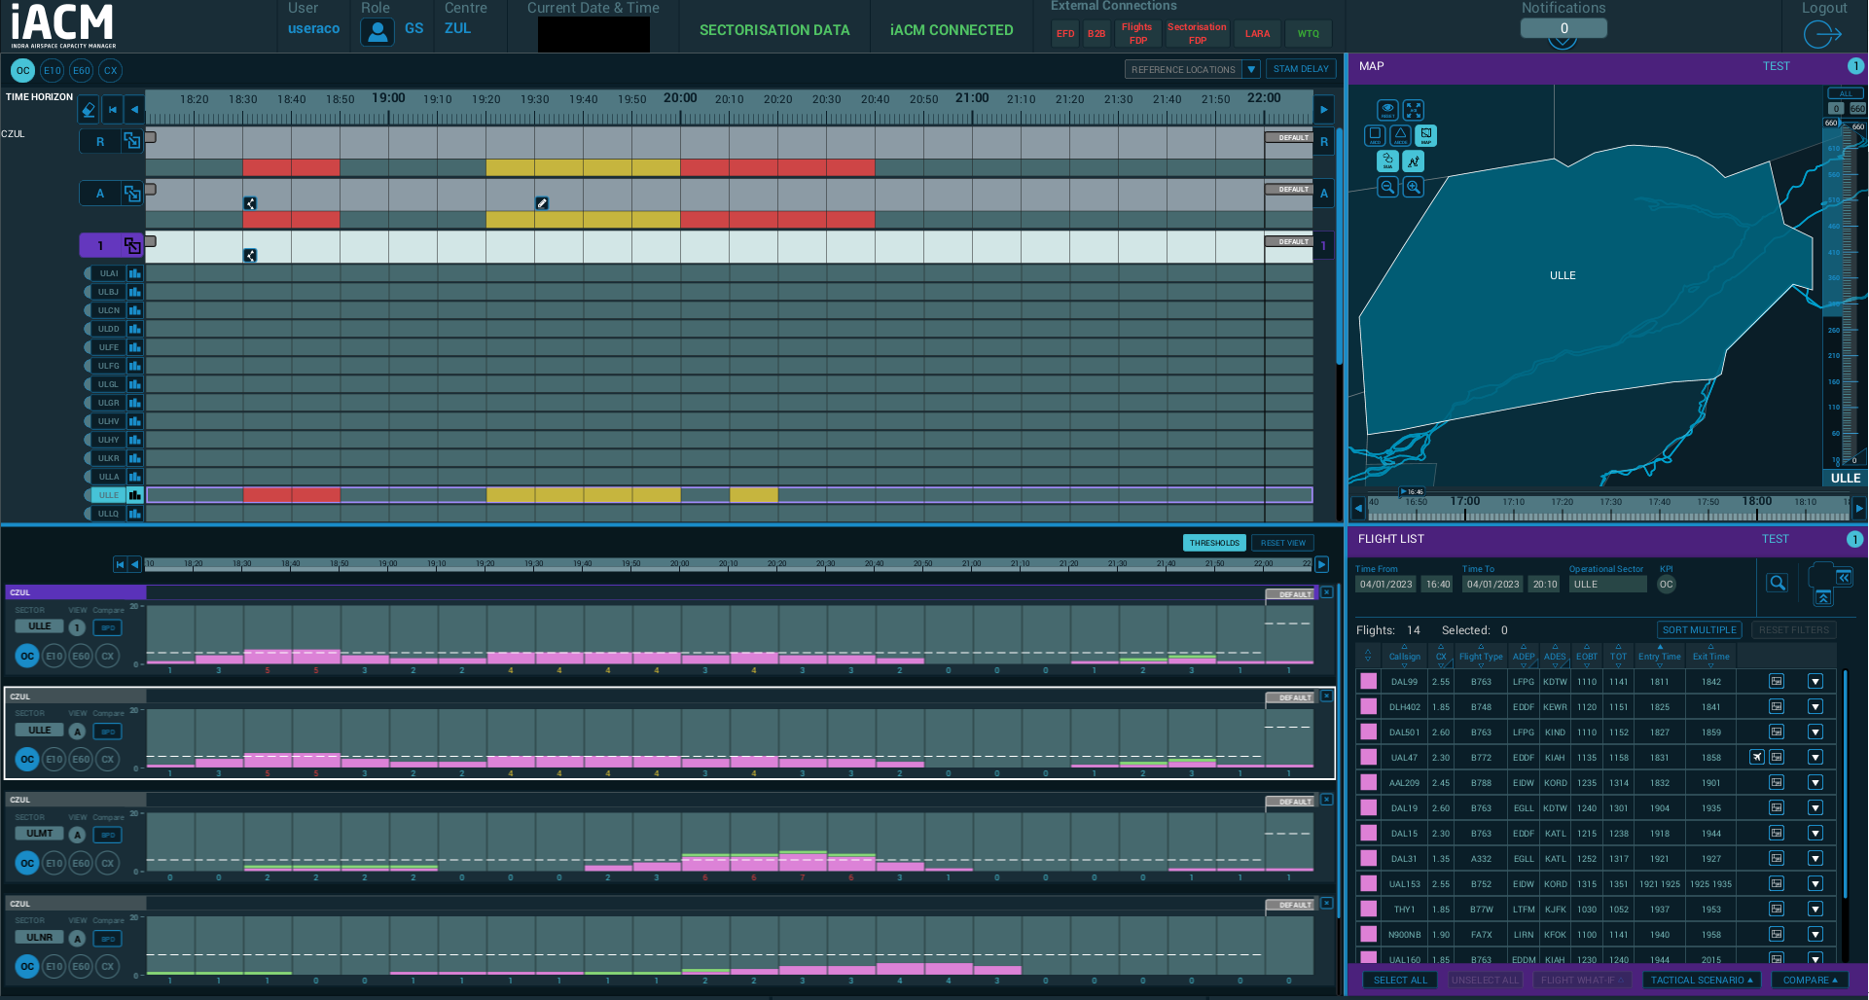
R & D TBO Support

Slide 9
What is Required?
Data Exchange
Development of SWIM infrastructure to support the sharing of data between internal systems and airspace users
Use of standardized message exchange models (FIXM,AIXM,WXXM) to support interoperability
Equipage
Performance based navigation to deliver flow efficiency within the airspace structure
CPDLC/ADS-C
Time Based Management
Increasing predictability through time based management and continuous constraint feedback

Slide 10
Deployment Roadmap
 | FY24 | FY25 | FY26 | FY27 | FY28 | FY29 | FY30 | FY31 | FY32 | FY33 | FY34+
Network Manager | `
Central Flight Data Management
Future FDP
Predictability
Phase1 – Centralized Services
Phase2 – Initial FDP Replacement
Phase3 – Full FDP Replacement
Network Manager Deployment
Initial Clearance Coordination
Optimized Clearance Coordination
Central FDP Deployment
FF-ICE/R1 (Initial)
FF-ICE/R1 (Complete)
FDP Replacement ACC#1
ACC#2
ACC#3
ACC#4+
FF-ICE/R2
UTM
FUA
Connected Aircraft / Datalink Enhancements
eTBS at 4 Majors
AMAN/DMAN/XMAN Integration
CSPO
DMAN @ CYYZ
DMAN @ 4 Majors
MIT Weather @ CYYZ
MIT Weather Tools @ 4 Majors
TFMS Integration
Localized Capabilities Addressing Capacity/Demand Imbalances
Initial TBO Deploying Network Manager and Central Services in Mixed-Mode Environment
Optimized TBO
Notes:
FAA is our largest partner and need to be in sync
- TBFM use cases
- cross border time management. Require both systems to be onboard to deliver customer and enviromental benefits
- Basic examples that we approached contacts with:
- SEATAC arrivals
- Automated call for release for near border departures
- YYZ/YUL arrivals

Slide 11
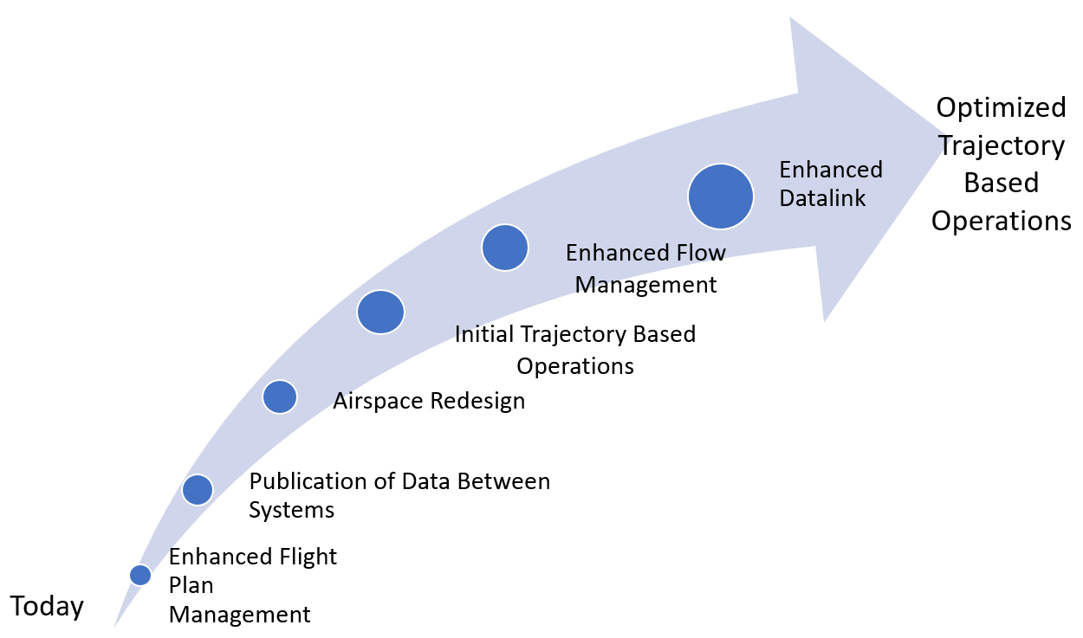
Key Building Block Takeaways
This is an iterative process
TBO is not a switch that gets turned on
Needs to be planned for multiple phases and areas of implementation
Customer collaboration
Sharing of overall ANSP roadmap with key stakeholders
- Datalink roadmap
- What benefits will be realized for early adopters
- What information is important

