Slide 1
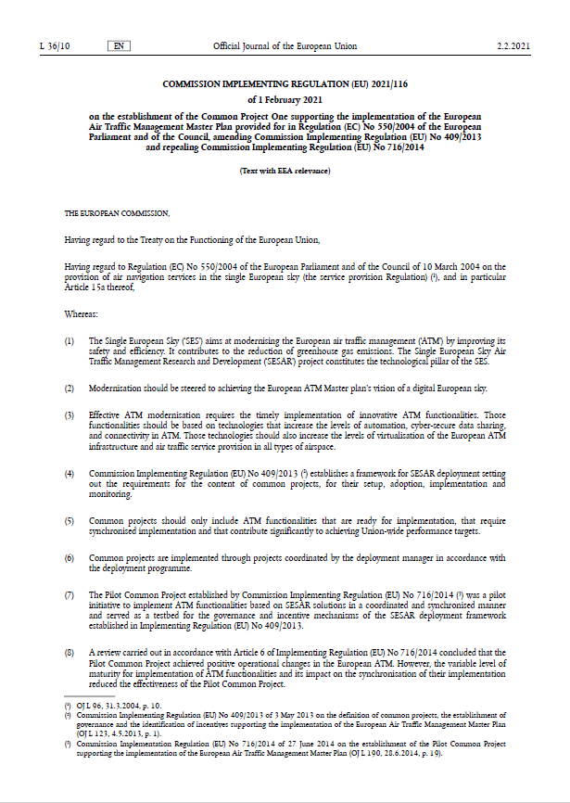
CP1 AF6 Regulatory Context Extract from IR (EU) No 116/2021 (CP1 regulation)
6.1.1 - ATM sub-functionality on initial air-ground trajectory information sharing
Aircraft must be equipped with the capability to automatically down-link trajectory information using ADS-C EPP as part of the ATS B2 services. The trajectory data automatically down-linked from the airborne system must update the ATM system in accordance with the terms of the contract.
Data link communications ground systems must support ADS-C (downlink of aircraft trajectory using EPP) as part of the ATS B2 services while keeping compatibility with controller - pilot data link communications (‘CPDLC’) services as required by Commission Regulation (EC) No 29/2009, including provision of service to flights equipped only with the Aeronautical Telecommunication Network Baseline 1 (‘ATN-B1’).
All ATS providers referred to in point 6.3 and the related ATC systems must be able to receive and process trajectory information from equipped aircraft.
The ATC systems must enable controllers to display the route of the downlinked trajectory.
ATC systems must provide a warning to controllers in case of a discrepancy between the downlinked aircraft trajectory and the ground system trajectory elaborated using the filed flight plan route.
*ADS-C EPP: Automatic Dependent Surveillance- Contract Extended Projected Profile
6.1.2 - ATM sub-functionality on Network Manager trajectory information enhancement
The Network Manager systems must use elements of the downlinked trajectories to enhance their information of trajectories flown by aircrafts.
AF6 extract from
IR (EU) No 116/2021
(CP1 regulation)
6.1.3 -ATM sub-functionality on initial trajectory information sharing ground distribution
Ground systems must ensure that trajectory data downlinked from the aircraft is distributed between ATS units and between ATS units and the Network Manager systems.
The data link capability referred to in Regulation (EC) No 29/2009 is an essential prerequisite for the AF6.
A reliable, fast and efficient air/ground communication infrastructure must support initial trajectory information sharing
Copyright SESAR Deployment Manager
Modernising Air Traffic Management As One - © SESAR Deployment Manager 2022

Slide 2
Initial Trajectory Information Sharing (AF6) in the SDP
State-of-the-art
In December 2023, EUROCONTROL published the ADS-C Common Service technical specifications and guidelines, elaborated in the OEP under the co-leadership of SDM
On Feb 2024, EASA delivered to EC an assessment report based on the outputs of the Industrialisation Forum established in 2023. It concluded that AF6 was ready for implementation and proposed a number of recommendations.
In March 2024, there was a SSC where EC presented its assessment and asked for opinions from Member States
On April 23, SSC provided a positive opinion to EC regarding the Industrialisation Target Date of AF6
EC has confirmed that AF6 remains in the Regulation, with implementation target date 31/12/2027
SESAR Deployment Manager is currently updating the SESAR Deployment Programme, which is expected to be approved by the Stakeholders – through the Investors Buy-in Group (IBG) – in June 27.
SESAR Deployment Manager has started the pre-coordination of an implementation project with the operational stakeholders. SDM is offering its coordination and support to all stakeholders interested in deploying AF6, regardless the inclusion or not of AF6 in the next CEF Call

Slide 3
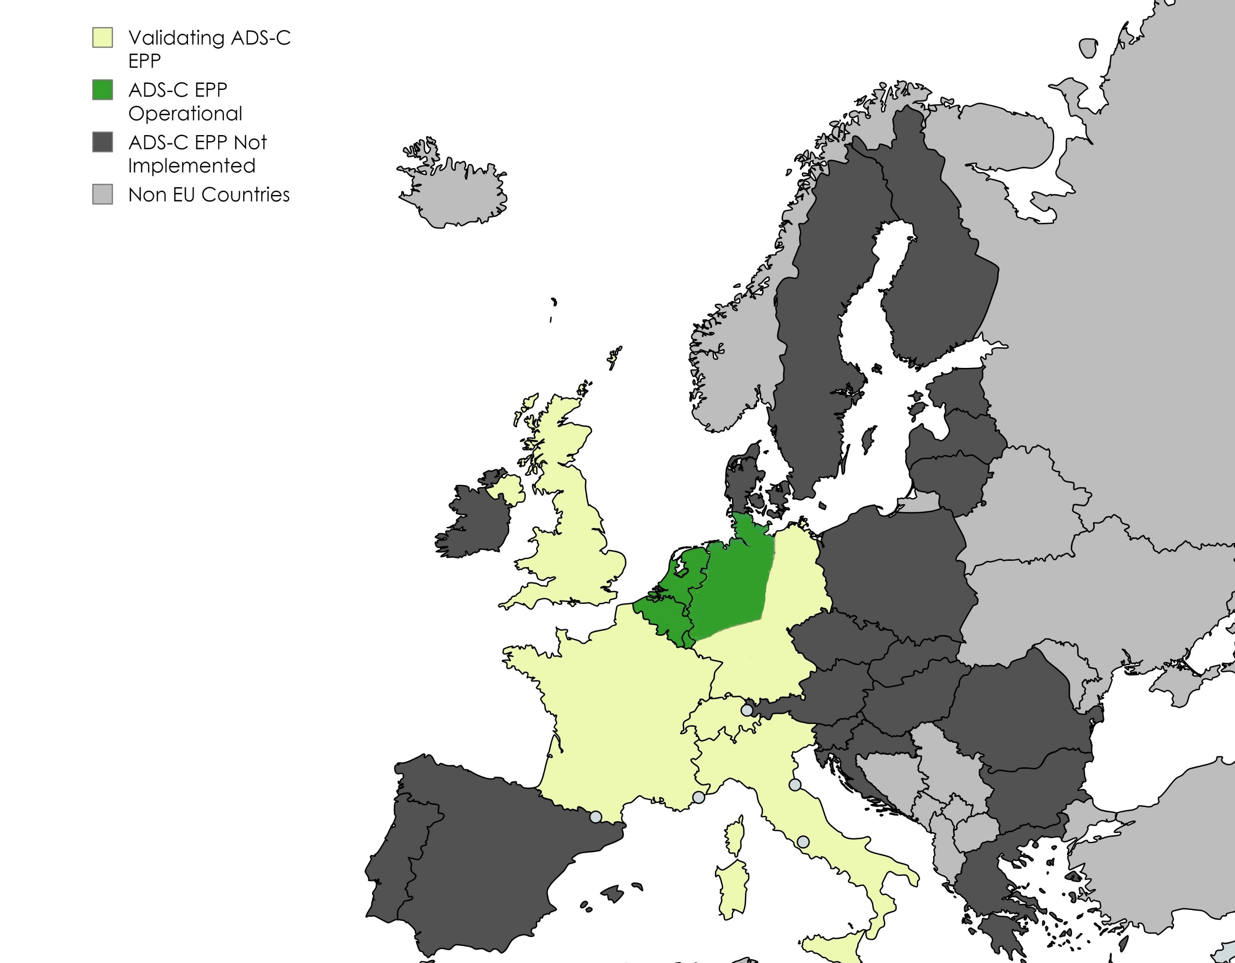
Implementation status
Airbone status
By end of 2023 ~ 250 aircraft equipped with ADS-C/EPP (Airbus)
Specific questionnaires being launched to aircraft manufacturers and suppliers
Ground status
MUAC operational (since May 22)
Several ANSPs participating in SESAR Project (PJ38), which concluded in June 23

Slide 4
AF6 Common Proposal
WBS
Project Leader
SDM - Coordinator
Ensure the establishment of ADS-C service based on common definition
Project Leader support
Project management activities
AUs Family 6.1.1
ANSPs Family 6.1.2
NM Family 6.2.1
ANSPs Family 6.3.1
Aircraft equipment with ADS-C/EPP compliant (down-linking trajectory information using ADS-C Extended Projected Profile)
ATM systems local upgrade to support ADS-C/EPP application, enabling display of downlinked trajectory and providing warning to the ATCOs in case of discrepancy
NM systems upgrade enabling the use of some element of the downlinked trajectory to enhance calculation/prediction of NM system trajectories
ANSPs contribution to the ADS-C Common Service, distribution of ADS-C/EPP data and ATS units capable to establish ADS-C contracts for aircrafts
Modernising Air Traffic Management As One - SESAR Deployment Manager 2024

