Slide 1
TBO Global Concept
Crystal Kim
Henk Hof
ATMRPP

Slide 2
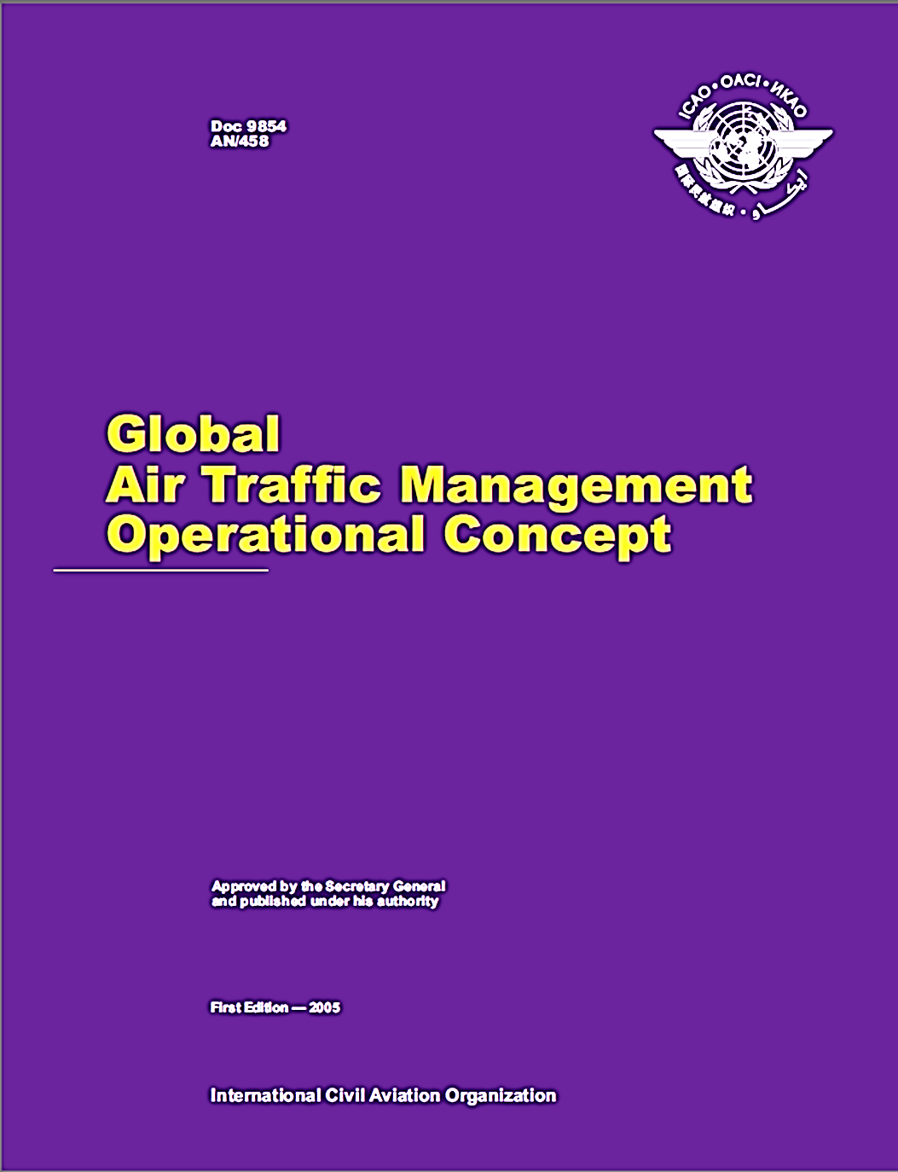
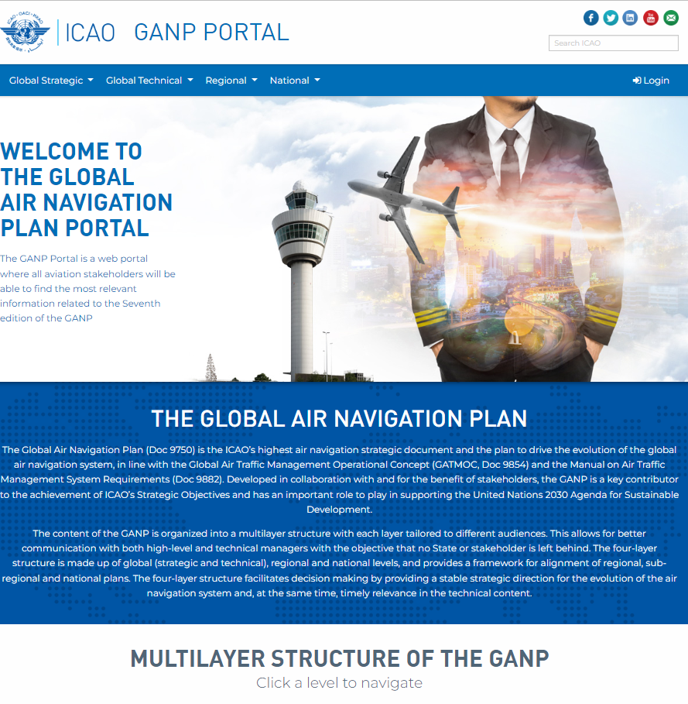
Global Air Traffic Management Operational Concept (Doc 9854)
The Foundation
Detailed concepts & performance framework
CDM/ATFM
FF-ICE
SWIM
TBO
Connected Aircraft
SARPs, PANS, and Guidance material
ATM System Requirements
Global Air Navigation System Performance
1st Edition in 2005

Slide 3
Global Air Traffic Management Operational Concept (Doc 9854)
The Foundation
considers the trajectory of a manned or unmanned vehicle during all phases of flight …
manages the interaction of that trajectory with other trajectories or hazards to achieve the optimum system outcome, with minimal deviation from the user-requested flight trajectory, whenever possible.
individual aircraft performance, flight conditions, and available ATM resources will allow dynamically optimized 4-D trajectory planning.
Management by trajectory does not mean that every aspect of a flight, including arrival profile, runway, taxi path and gate needs to be predetermined and captured in detail in the agreement at the time of departure. The agreement and the management of that agreement will have the details required by the traffic management phases that the flight is subject to at the time the initial agreement and subsequent updates are made.
And many more….

Slide 4
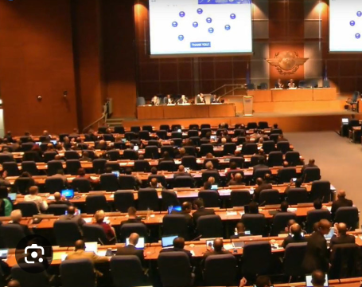
Global TBO Concept
Broad support from the 13th Air Navigation Conference (Montréal, 9-19 October 2018)
Integrated in the Global Air Navigation Plan and Aviation System Block Upgrade Framework

Slide 5
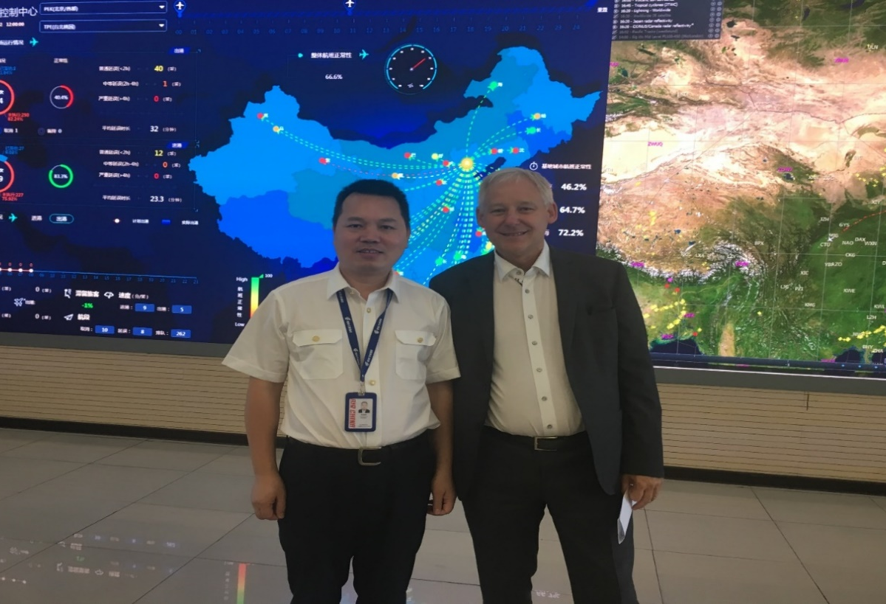


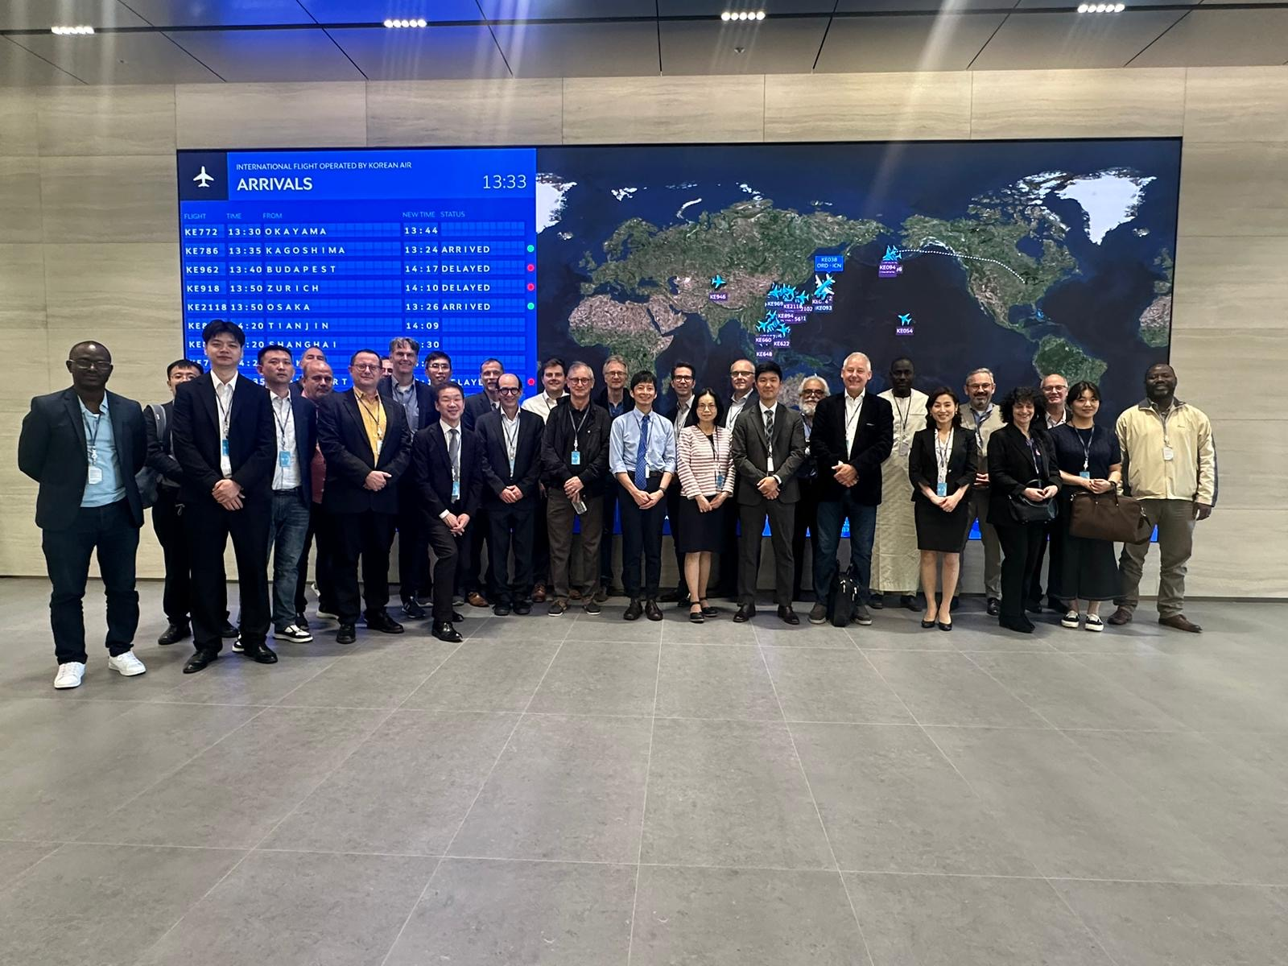
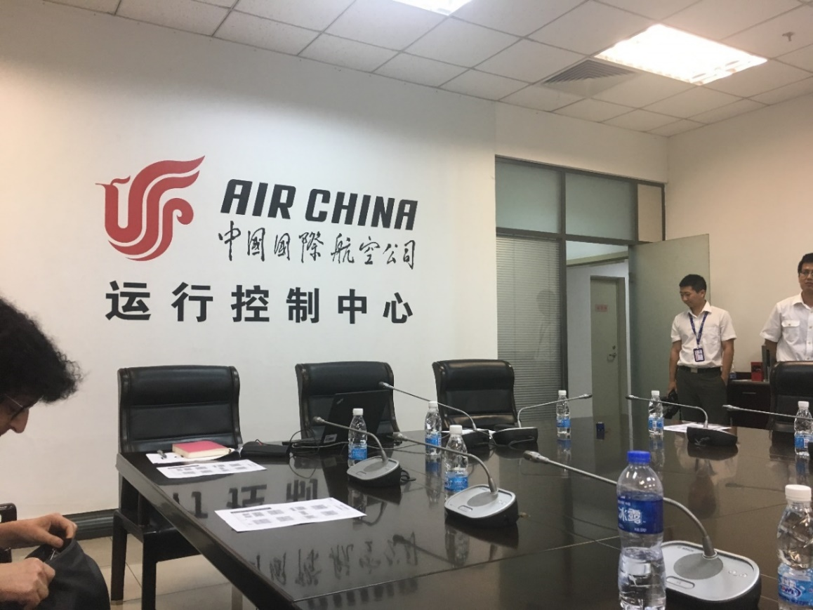
Needs of Airspace Users

Slide 6
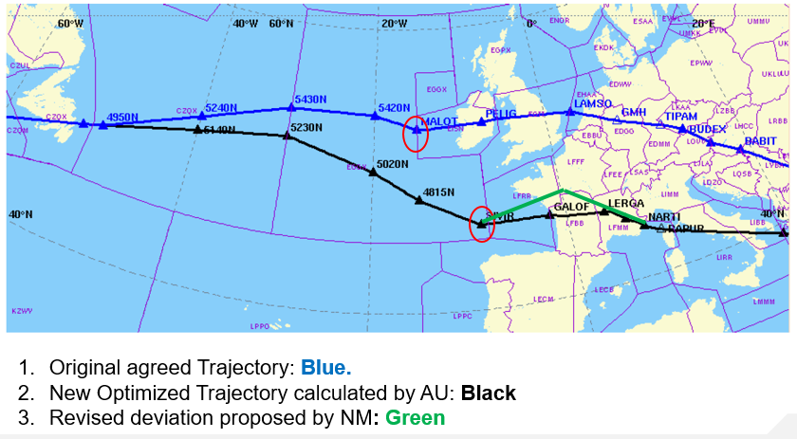

Trajectory revision on AU initiative due to Weather conditions changes
Flight efficiency
through Flight Planning

Slide 7
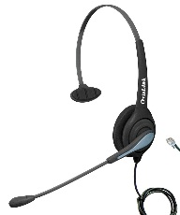


Collaboration – Today
Flight Deck Automation
Imprecise execution
Automation not Informed
FOC Automation
ATC Automation
Plan not followed
Limited In-Flight Coordination
Disparate Plans in Automation
TFM Automation

Slide 8
Collaboration – Full TBO Environment
Flight Deck Automation
Improved Control Precision
Accurate Execution
Automation Informed
Closed Trajectory
Shared plans, consistent trajectories
FOC Automation
ATC Automation
Negotiated Trajectory
Robust Solutions
Trajectory Constraints
TFM Automation

Slide 9




Flight/Flow Information
for a Collaborative Environment
(FF-ICE)
SHARING
MAINTAINING
Trajectory Based Operations
USING
Connected Aircraft

Slide 10
TBO bringing it all together
Years
Months
Days
Hours
Minutes
Depart
In Flight
Tactical Planning
Long-term Planning
Mid-term Planning
Execution
Flow Management
Scheduling
Flight Planning
Re-optimisation
Capacity Management
Collaboration
Departure AO
Arrival AO
Traffic Synchronisation
Separation Provision
ATFM
ATC
AM
AU
A0
AM Airspace Management
ATFM Air Traffic Flow Management
AU Airspace User
ATC Air Traffic Control
AO Aerodrome Operator
Flight Information

Slide 11
Framework
Feedback to AU
Problem evaluation
Legend
Flight Information Sharing
Negotiation
Re-optimize
Keep up with uncertainty & clearances
Changing Circumstances
Manage Agreed Trajectory
Share and ensure agreement reflects what has happened
Maintain
Tactical Interventions
Deliver Clearance
ATC delivers the Agreed Trajectory using clearances

Slide 12
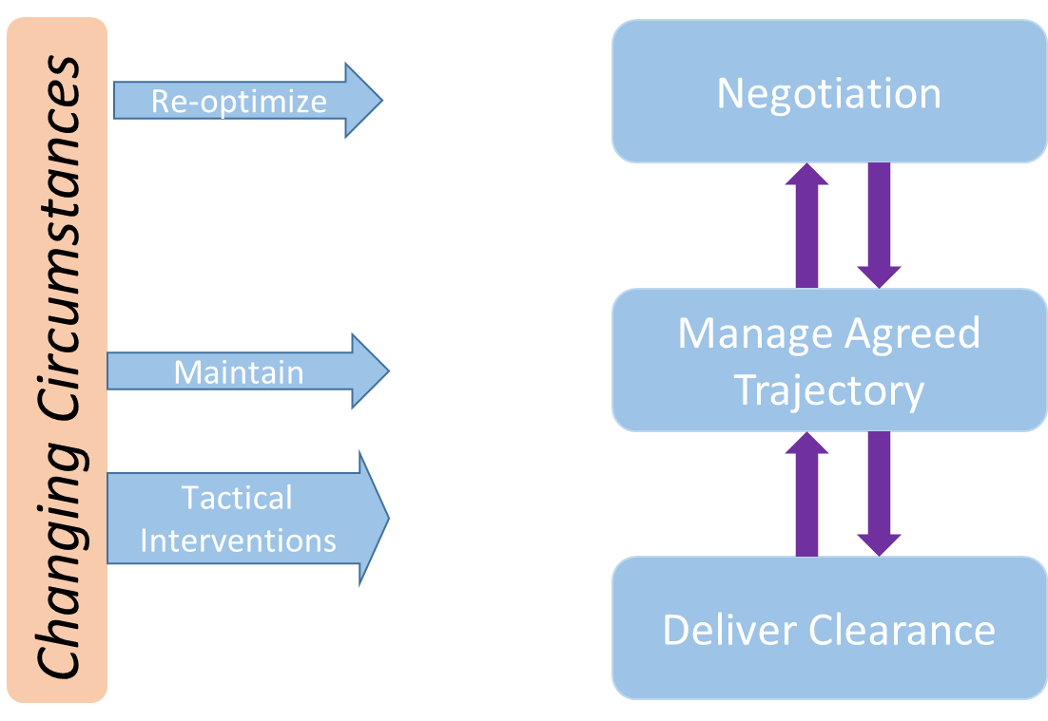
Incorporation of ATFM
Legend
Flight Information Sharing
Flow Information Sharing
Agreed trajectory managed for many flights
ATFM Uses Agreed Trajectories for Demand Estimation
Demand Estimation
Capacity Estimation
Flight
Capacities for ATFM also changing
Changing Circumstances
Is there a problem?
Did one go away?
Monitor Flow, D&C
Flow
Initiate / modify ATFM solutions
Evaluate alternative ATFM solutions
Flow data affects flight data
What changes make sense?
ATFM

Slide 13
TBO Enablers
Capability | ADS-B | ADS-C | CPDLC | PBN | PBC | PBS | FMS | Connected Aircraft | FF-ICE | SWIM
Pre-Departure Trajectory Negotiation |  |  |  |  |  |  |  | ↑ | ✓ | ✓
Post-Departure Trajectory Negotiation |  |  | ↑ |  |  |  | ↑ | ✓ | ✓ | ✓
Trajectory Parameter Exchange |  |  |  |  |  |  |  | ✓ | ✓ | ✓
TBO Clearances |  | ✓ | ✓ |  |  |  | ✓
Sharing of Aircraft–Derived Trajectory (ADS-C) |  | ✓ |  |  |  |  | ✓
Sharing of Aircraft-Derived Trajectory (A/G SWIM) |  |  |  |  |  |  | ✓ | ✓ | ✓ | ✓
Precise Clearance Execution |  |  | ✓ | ✓ | ↑ | ↑ | ✓
GATMOC Component Integration |  |  |  |  |  |  |  |  | ✓ | ✓
ASP Coordination & Negotiation |  |  |  |  |  |  |  |  | ✓ | ✓
+ Trajectory Prediction Accuracy | ↑ | ↑ | ↑ | ↑ | ↑ | ↑ | ↑ | ↑ | ↑
Legend
✓ Required
↑ Improves

Slide 14





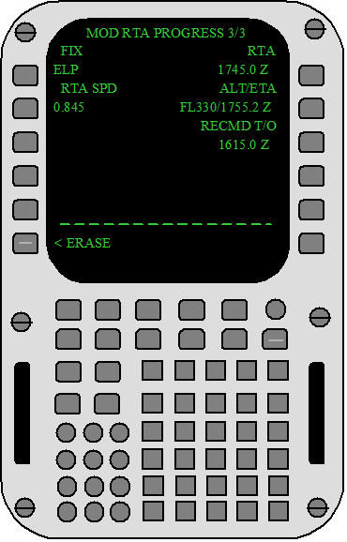

TBO Capability Evolution
Use Trajectory
Open→ Closed
Create Clearances
Deliver Agreed
Trajectory Revisions
Piecewise→ End-to-end
TM Rules
Precision where needed
Airspace User
Trajectory Accuracy
Clearances
ATM Components
FPL
ADS-B
Voice
TBO Components
Pre-departure Negotiation
Shared Parameters
FOC
Initial CPDLC
Ground Synchronization
Post-departure Negotiation
FOC
Aircraft-Derived
EFB
FD
Aircraft 4DT (EPP)
Precise Clearances
Full TBO Integration
ADS-C

Slide 15


Mixed-mode & transition (1/2)
System is performance-driven
No “Big-Bang”
  Mixed-mode: Individual ANSP deploy capabilities along different timelines
  Mixed Equipage: Aircraft operators as well
Expect mixed-mode, mixed-equipage
Image: NASA/JPL-Caltech
Need for Synchronization
  ASBUs define timeline for availability of capabilities
  There will be a need for a “minimum-path”
Wild-West
Image: Personal photograph

Slide 16

Mixed-mode & transition (2/2)
One size does not fit all
OK to use different pathways and timelines
As long as we all converge interoperably to the same point

Slide 17
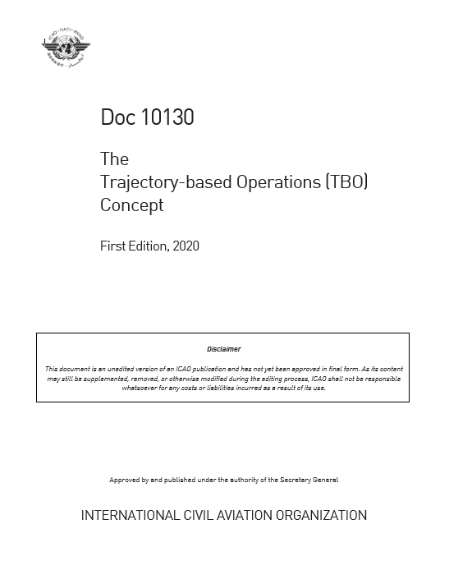
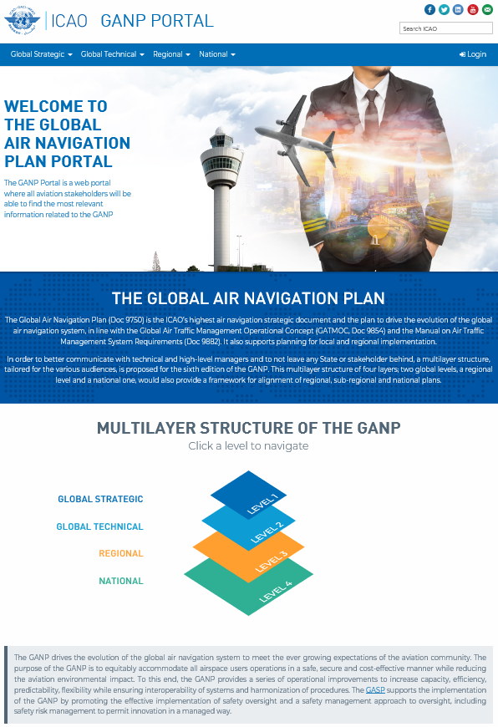
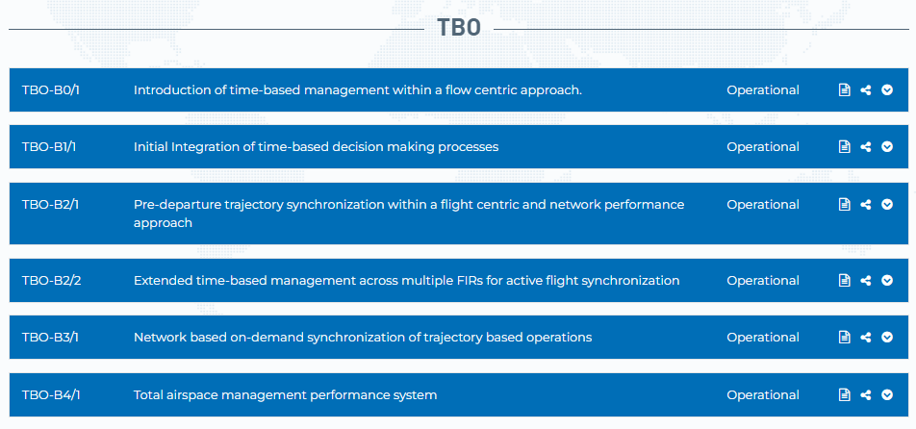
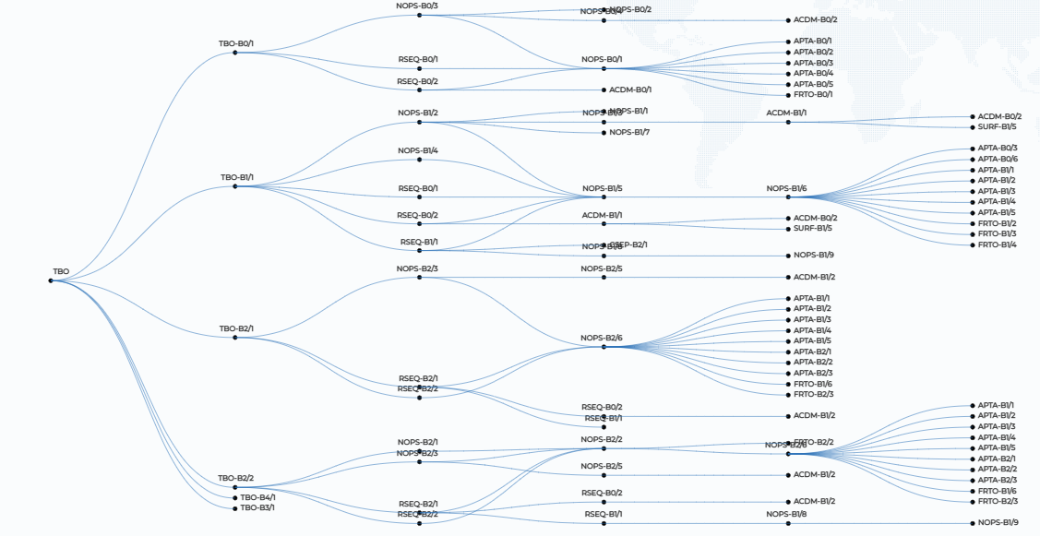
Ongoing TBO work of ICAO (1/2)
Refinement of the concept
Update to GANP
1stEdition

Slide 18

Ongoing TBO work of ICAO (2/2)
Guidance on the value-driven TBO evolution to support:
  planning and implementation of TBO enablers
  development of proposals for amendment to ICAO provisions as necessary

Slide 19

Thank You !

