Slide 1
Florian Guillermet
FLY AI webinar “Research and Innovation in AI for Aviation”
23rd of March

Slide 2
The tree is getting bigger than the pot

Slide 3
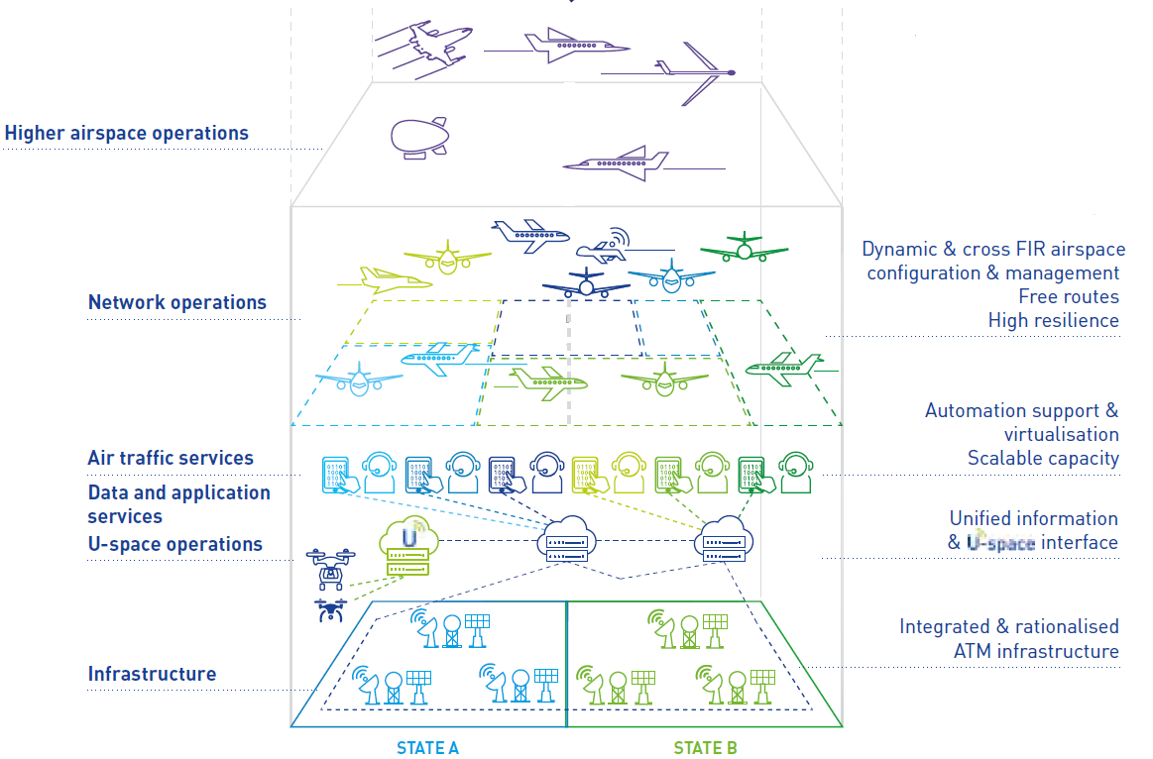
The Digital European Sky vision
Connectivity
Air and Ground
Automation
Virtualisation
Data services

Slide 4
Thank you very much for your attention!

